Slide 1
Mediactive:
Using Media in a Networked Age
Dan Gillmor
Knight Center for Digital Media Entrepreneurship

Slide 2
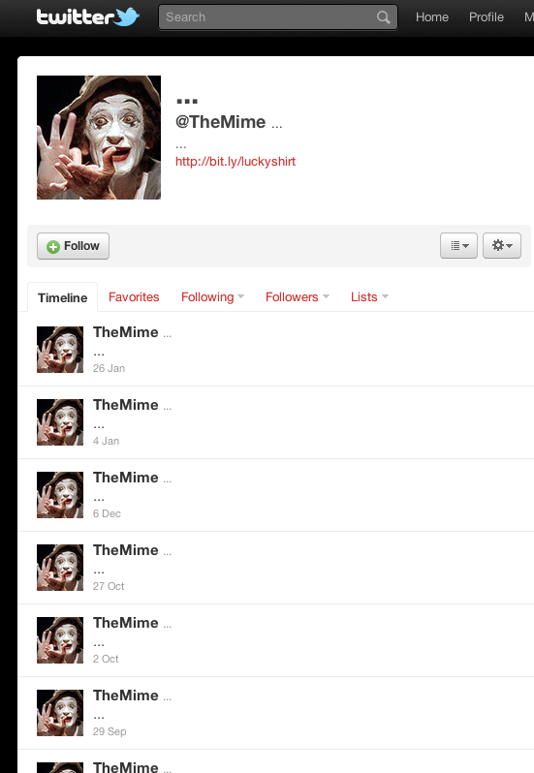
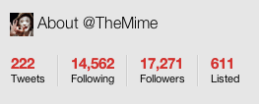

Slide 3
0
Media Shift

Slide 4
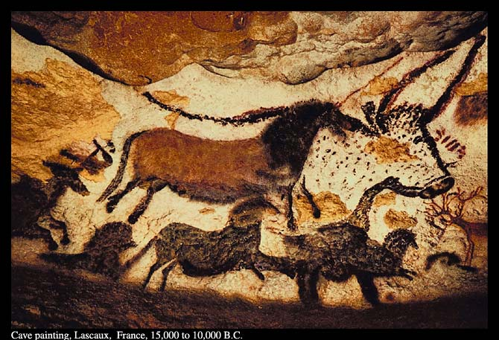
Media 0.1
Notes:
Media are more democratic, but democracy in this case is about participation, not voting

Slide 5
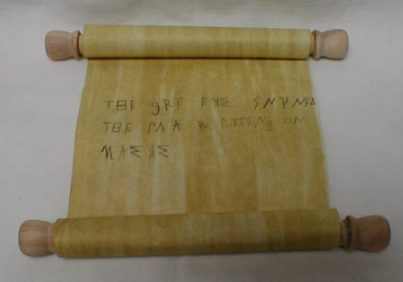
Media 0.5
Notes:
Media are more democratic, but democracy in this case is about participation, not voting

Slide 6
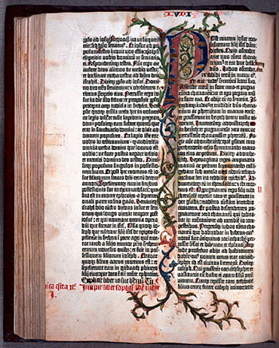
Media 1.0
Notes:
Media are more democratic, but democracy in this case is about participation, not voting

Slide 7
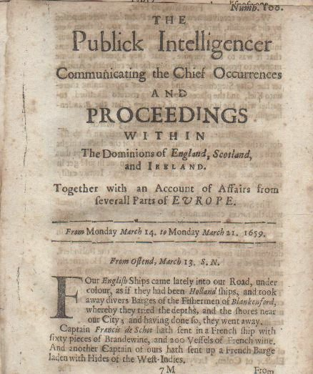
Media 1.1
Notes:
Media are more democratic, but democracy in this case is about participation, not voting

Slide 8
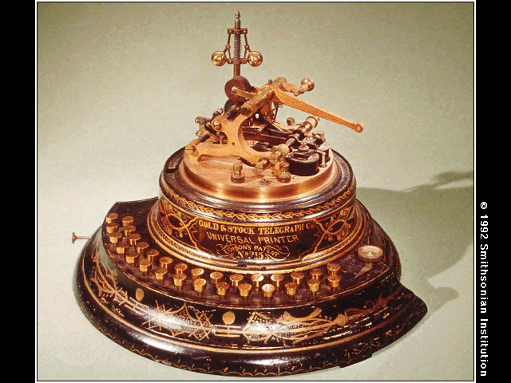
Media 1.5
Notes:
Media are more democratic, but democracy in this case is about participation, not voting

Slide 9
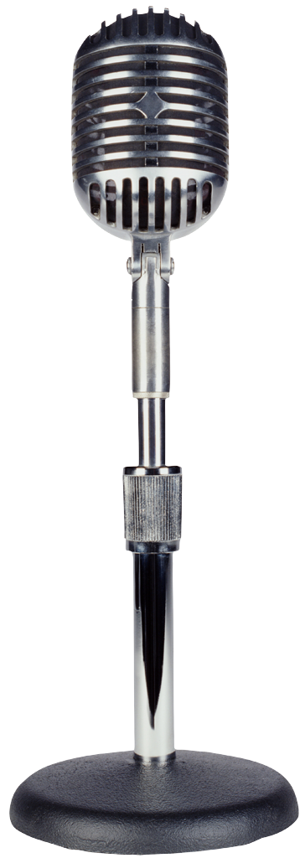
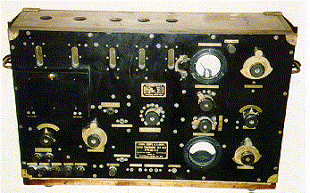
Media 2.0
Notes:
Media are more democratic, but democracy in this case is about participation, not voting

Slide 10
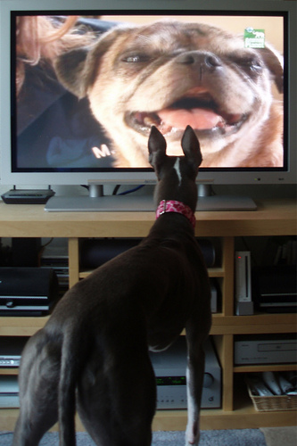
Media 2.5
Notes:
Media are more democratic, but democracy in this case is about participation, not voting

Slide 11
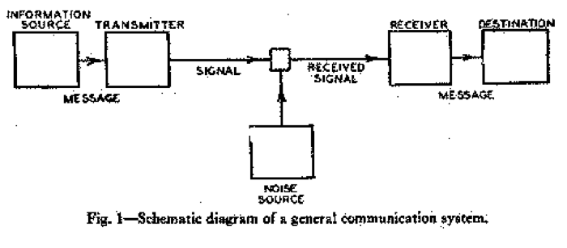
20th Century Information Theory
Notes:
Media are more democratic, but democracy in this case is about participation, not voting

Slide 12
Or…
Sources
Author(s)
Media
Readers
Info
Sent Info
Message
Message
Misinformation, disinformation, junk, etc.
Notes:
Media are more democratic, but democracy in this case is about participation, not voting

Slide 13
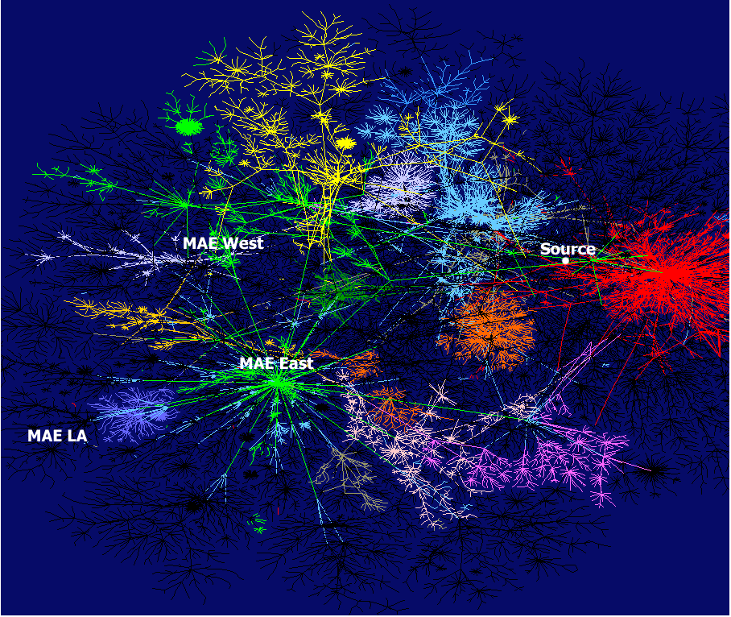
Media 3.0
Notes:
Media are more democratic, but democracy in this case is about participation, not voting

Slide 14
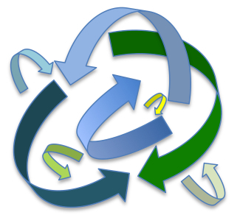
20th Century Information Theory

Slide 15
‘Democratized’ Media
Not in the sense of voting...
...but Participation
Creation/Production
Access

Slide 16
A Read-Write Web

Slide 17
Consumers <==> Creators

Slide 18
Creators <==> Collaborators

Slide 19
1
Supply

Slide 20
Who is a journalist?
Wrong question.

Slide 21
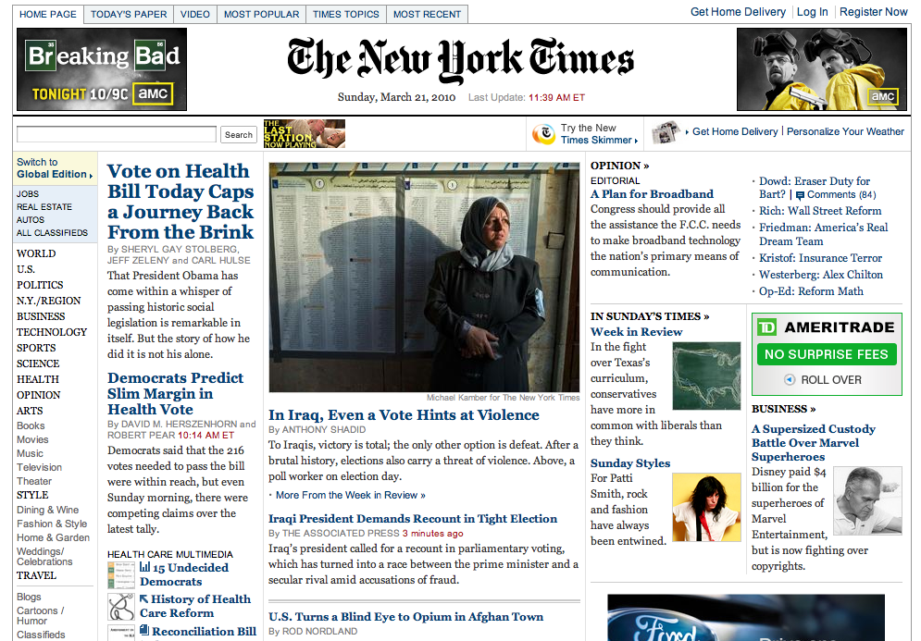
Journalism

Slide 22
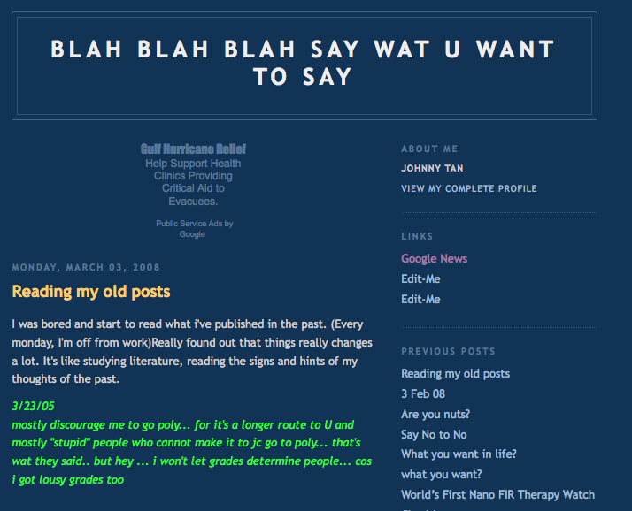
Not Journalism

Slide 23
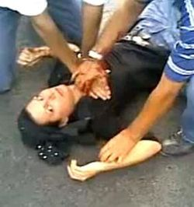

Slide 25
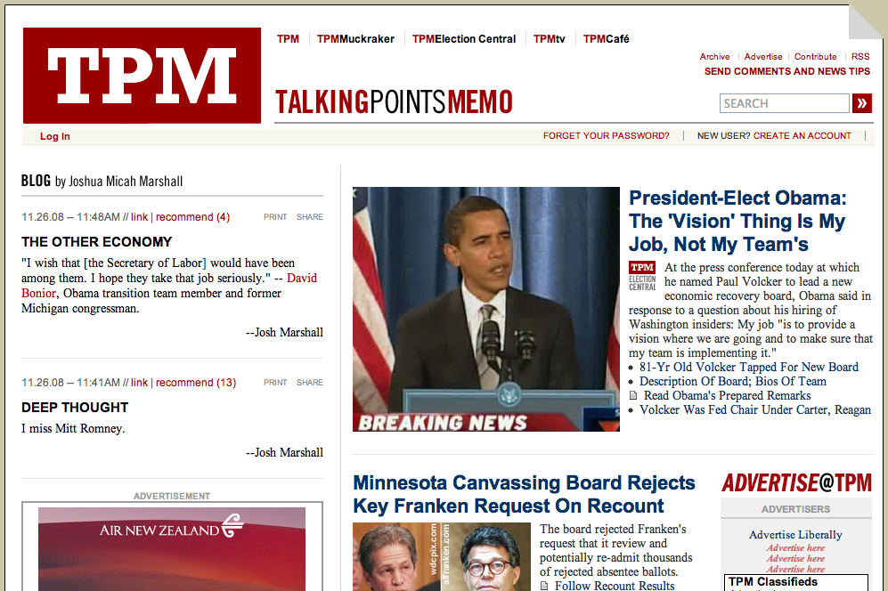

Slide 26
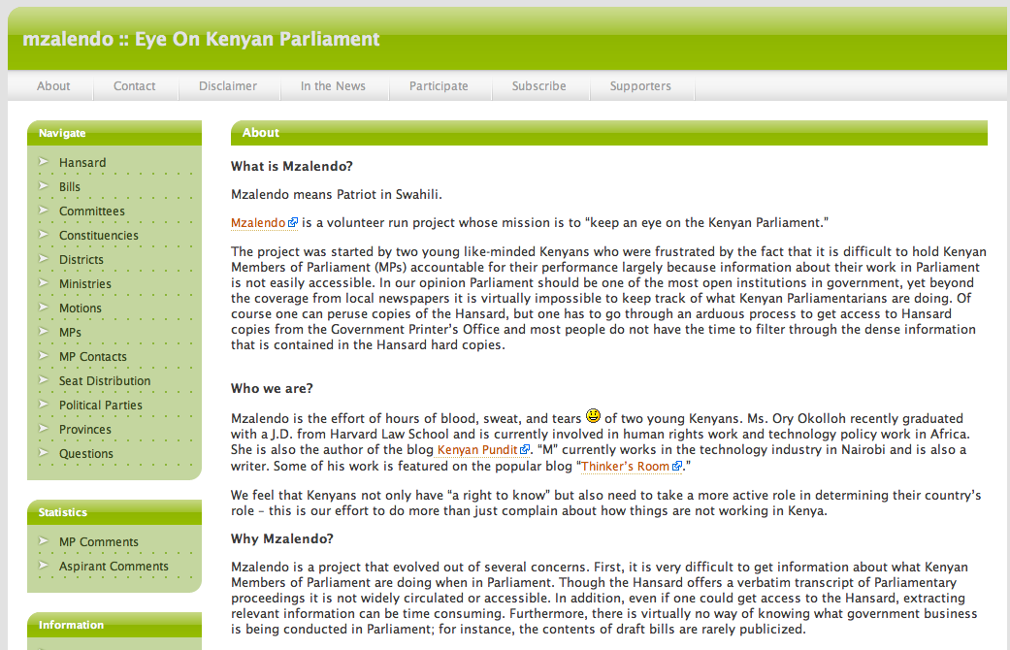

Slide 27
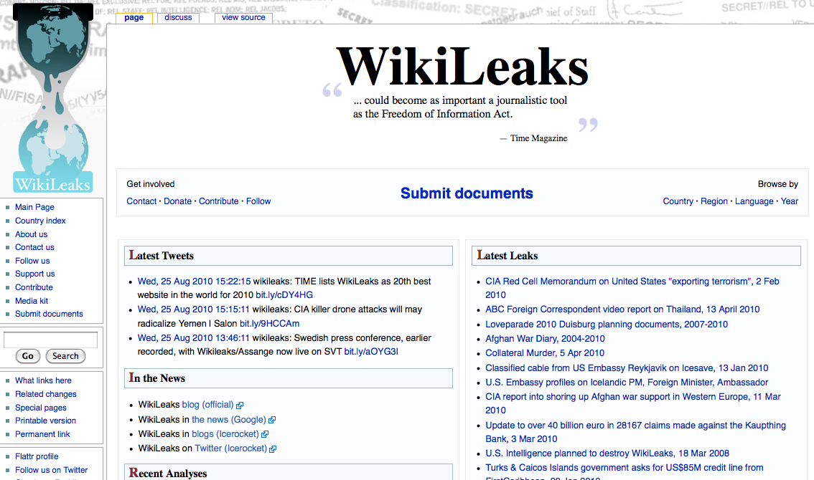

Slide 28
AND, not OR

Slide 29
Innovation | Adaptation
(Good news: Trying New Things is Cheap)

Slide 30
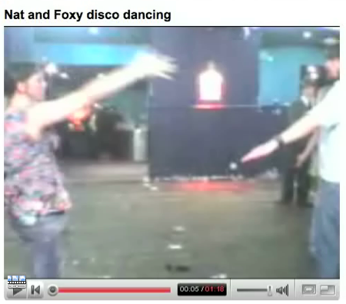
(Part of) Emerging Media Ecosystem
Mass
Local TV News
Aftenbladet
Niche
“Amateur”
Professional

Slide 31
2
Demand

Slide 32
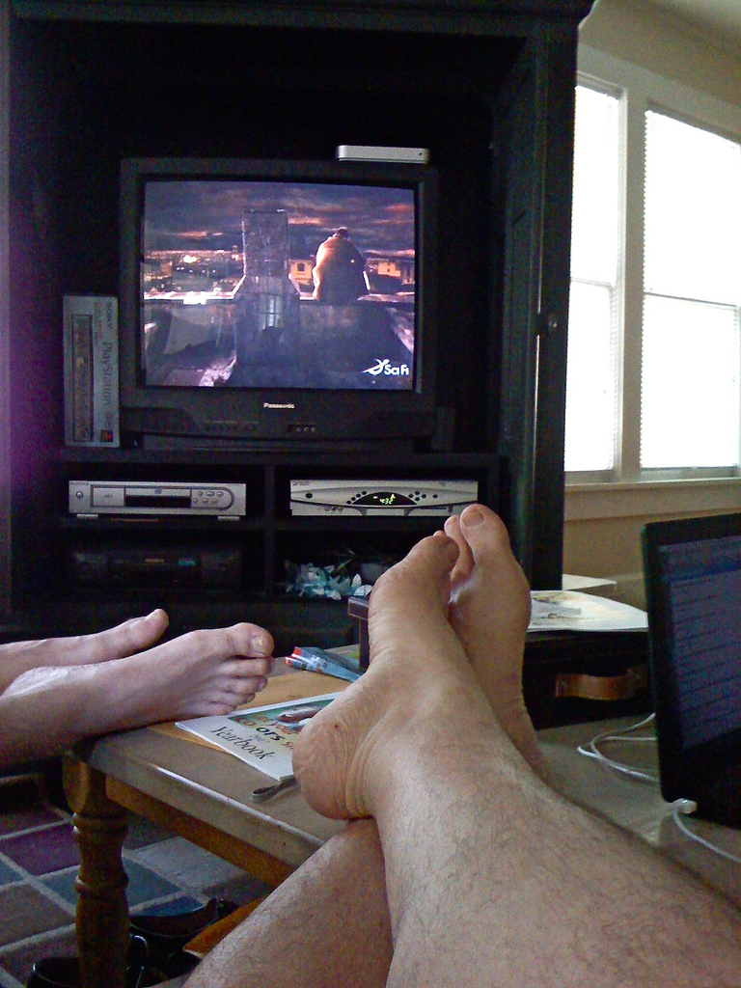
Photo by Stovak via Flickr

Slide 33
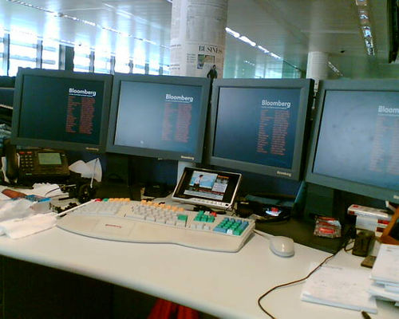
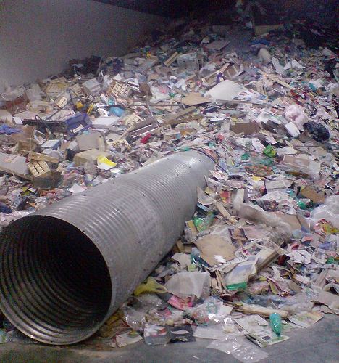
Too Much Information
Photos by Eammon Sullivan and perspikace via Flickr

Slide 34
Accurate? Trustworthy?
Not Necessarily, in a ‘Photoshop’ World

Slide 35
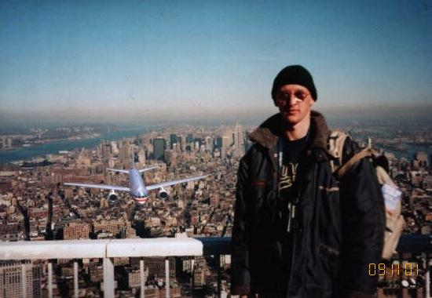

Slide 36
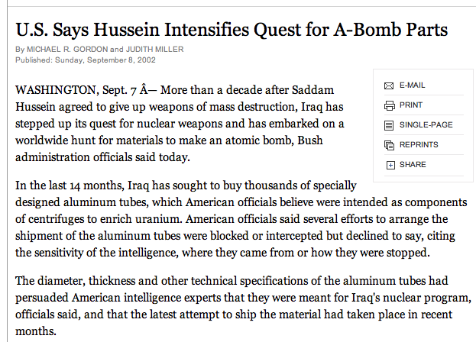
Not to Mention (ahem)…

Slide 37
3
Principles

Slide 38
1. Using. Not consuming. 2. Participation with integrity.

Slide 39
Principles (for “consumers”)
Skepticism
Be skeptical of absolutely everything

Slide 40
Principles
Skepticism
Judgment
But not equally skeptical of absolutely everything

Slide 41
Credibility Scale
Anonymous Comments
-30
0
+30

Slide 42
Principles
Skepticism
Judgment
Research
Ask your own questions, especially when making big decisions

Slide 43
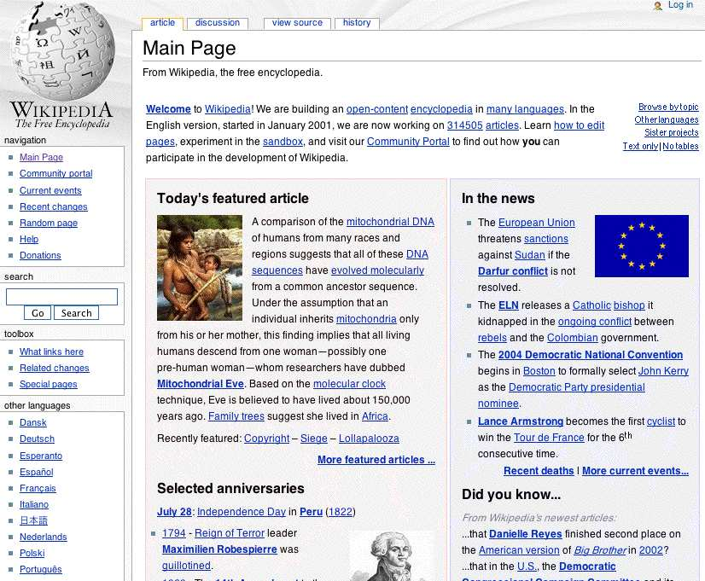
Best place to start
Worst place to stop

Slide 44
Principles
Skepticism
Judgment
Research
Free thinking
Go outside your comfort zone, in politics and culture
Be relentless with yourself

Slide 45
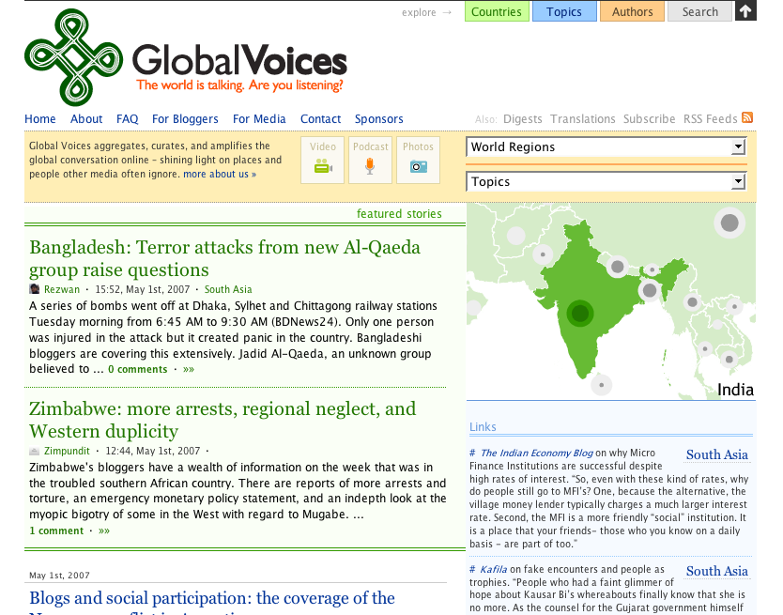

Slide 46
Principles
Skepticism
Judgment
Research
Free thinking
Techniques
Create media
Understand how media persuade

Slide 48
For ‘Creators’
All of the above (principles for consumers) PLUS these journalistic principles:
Thoroughness
Not just interviews, documents, but also wider collaboration

Slide 49
Principles for Creators
Thoroughness
Accuracy

Slide 50
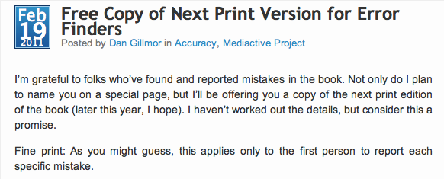

Slide 51
Principles for Creators
Thoroughness
Accuracy
Fairness

Slide 52
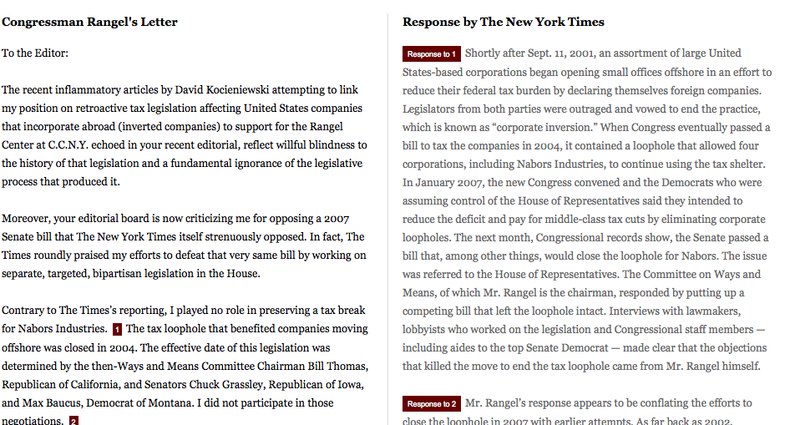

Slide 53
Principles for Creators
Thoroughness
Accuracy
Fairness
Independence

Slide 54
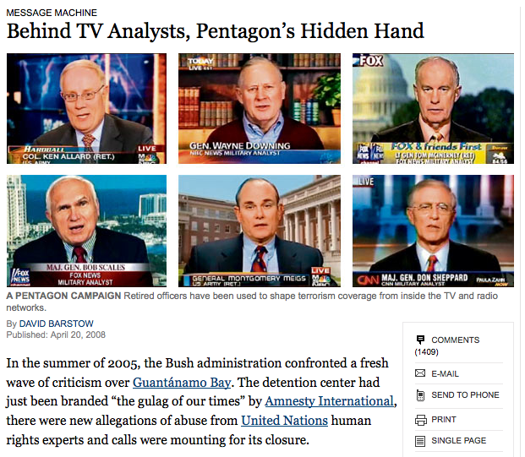

Slide 55
Principles for Creators
Thoroughness
Accuracy
Fairness
Independence
Transparency

Slide 56
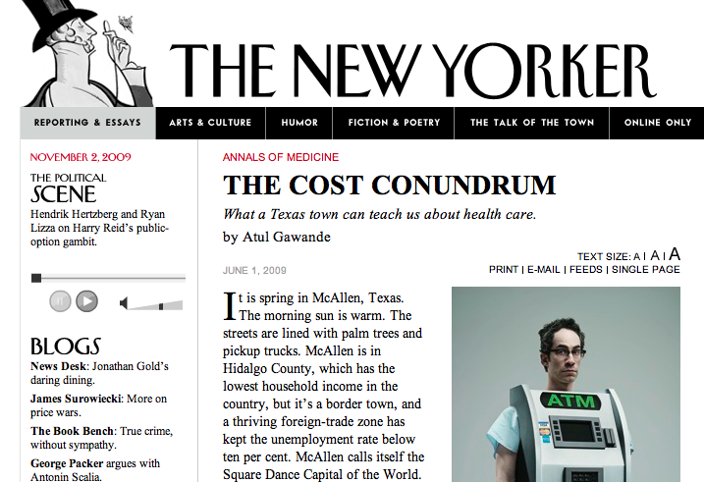

Slide 57
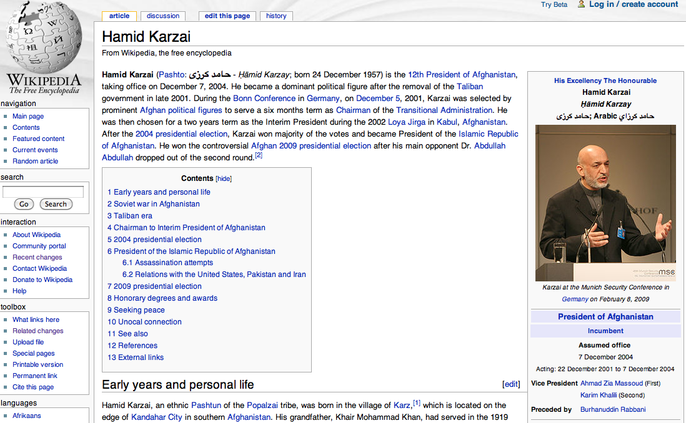

Slide 58
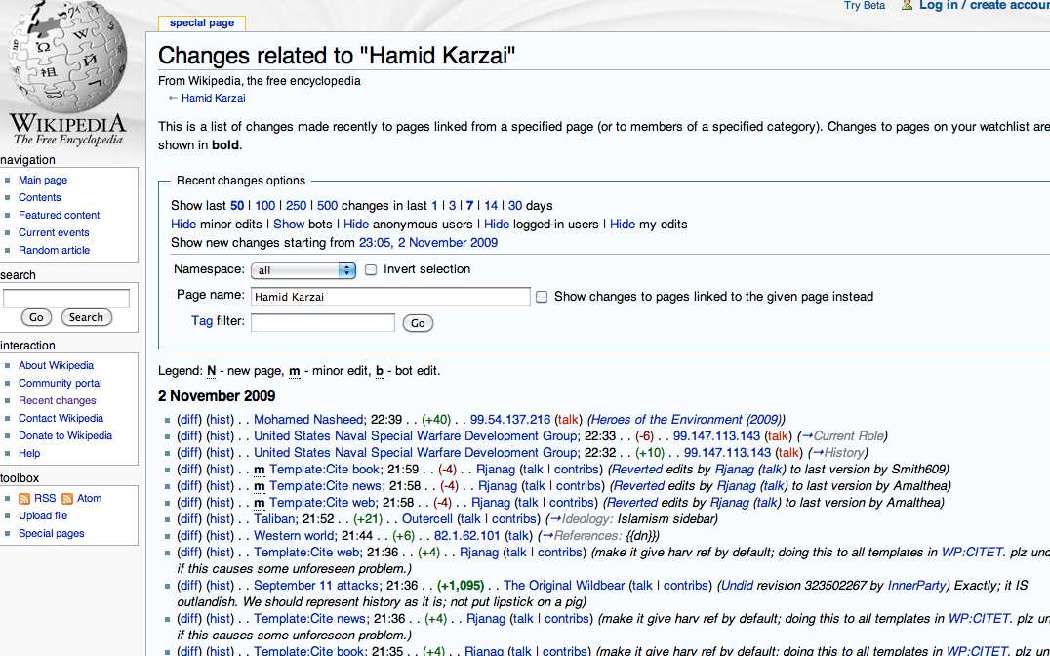

Slide 59
4
Mediactive
(In the Digital Age, what is a book?)

Slide 60
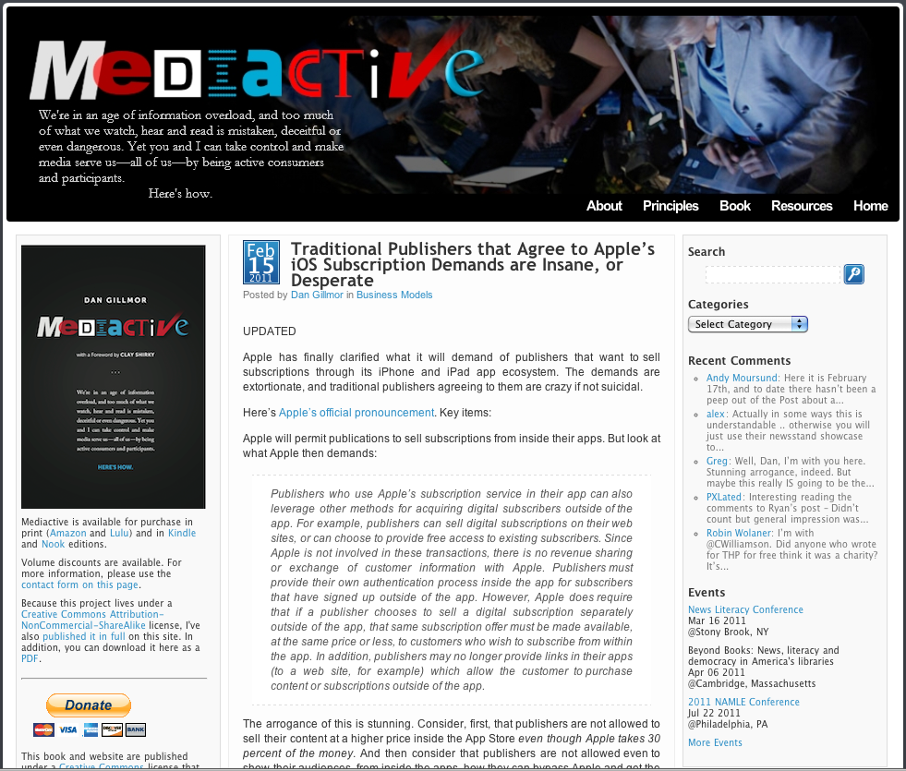
Mediactive.com

Slide 62
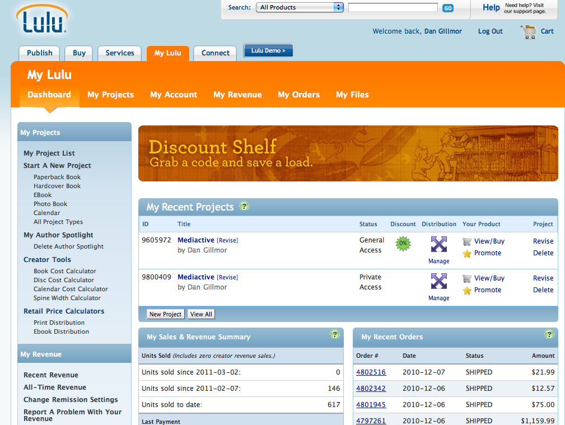

Slide 63
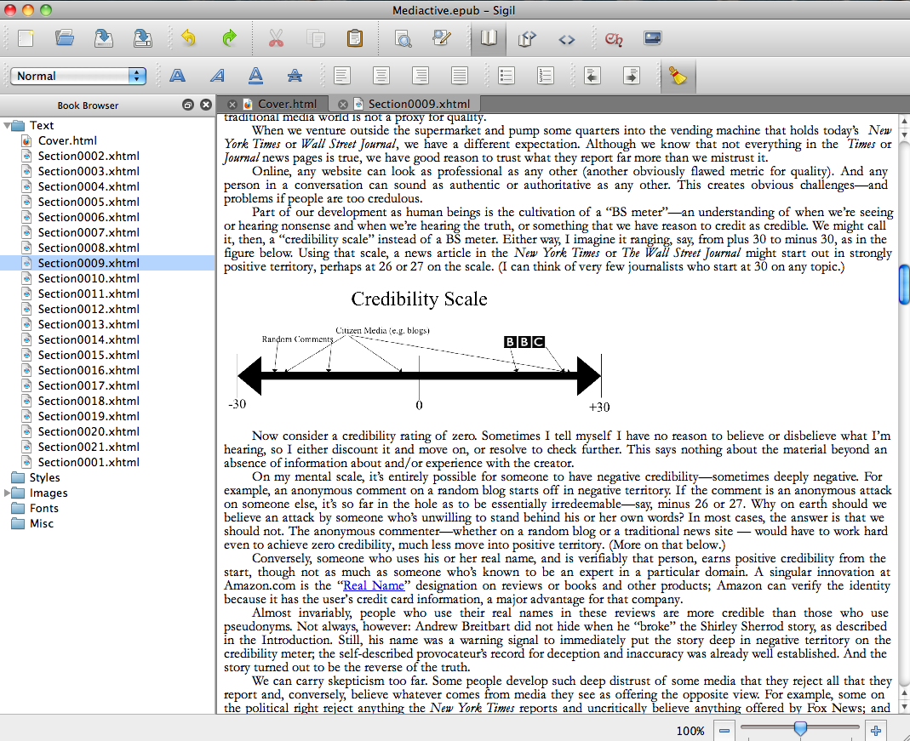

Slide 64
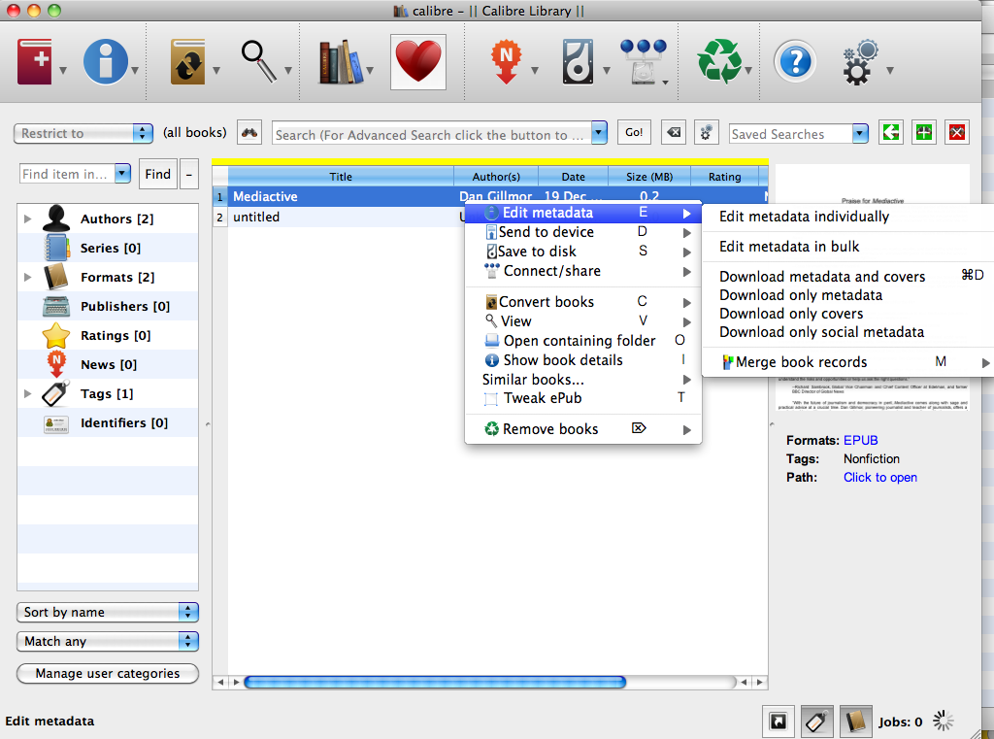

Slide 65
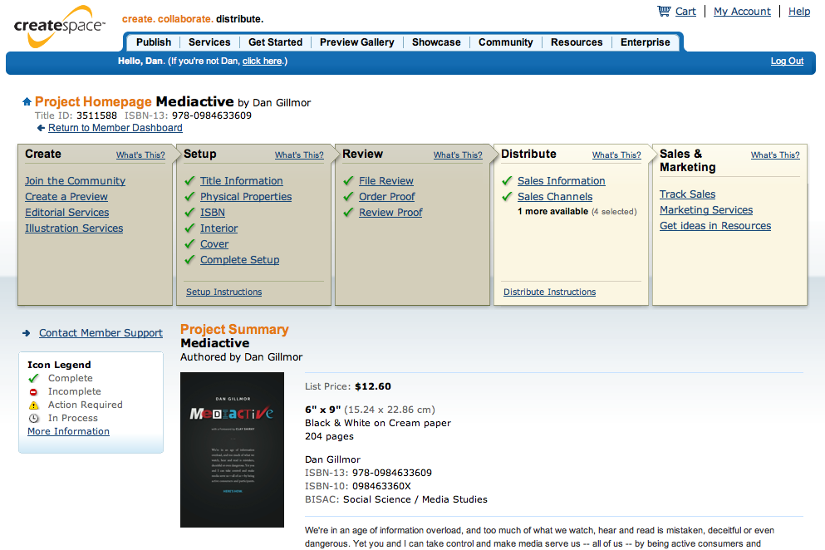

Slide 66
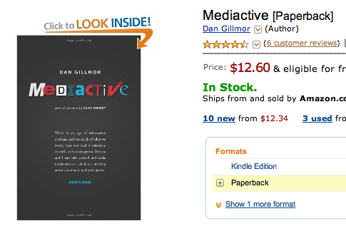

Slide 67
Upcoming:
Foreign editions
Version 2.0 print
Various EPUB editions
Game inside ebook
Kindle Singles
(more)

Slide 68
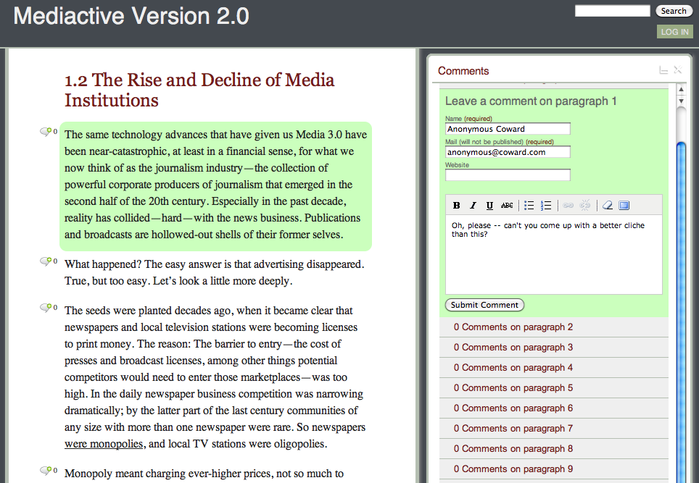

Slide 69
How to find me: dan@dangillmor.com dangillmor.com/about Twitter: @dangillmor

