Slide 1
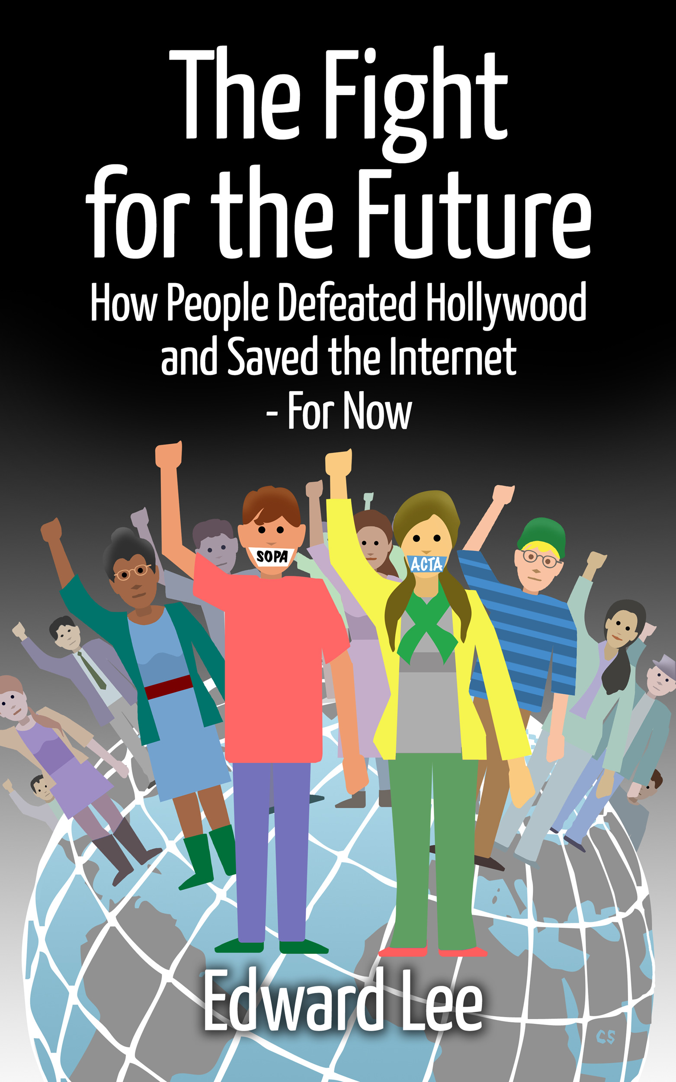

Slide 2
April 18, 1775 midnight

Slide 3
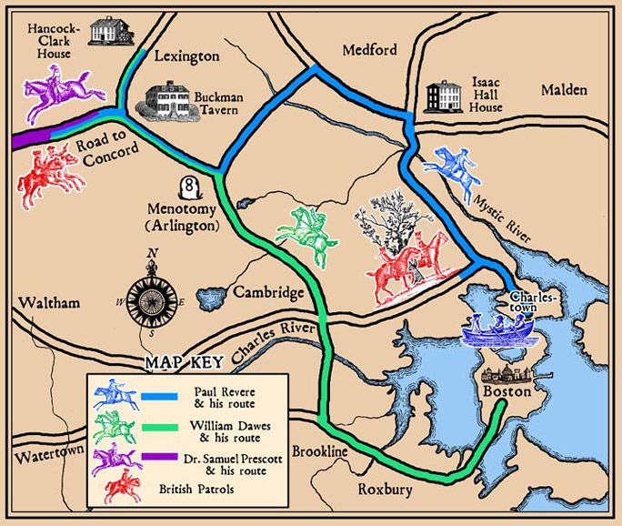
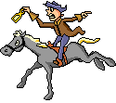
Cortney Skinner

Slide 4
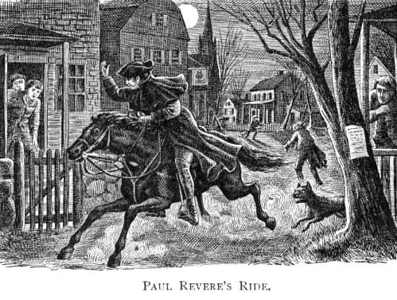
http://newspaper.li/paul-revere/

Slide 5
So through the night rode Paul Revere;
And so through the night went his cry of alarm
To every Middlesex village and farm,--
A cry of defiance, and not of fear,
A voice in the darkness, a knock at the door,
And a word that shall echo for evermore!
-Henry Wadsworth Longfellow

Slide 6
small problem…

Slide 7
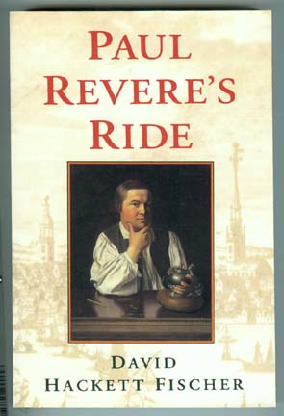
“This romantic idea is etched indelibly upon national memory, but it is not what actually happened that night.
“Many other riders helped
Paul Revere to carry the alarm.”

Slide 8
American system

Slide 9
decentralized

Slide 10
“Coordinated thru an open, disorderly network of congresses and committees, but no central authority…”

Slide 11
“enlisted its churches and ministers, its physicians and lawyers, its family networks and voluntary associations.”

Slide 12
(simulated)

Slide 13
“Revere style” network

Slide 14
mobilized people quickly
“bottom UP”

Slide 15
Midnight riders tapped into local
groups, communities

Slide 16
People
sounded
the alarm

Slide 17
bells
guns
drums

Slide 18
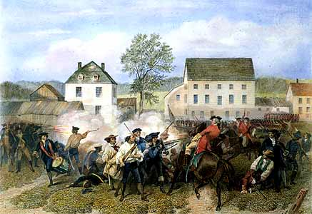
Mobilized
resistance

Slide 19
British system =
centralized

Slide 21
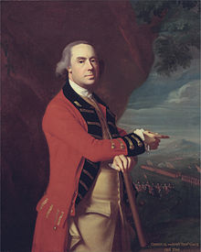

centralized

Slide 22
January 18, 2012 midnight

Slide 23
largest Internet blackout

Slide 24
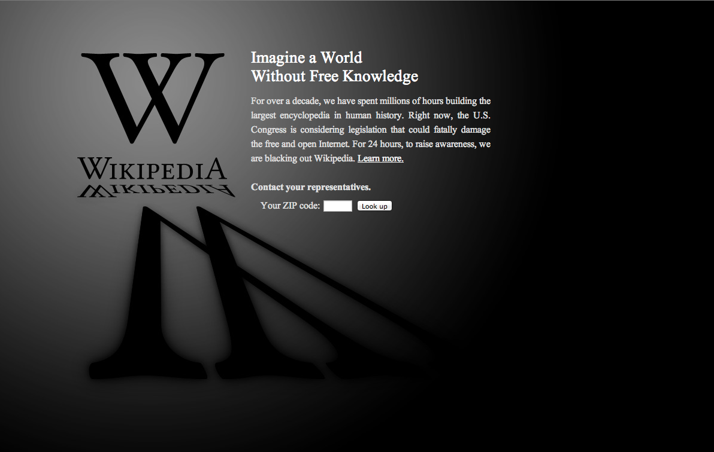

Slide 25
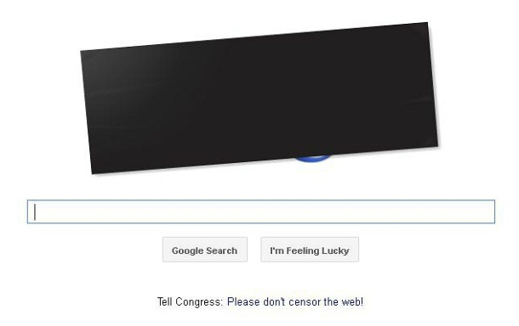
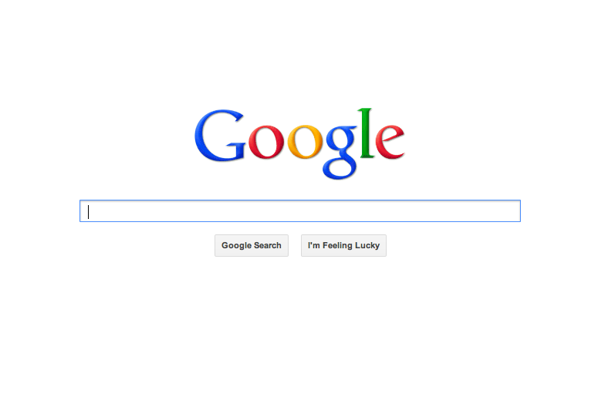

Slide 26
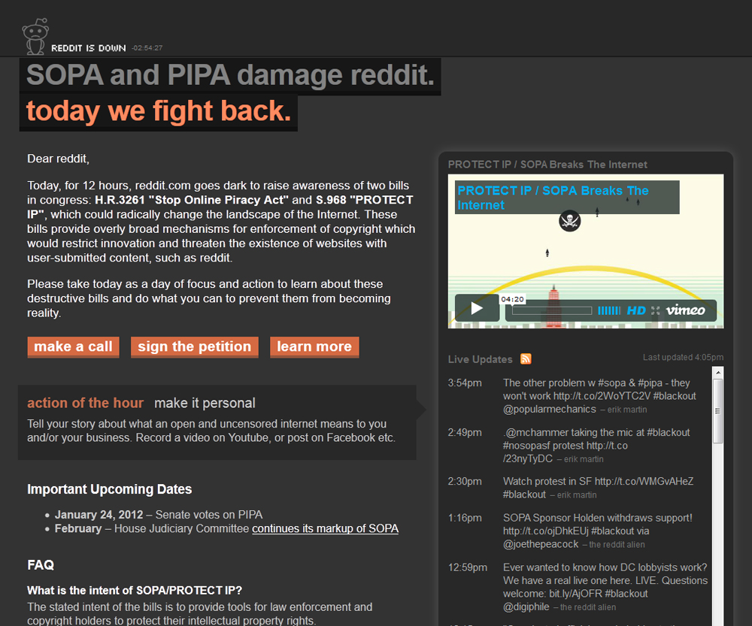
Reddit

Slide 27
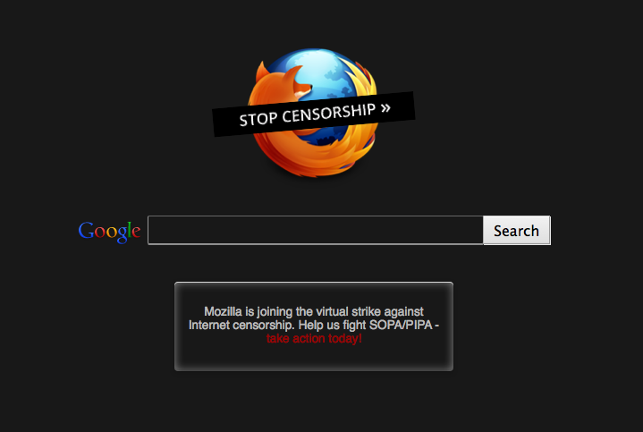
Mozilla

Slide 28
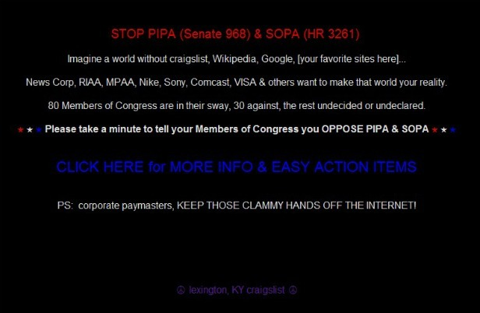
Craigslist

Slide 29
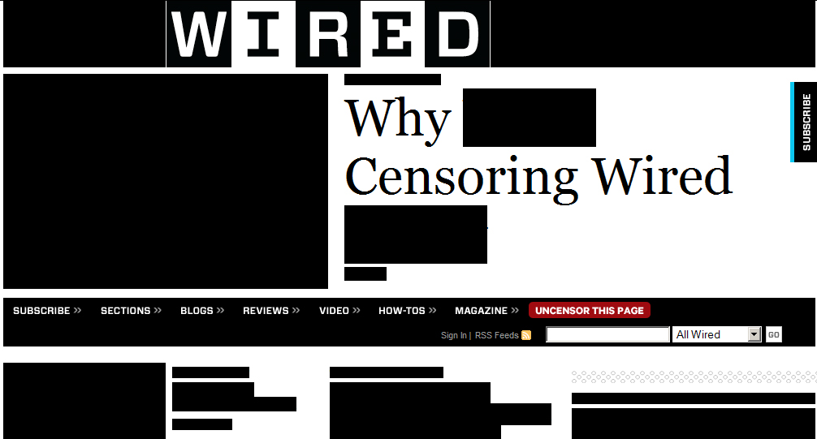

Slide 30
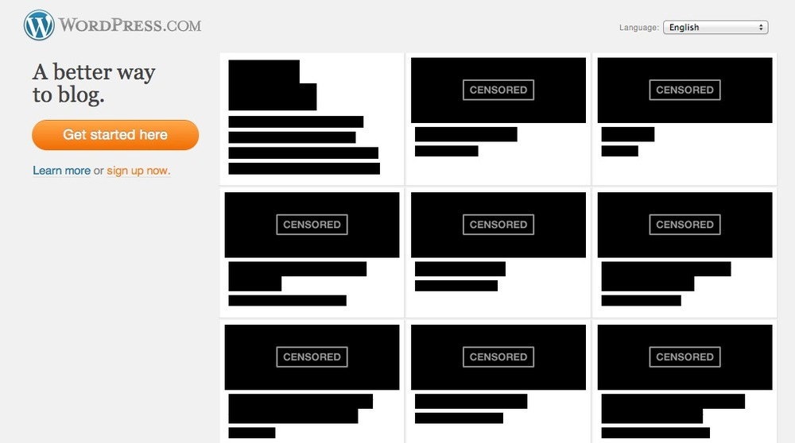

Slide 31
115,000 websites blacked out

Slide 32
sound alarm re: SOPA

Slide 33
Stop Online Piracy Act

Slide 34
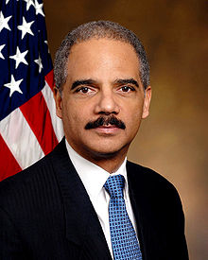
Domain name blocking (by Atty. Gen.)

Slide 35
241 lobbyists for entertainment industry
$91 million for SOPA - Nov. 16
Center for Responsive Politics

Slide 36









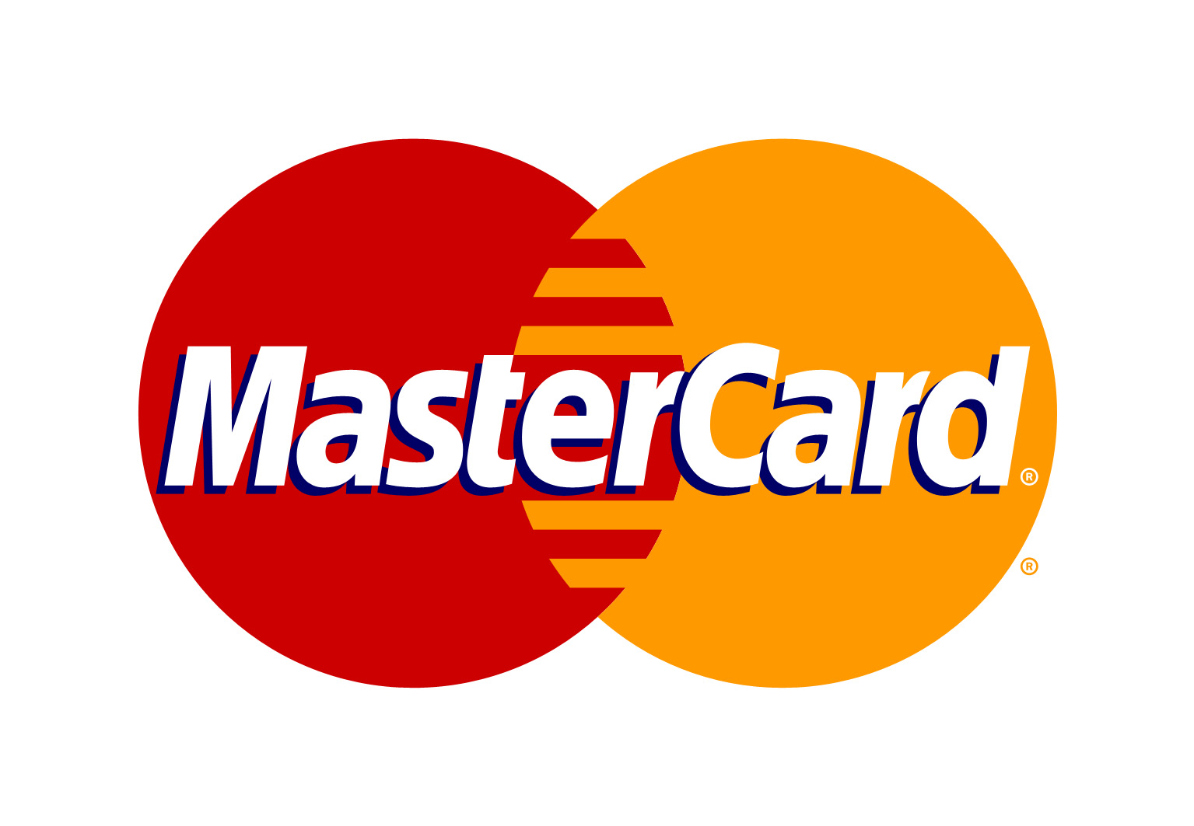









Slide 37
32 co-sponsors in House
42 co-sponsors in Senate

Slide 38
strong bipartisan support

Slide 39
slam dunk to pass …

Slide 40
Day after blackout (Jan 19)

Slide 41
SOPA = TOXIC

Slide 42
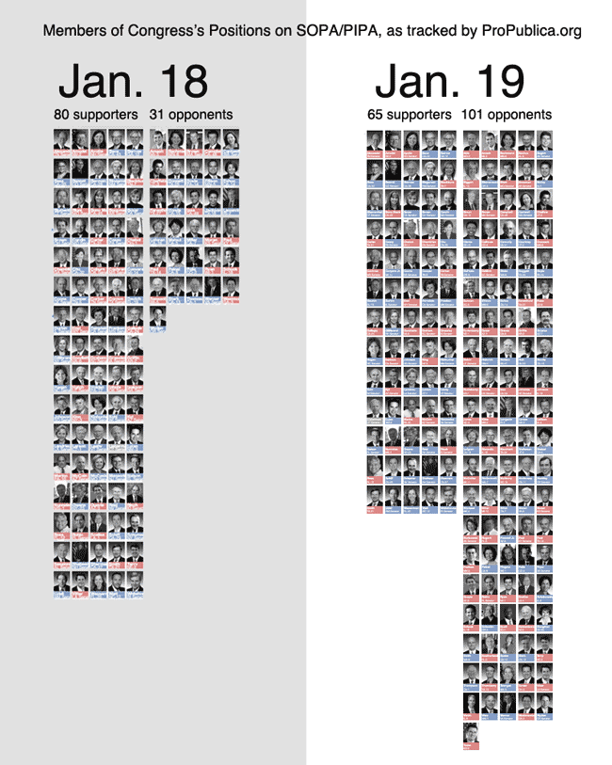
opposed

Slide 43
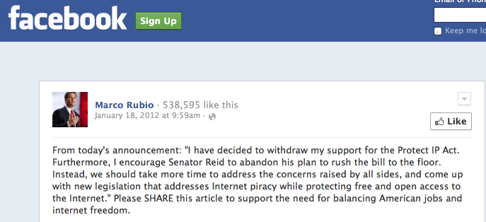
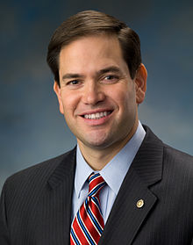
“protect free and open
access to the Internet”

Slide 44
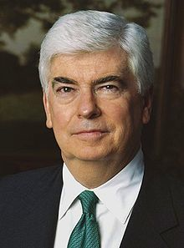
“This is altogether a new effect,” Dodd said, comparing the online movement to the Arab Spring.
Chris Dodd, MPAA

Slide 45
My view…

Slide 46
Jan. 18 / April 18

Slide 47
“Revere style” network

Slide 48
decentralized

Slide 49
instead of

Slide 50
websites

Slide 51
mobilized people quickly
“bottom UP”

Slide 52
Millions voiced opposition

Slide 53
8 million “looked up” Congress members
10 million signed petitions to Congress
3 million emails to Congress
100,000+ calls to Congress

Slide 54
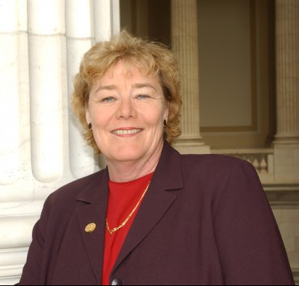
“Melt the phone lines.”
Rep. Lofgren

Slide 55
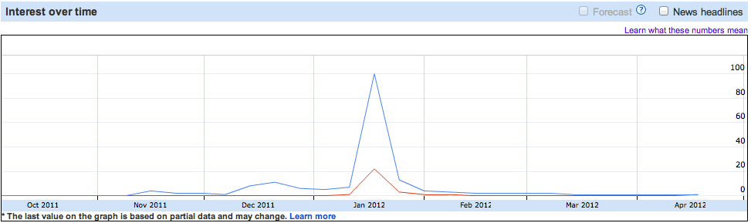
Google searches: SOPA, PIPA
Jan.18

Slide 56
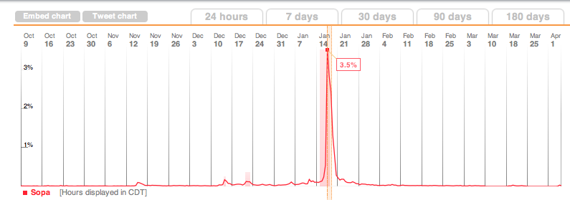
Tweets: SOPA
3.5% all Tweets
Jan.18

Slide 57
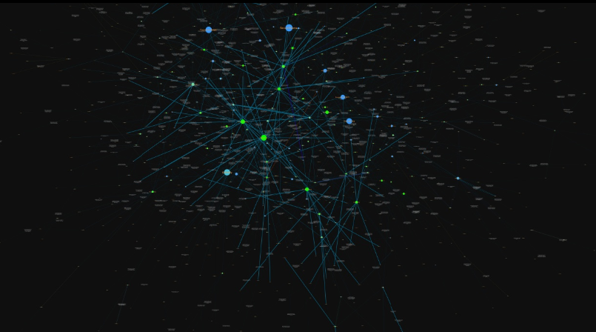

Slide 58
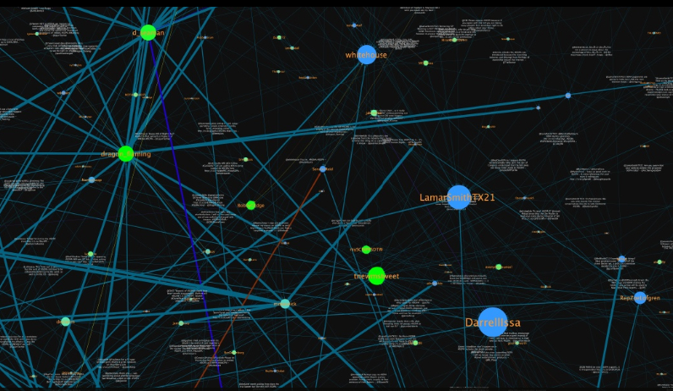

Slide 59
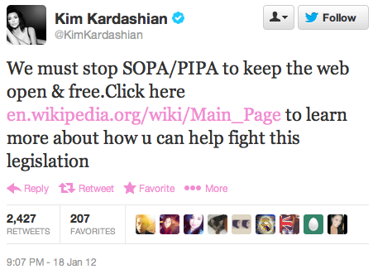

Slide 60
SOPA shelved

Slide 61
Story of civic engagement

Slide 62
February 11, 2012

Slide 63
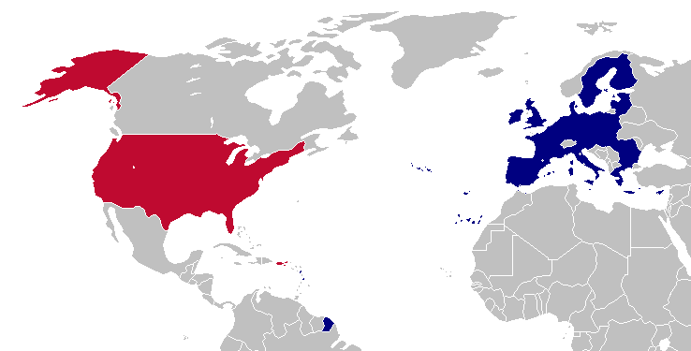
Protests

Slide 64
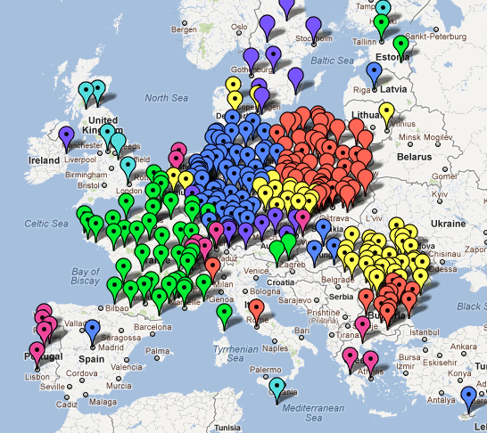
250 cities, 27 countries protest

Slide 65
ACTA

Slide 66
Anti-Counterfeiting Trade Agreement

Slide 67
ACTA + SOPA
= Internet policing
Internet freedom

Slide 68
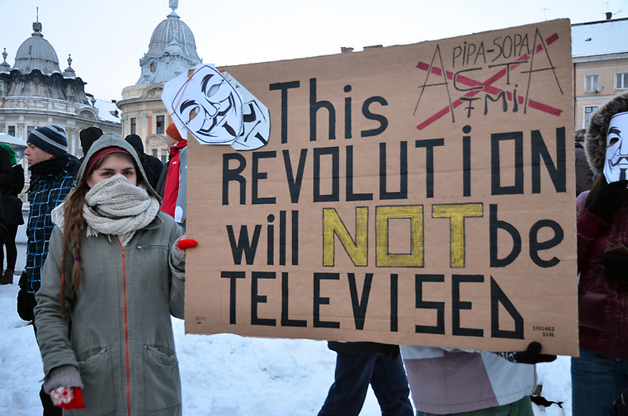
Laura Muresan, http://ireport.cnn.com/docs/DOC-746395

Slide 69
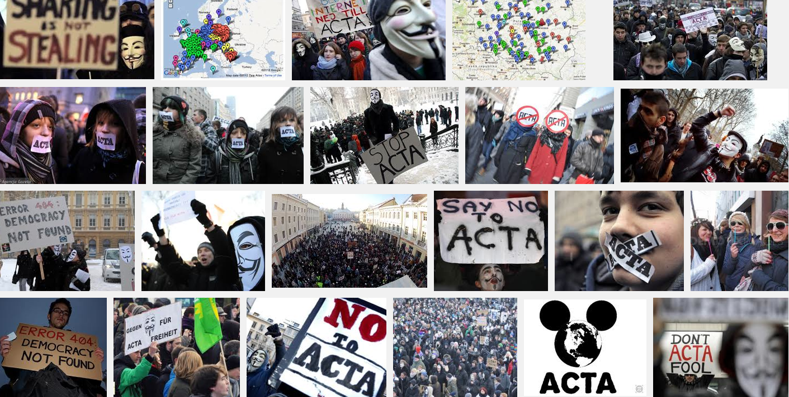

Slide 70
civic engagement(x2)

Slide 71
civic engagement(x27)

Slide 72
Lessons?

Slide 73
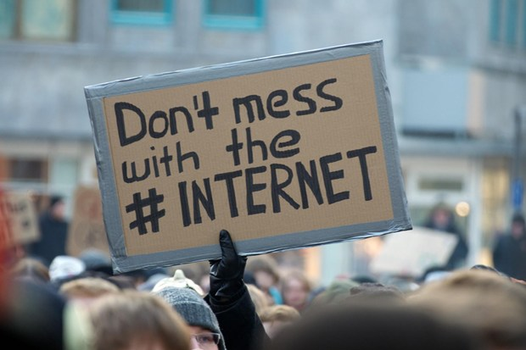
(1)
http://www.greenyourope.net

Slide 74

(2)

Slide 75
Fight for “free and open Internet”

Slide 76
not defined by courts (yet)

Slide 77
Defined by people.

Slide 78
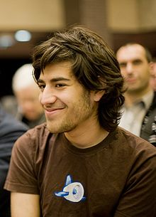
“We won this fight because everyone made themselves the hero of their own story. Everyone took it as their job to save this crucial freedom. They did whatever they could think of to do. They didn’t stop to ask anyone for permission.”
Aaron Swartz

Slide 79
“The Senators were right. The Internet really is out of control.”
Aaron Swartz

Slide 80
But what do people know?

Slide 81
Theory 1: Millions misinformed

Slide 82
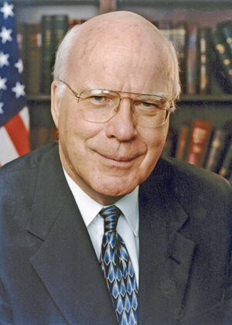
“A lot of false information going on…
Sen. Leahy,
PIPA sponsor

Slide 83
“Netizens did poison the well….
There’s certainly a feeling on Capitol Hill that the Internet response was orchestrated by misinformation.”
Stephanie Moore,
Dem. Chief Counsel

Slide 84
reminiscent…

Slide 85
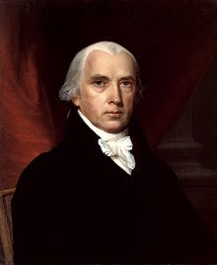
-James Madison
Who Are the Best Keepers of
the People’s Liberties?

Slide 86
Anti-republican. — The people are stupid, suspicious, licentious. They cannot safely trust themselves….
[T]hey should think of nothing but obedience, leaving the care of their liberties to their wiser rulers.

Slide 87
Theory 2: Popular constitutionalism

Slide 88
People’s view of Constitution…

Slide 89
reigns supreme.

Slide 90
Republican. — The people themselves. The sacred trust can be no where so safe as in the hands most interested in preserving it.
-James Madison

Slide 91
My view: did so in SOPA debate.

Slide 92
People’s view of “free speech”

Slide 93
“free and open Internet”

Slide 94
reigned supreme.

Slide 95
memos by Floyd Abrams + Laurence Tribe

Slide 96
Intermediate v. strict scrutiny

Slide 97
People’s scrutiny

Slide 98
SOPA flunked.

Slide 99
Power of social media
(3)

Slide 100
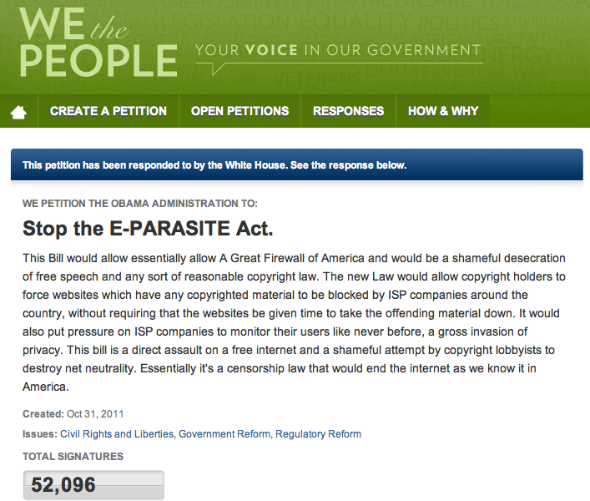
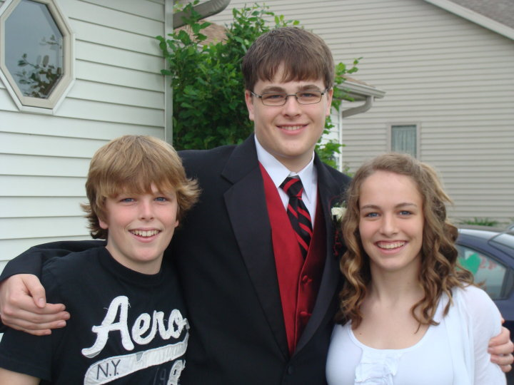
Ryan Bertsche
“censorship law that would end
the Internet as we know it”

Slide 101

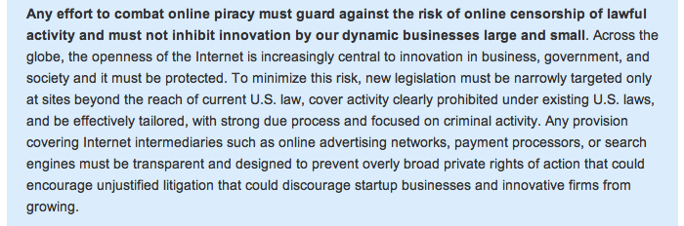
“must guard against risk of
online censorship”

Slide 102
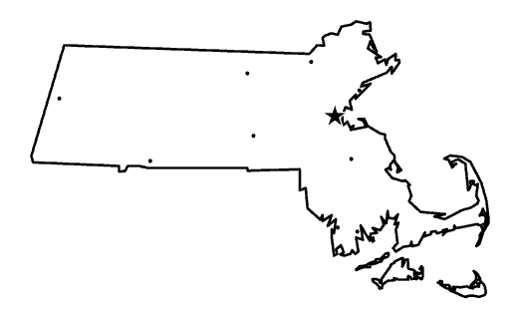
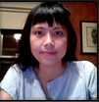
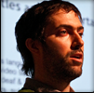
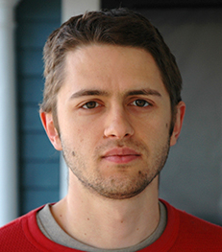
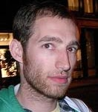
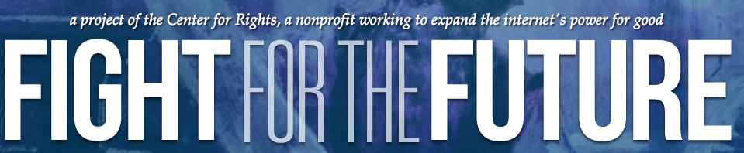

Slide 103
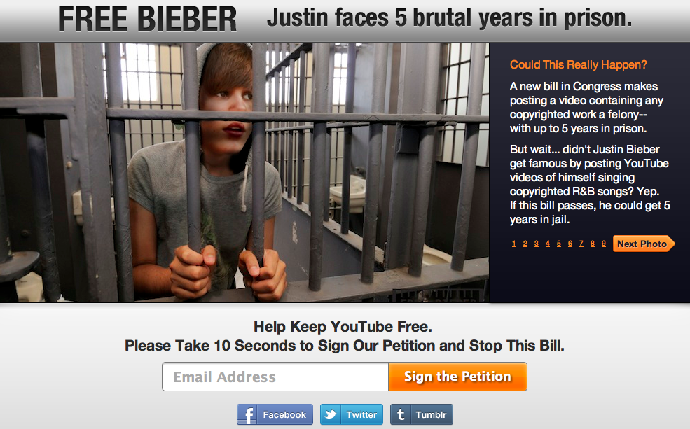

Slide 104
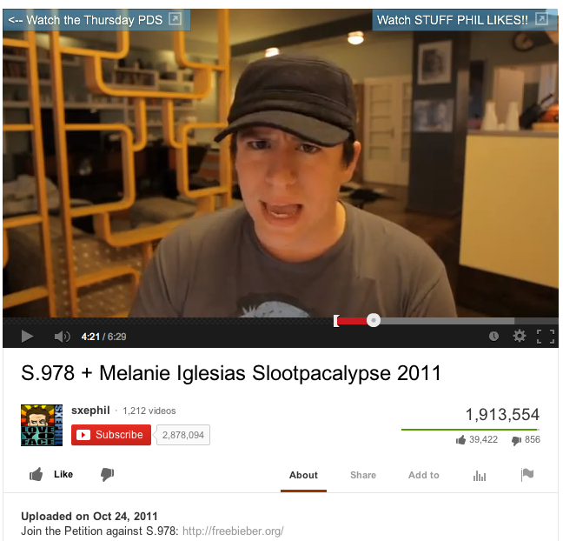


Slide 105
Bieber: bill is “ridiculous.”
Bill sponsors should be “locked up.”

Slide 106
What next?

Slide 107
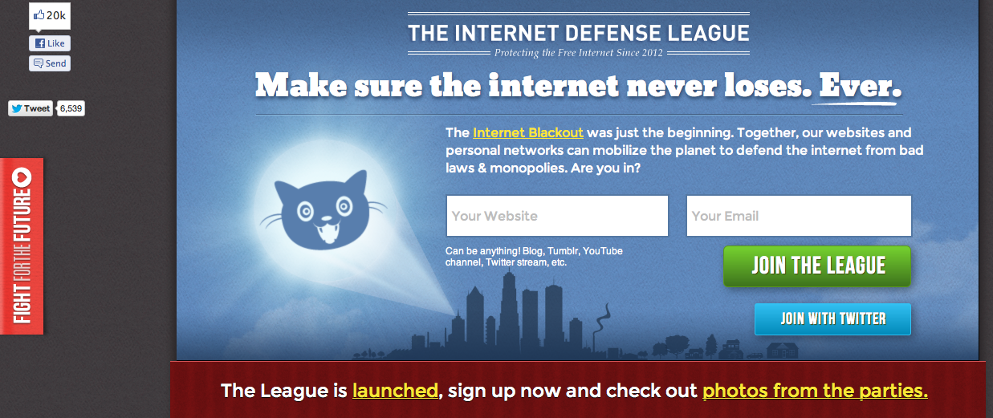

Slide 108
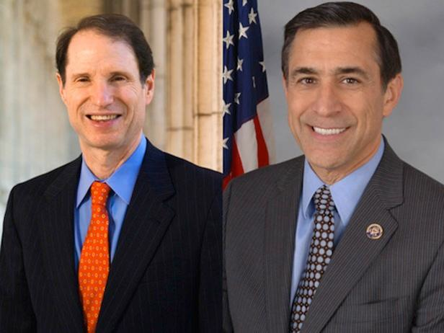
Internet Bill of Rights?

Slide 109

Internet Bill of Rights
The right to a free and uncensored Internet.
The right to an open, unobstructed Internet.
3. The right to equality on the Internet.
4. The right to gather and participate in online activities.
5. The right to create and collaborate on the Internet.
6. The right to freely share their ideas.
7. The right to access the Internet equally, regardless of
who they are or where they are.
8. The right to freely associate on the Internet.
9. The right to privacy on the Internet.
10.The right to benefit from what they create.

Slide 110
up for grabs…

Slide 111
NSA

Slide 112
challenge + opportunity

Slide 113
http://newspaper.li/paul-revere/

Slide 114
Join “a common effort
in the cause of freedom”

Slide 115
“not into politics”?

Slide 116



aware of politics

Slide 117
Why fight?

Slide 118
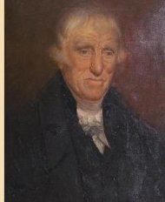
“We had always governed ourselves and we always meant to. [The British] didn't mean we should.”
Capt. Levi Preston

Slide 119
freedom of the Internet

Slide 120
(open)

Slide 121
(closed)

Slide 122
This Fight for the Future…

Slide 123
TheFightfortheFuture.com

