Slide 1
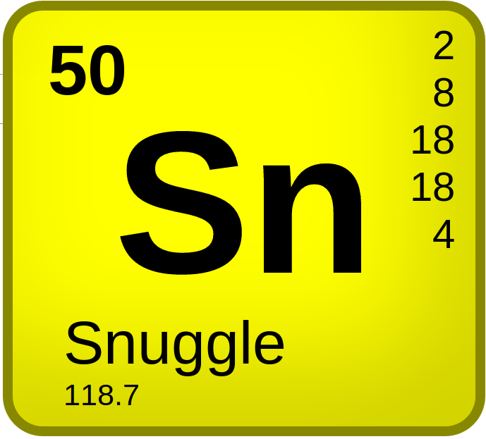
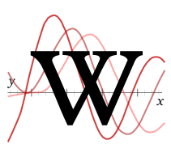
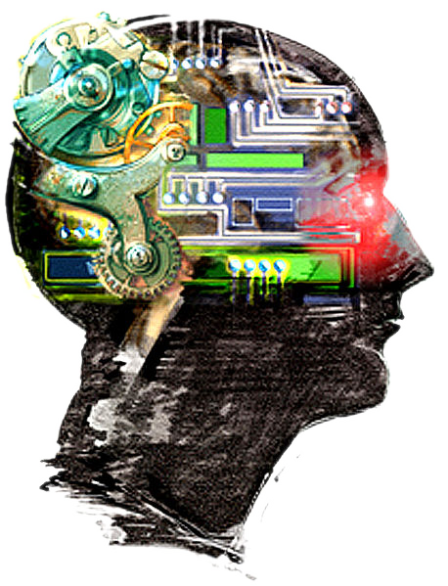
Engineering open production efficiency at scale
User:ClueBot NG
HotCat
Aaron Halfaker
ahalfaker@wikimedia.org
Wikimedia
Research
Notes:
http://etherpad.wikimedia.org/p/open_algorithms_platform

Slide 3
Wikipedia as a socio-technical system
Systems-thinking & Biological metaphors
~

Slide 4
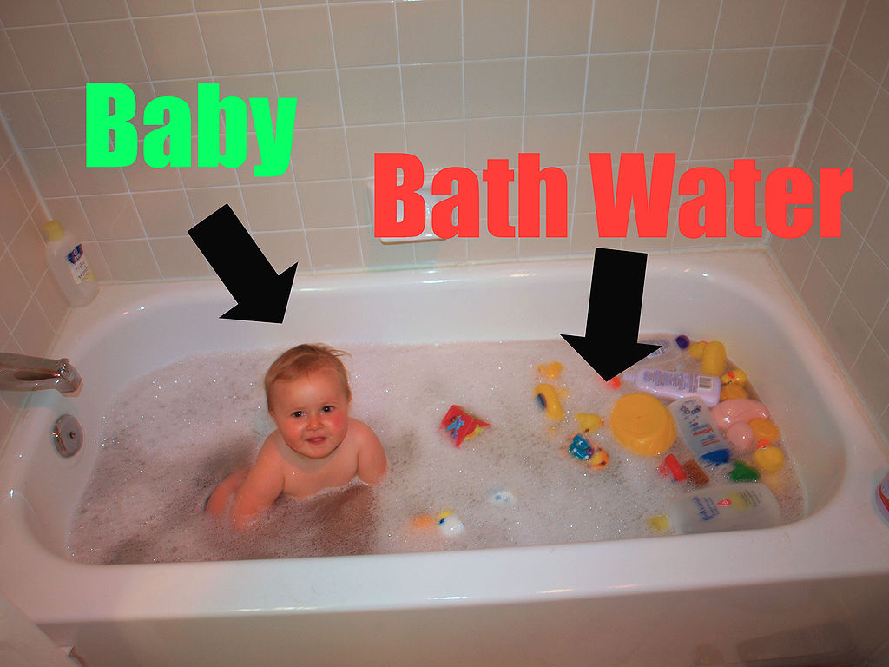
Wikipedia as a socio-technical system
Systems-thinking & Biological metaphors
Critique of algorithmic quality control
Standpoint epistemology
Encoding of ideology in technology
~

Slide 5
Wikipedia as a socio-technical system
Systems-thinking & Biological metaphors
Critique of algorithmic quality control
Standpoint epistemology
Encoding of ideology in technology
Infrastructure for socio-technical change
“progress catalyst”
Hearing to speech vs. Speaking to be heard
The dangers of “subjective algorithms”
~

Slide 6
Part 1. The socio-technical of Wikipedia

Slide 7
What is Wikipedia?

Slide 8
The world’s largest encyclopedia
~5 million articles
in English

Slide 9
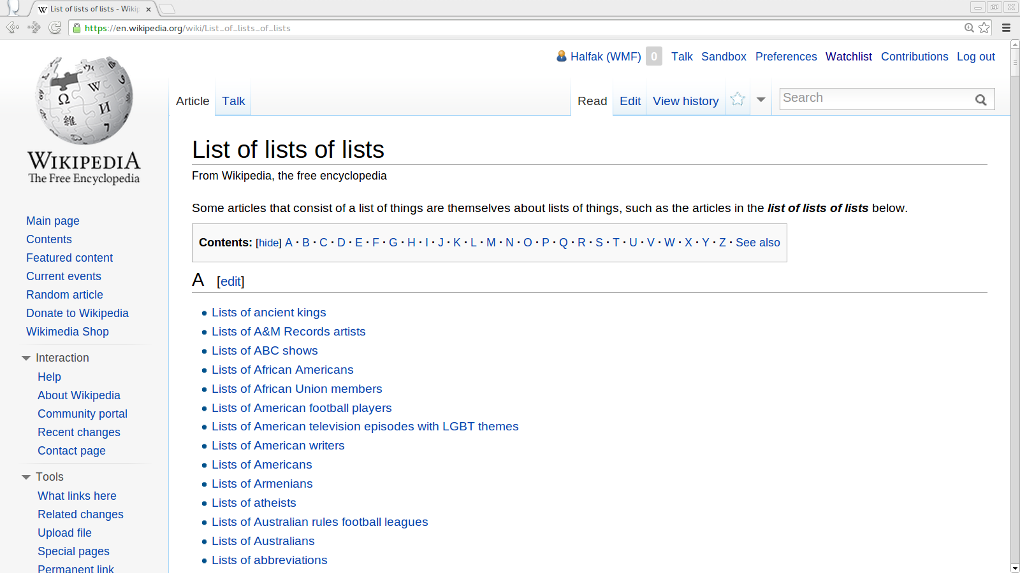

Slide 11
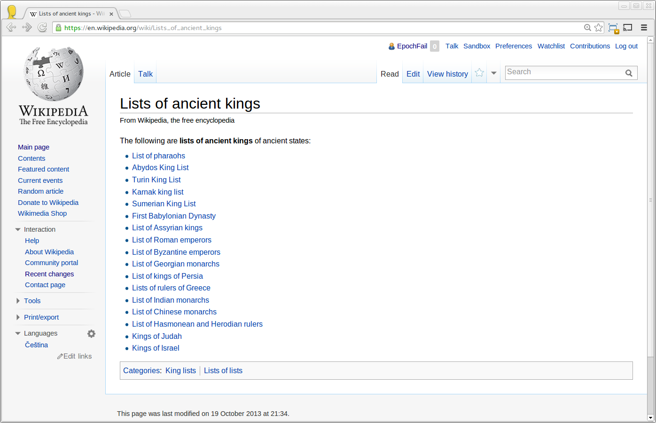

Slide 13
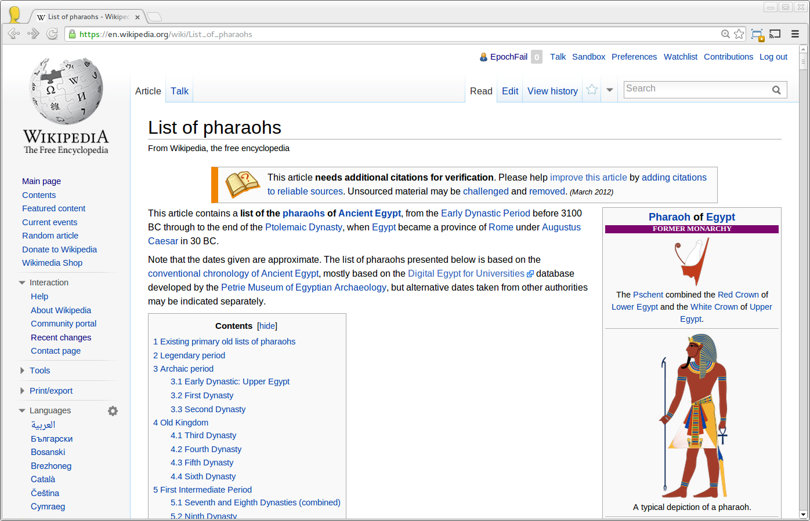

Slide 14
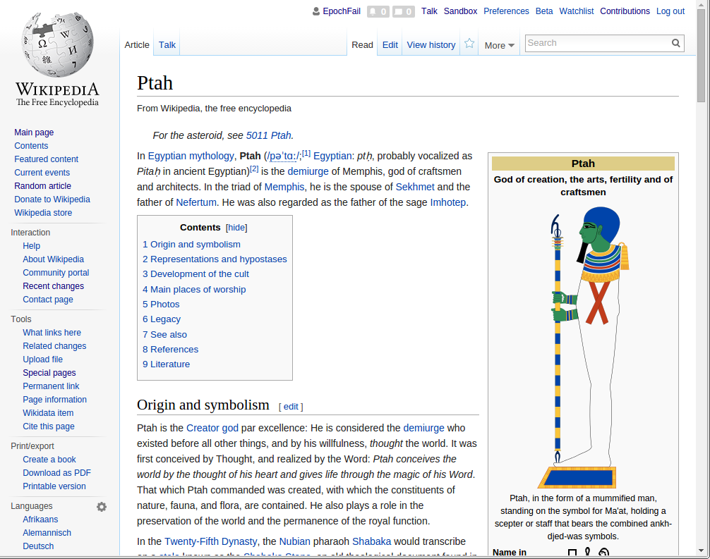

Slide 16
A wiki
Anyone can edit
Shared authorship
Flipped publication model
publish first
review later (maybe)

Slide 17
An online community
~100k active volunteer editors
WikiProject Video Games
WikiProject Medicine

Slide 18
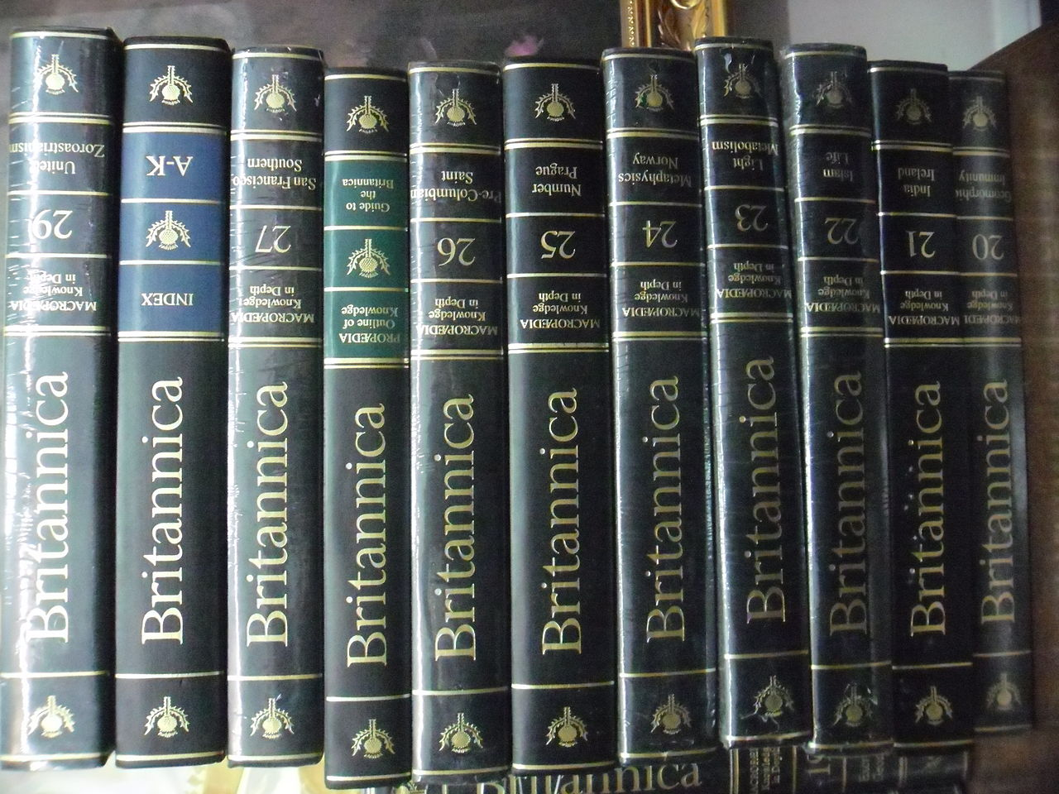
A system
Available Human Attention

Slide 19
A system
Output
Input
Available Human Attention

Slide 20
A system
Output
Input
Available Human Attention
Socio-technical

Slide 21
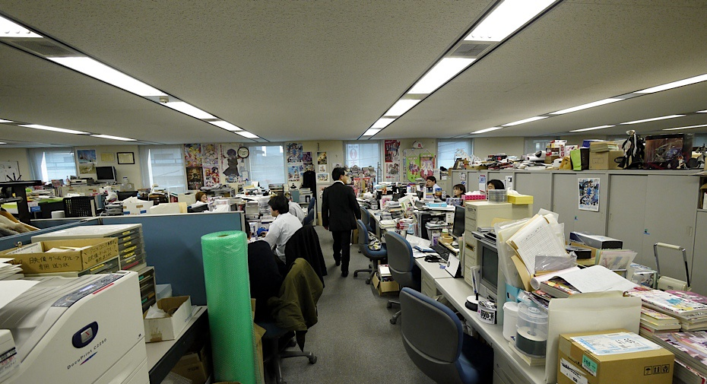
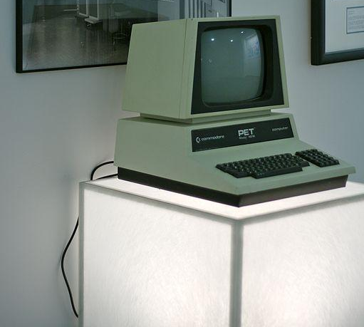
Social
Technical
https://commons.wikimedia.org/wiki/File:Kadokawa_office_(2).jpg
https://commons.wikimedia.org/wiki/File:Commodore_PET_4016,_Google_NY_office_computer_museum.jpg

Slide 22
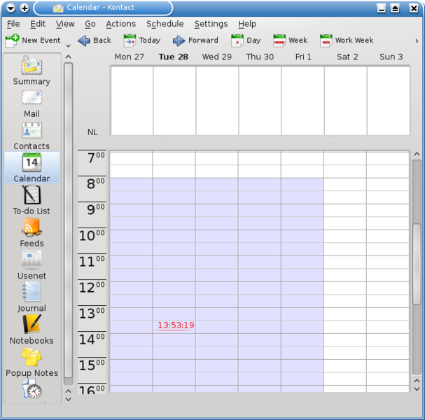
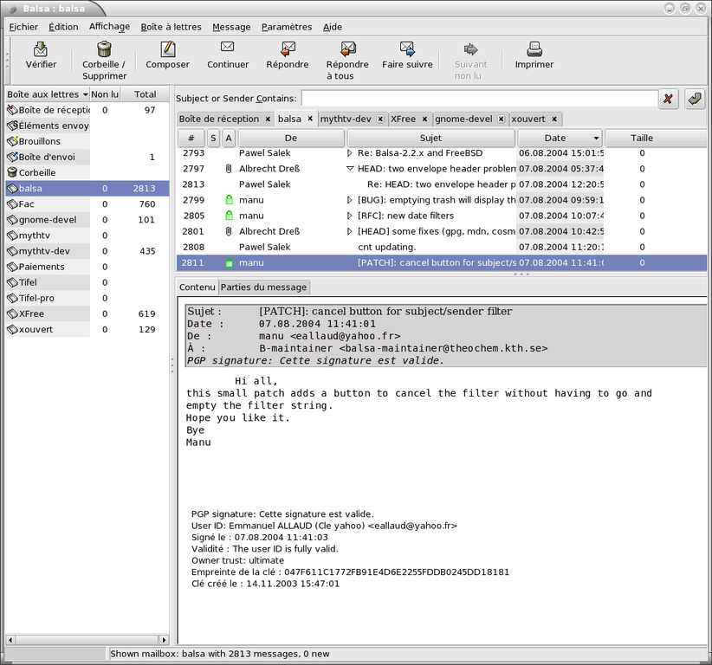
Social
Technical
https://commons.wikimedia.org/wiki/File:Marcus_Bains_Line.png
https://commons.wikimedia.org/wiki/File:Balsa-gpg.png

Slide 23
Socio-technical

Slide 25
Technologist

Slide 26
Techno-biologist?

Slide 27
Bacterium
Paramecium

Slide 28
DNA
ribosomes
vacuole
Bacterium
Paramecium

Slide 29
macronucleus
micronucleus
endoplasmic reticulum
oral groove
DNA
vacuole
ribosomes
contractile vacuole
vacuole
Bacterium
Paramecium

Slide 30
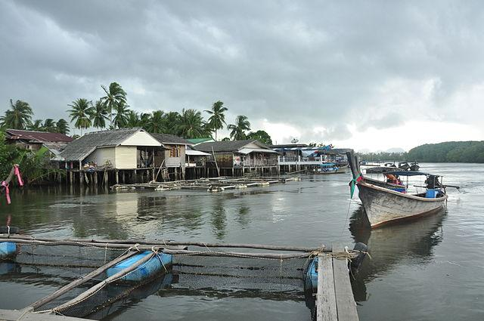
Bacterium
Paramecium

Slide 31
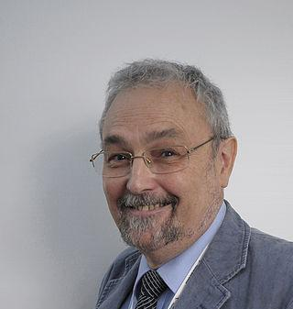
Via commons. CC-BY-SA 2.0
Dunbar’s number: ~150
Bacterium
Paramecium

Slide 32
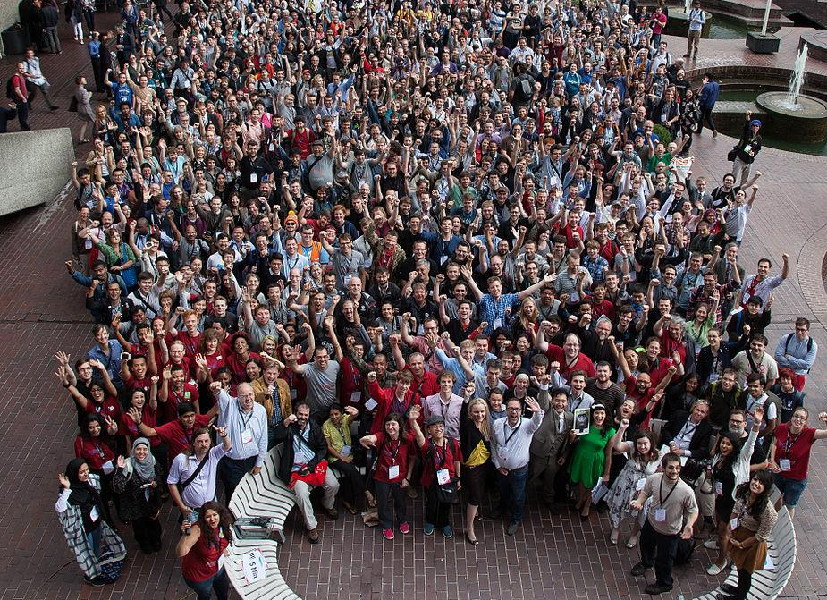
Bacterium
Bare-amecium
Organelles
Paramecium
Policies & Guidelines
Robots & tools

Slide 33
socio - technical

Slide 34
socio-technical

Slide 35
~
System with specialized sub-systems
System with specialized sub-systems

Slide 37
Work allocation
Identify, prioritize and assign tasks

Slide 38
Work allocation
Largely for free due to Linus’ Law

Slide 39
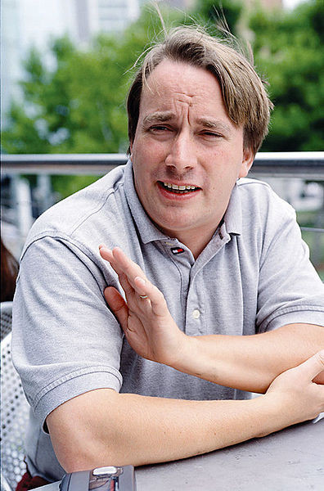
Linus’s Law?

Slide 40
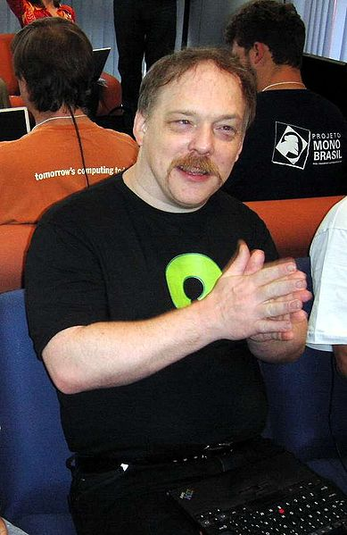
Linus’s Law?
Eric
Raymond

Slide 41
Linus’s Law?
“given enough eyeballs, all bugs are shallow”

Slide 42
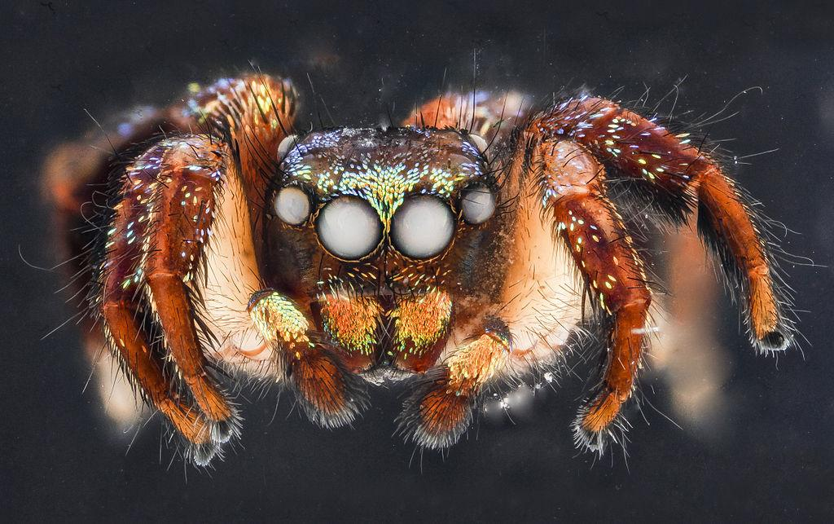
Linus’s Law?
“given enough eyeballs, all bugs are shallow”
yessss…
bugssss….

Slide 43
Linus’s Law?
“given enough eyeballs, all bugs are shallow”

Slide 44
Linus’s Law?
“given enough eyeballs, all bugs are shallow”
!

Slide 45
Linus’s Law?
visibility is critical to open collaboration

Slide 46
A corollary for Wikipedia
Given that enough people see an incomplete article, all potential contributions to that article will be easy for someone.
Works in theory -- Stvilia, B., et al. (2008). Information quality work organization in Wikipedia. JASIST, 59(6), 983-1001.
Part of becoming a Wikipedian -- Bryant, S. L., Forte, A., & Bruckman, A. (2005, November). Becoming Wikipedian. GROUP (pp. 1-10). ACM.
We can support visibility with technology -- Cosley, D., et al. (2007, January). SuggestBot: using intelligent task routing to help people find work in wikipedia. IUI (pp. 32-41). ACM.
Bad things happen when we take it away -- Schneider, J., et al. (2014, August). Accept, decline, postpone. OpenSym(p. 26). ACM.
!

Slide 47
Work allocation
Identify, prioritize and assign tasks
Regulation of behavior
Norm formation, propagation and enforcement

Slide 48
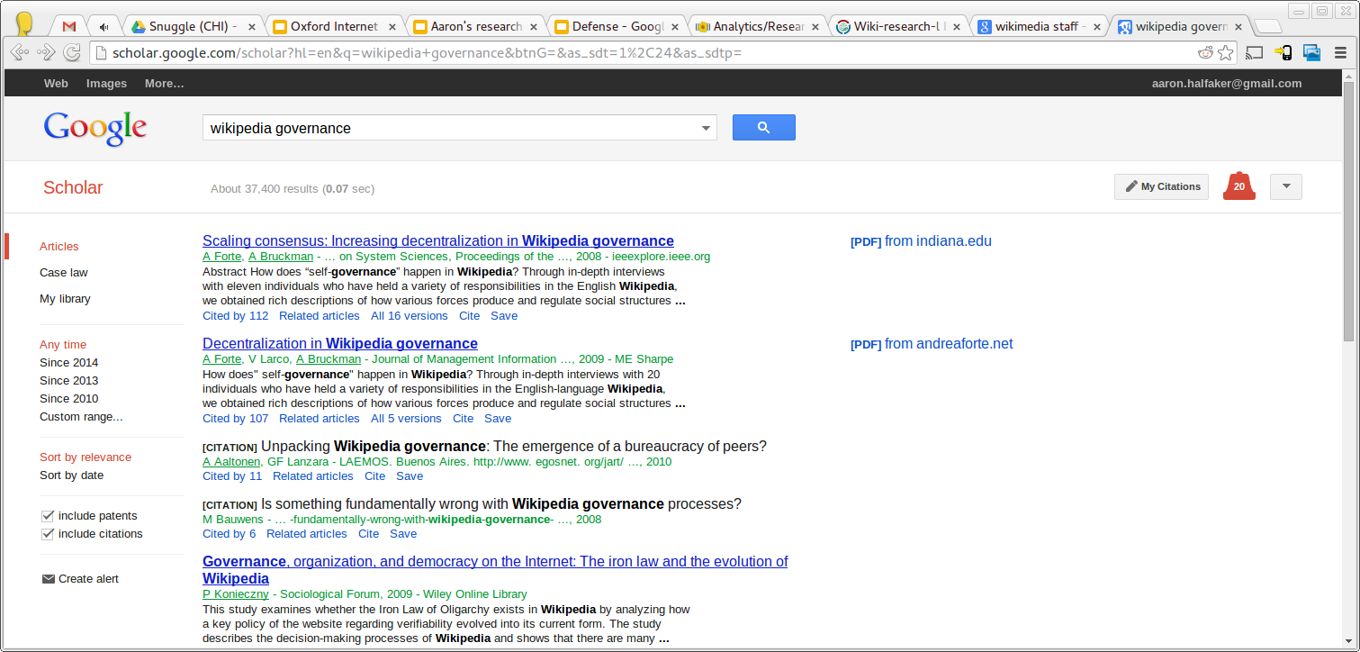

Slide 49
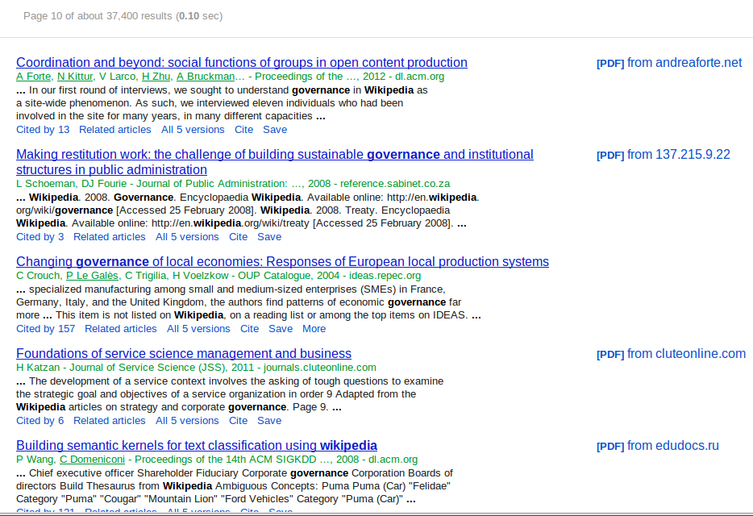

Slide 50
Prescriptive
Idea for a Norm
Descriptive
Observation of consistent behavior

Slide 51
Prescriptive
Idea for a Norm
ESSAY
Descriptive
Observation of consistent behavior

Slide 52
Prescriptive
Idea for a Norm
ESSAY
Requests for Comments
Descriptive
Observation of consistent behavior
rabble
rabble
rabble

Slide 53
POLICY
Prescriptive
Idea for a Norm
ESSAY
Requests for Comments
Descriptive
Observation of consistent behavior
rabble
GUIDELINE
rabble
rabble

Slide 54
Informal
Formalized
Morgan, J. T., & Zachry, M. (2010, November). Negotiating with angry mastodons: the wikipedia policy environment as genre ecology. In Proceedings of the 16th ACM international conference on Supporting group work (pp. 165-168). ACM.
POLICY
Halfaker, A., Geiger, R. S., Morgan, J. T., & Riedl, J. (2012). The rise and decline of an open collaboration system: How Wikipedia’s reaction to popularity is causing its decline. American Behavioral Scientist, 0002764212469365.
ESSAY
GUIDELINE

Slide 55
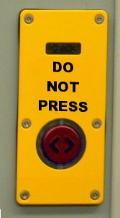
Informal
Formalized

Slide 56
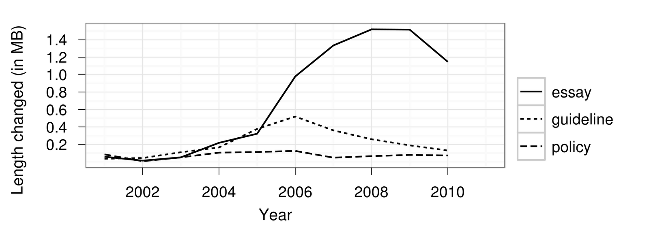
Growth of regulations
Halfaker, A., Geiger, R. S., Morgan, J. T., & Riedl, J. (2012). The rise and decline of an open collaboration system: How Wikipedia’s reaction to popularity is causing its decline. American Behavioral Scientist, 0002764212469365.

Slide 57
Growth of regulations
Halfaker, A., Geiger, R. S., Morgan, J. T., & Riedl, J. (2012). The rise and decline of an open collaboration system: How Wikipedia’s reaction to popularity is causing its decline. American Behavioral Scientist, 0002764212469365.

Slide 58
Growth of regulations
Halfaker, A., Geiger, R. S., Morgan, J. T., & Riedl, J. (2012). The rise and decline of an open collaboration system: How Wikipedia’s reaction to popularity is causing its decline. American Behavioral Scientist, 0002764212469365.

Slide 59
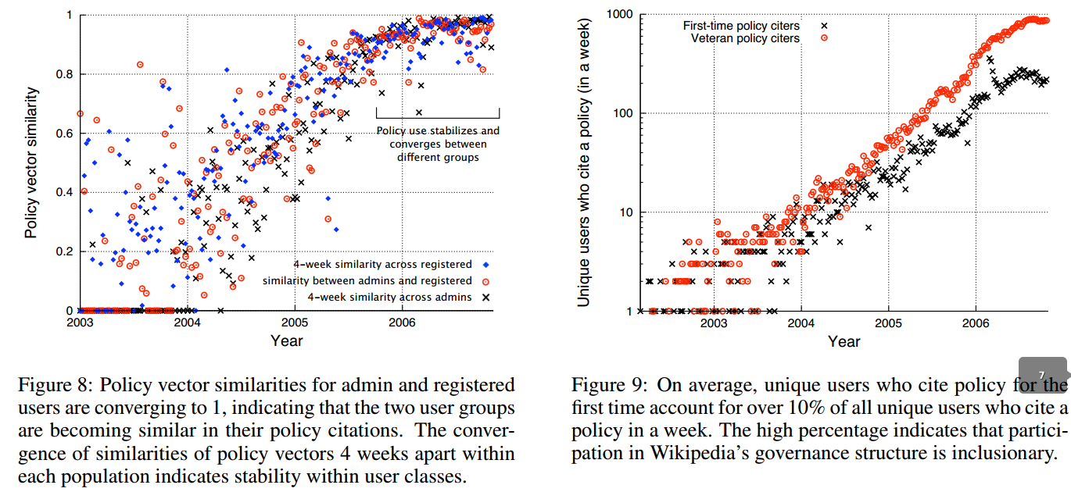
Citation distribution
Beschastnikh, I., Kriplean, T., & McDonald, D. W. (2008, March). Wikipedian Self-Governance in Action: Motivating the Policy Lens. In ICWSM.

Slide 60
Citation distribution
“Wikipedia’s governance structure is inclusionary”
Beschastnikh, I., Kriplean, T., & McDonald, D. W. (2008, March). Wikipedian Self-Governance in Action: Motivating the Policy Lens. In ICWSM.

Slide 61
Work allocation
Identify, prioritize and assign tasks
Regulation of behavior
Norm formation, propagation and enforcement
Quality control
Identify and remove damage

Slide 62
Quality control

Slide 63
Quality control
!

Slide 64
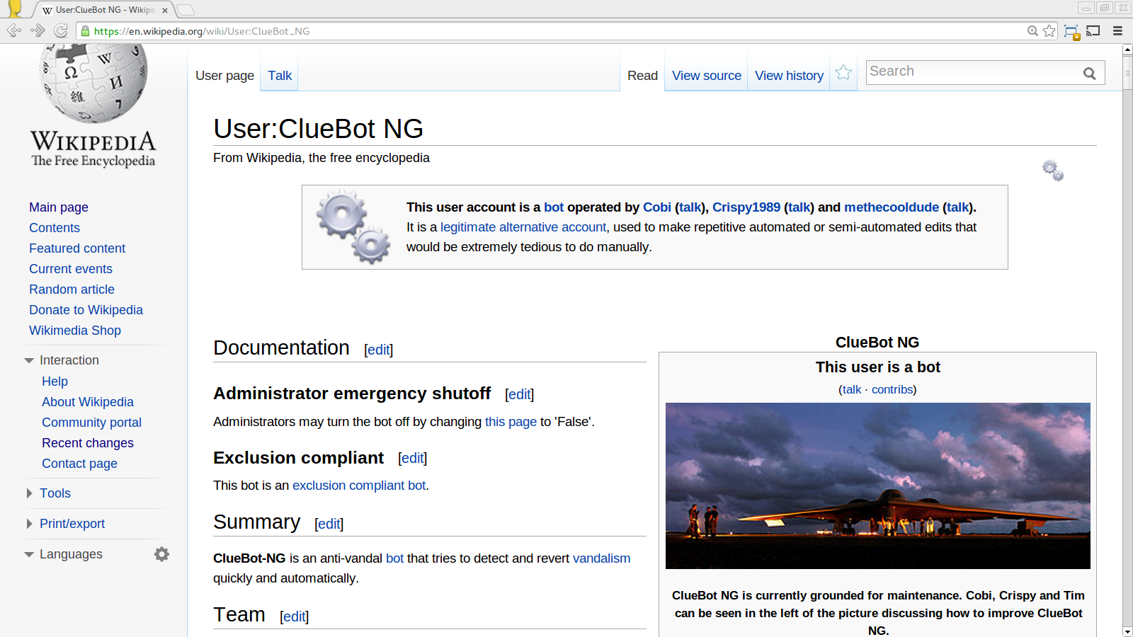
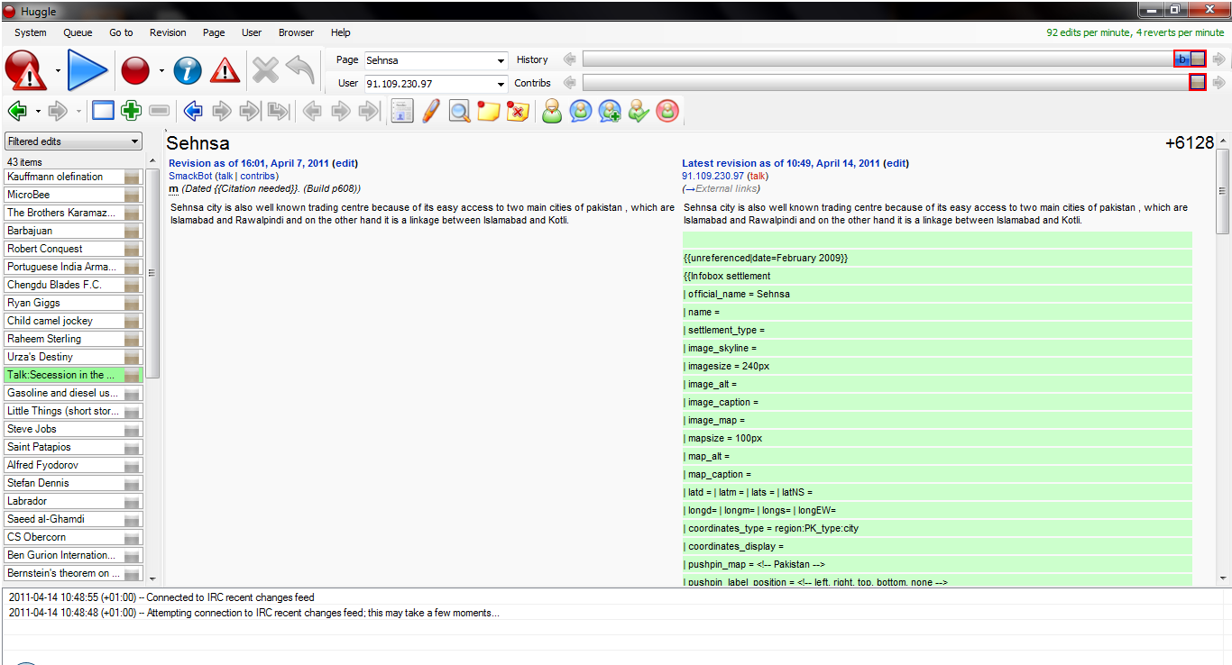
Quality control
Fully automated
Semi automated
!
Machine learning
Fast (~ 5 seconds)[1]
No human effort
Only obvious vandalism
Human computation
Still pretty fast (~ 30 seconds)[1]
Minimizes human effort
Humans catch most vandalism at a glance
1. R. Stuart Geiger & Aaron Halfaker. When the Levee Breaks (2013). WikiSym.

Slide 65
Quality control
Fully automated
Banning (Admins)
Semi automated
!

Slide 66
Quality control
Fully automated
Banning (Admins)
Innate
- Fast
- General
- Local
Adaptive
- Slow
- Specific
- Global
Semi automated
!
Halfaker, A. & Riedl, J. (2012) Bots and Cyborgs, IEEE Computing 45(3) (p. 79-82)
Geiger, R. S., & Ribes, D. (2010, February). The work of sustaining order in wikipedia: the banning of a vandal. CSCW (pp. 117-126). ACM.

Slide 67
Work allocation
Identify, prioritize and assign tasks
Regulation of behavior
Norm formation, propagation and enforcement
Quality control
Identify and remove damage
Community management
Newcomer socialization, dispute mediation & training

Slide 68
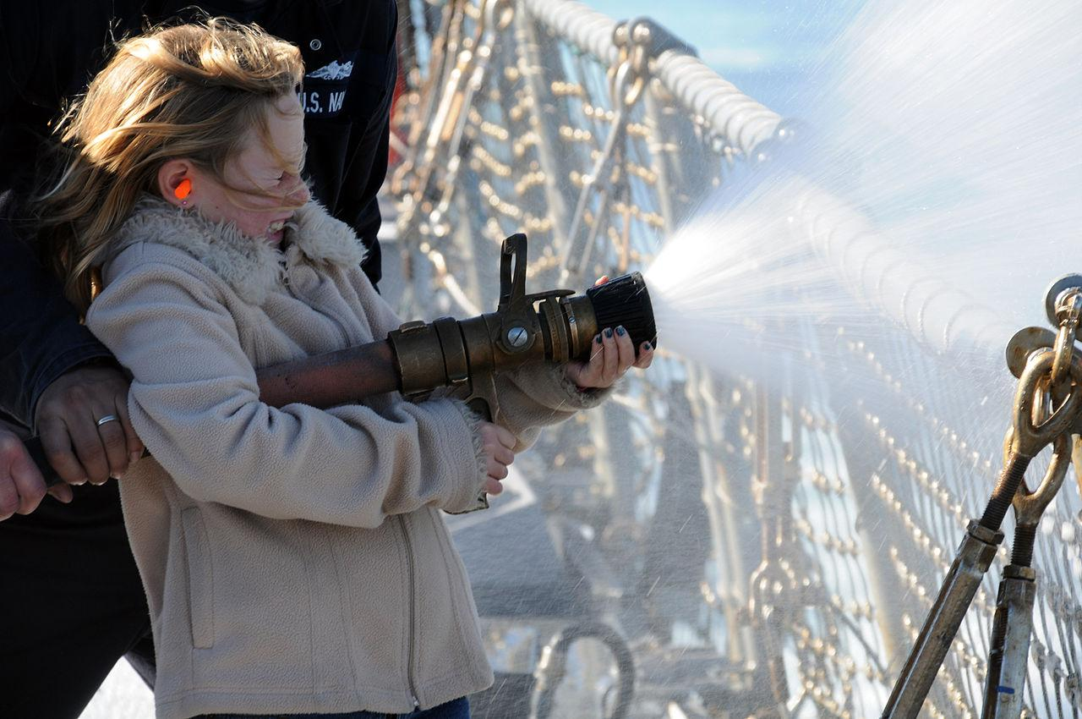
https://commons.wikimedia.org/wiki/File:Flickr_-_Official_U.S._Navy_Imagery_-_Sailor%27s_daughter_operates_a_fire_hose_with_crew_member_assistance..jpg
6,000 newcomers per day

Slide 69
vandals
HostBot
good-faith
https://commons.wikimedia.org/wiki/File:Flickr_-_Official_U.S._Navy_Imagery_-_Sailor%27s_daughter_operates_a_fire_hose_with_crew_member_assistance..jpg
6,000 newcomers per day

Slide 70
vandals
HostBot
good-faith
https://commons.wikimedia.org/wiki/File:Flickr_-_Official_U.S._Navy_Imagery_-_Sailor%27s_daughter_operates_a_fire_hose_with_crew_member_assistance..jpg
6,000 newcomers per day

Slide 71
Work allocation
Identify, prioritize and assign tasks
Regulation of behavior
Form, propagate and enforce norms
Quality control
Identify and remove damage
Community management
Socialize & train newcomers; mediate disputes
Reflection (Adaptation)
Where are we going? Where do we want to go? How do we want to get there?

Slide 72
Reflection (Adaptation)
?
Where are we going?
Where do we want to go?
How do we get there?

Slide 74
Reflection
Adaptation

Slide 75
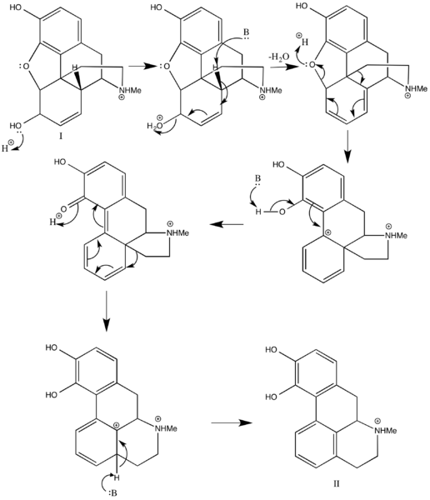
https://commons.wikimedia.org/wiki/File:Morphine_to_Apomorphine.png CC-SY-SA 4.0

Slide 76
https://commons.wikimedia.org/wiki/File:Morphine_to_Apomorphine.png CC-SY-SA 4.0
Policies & Guidelines
Robots & tools
https://commons.wikimedia.org/wiki/File:Gear_reducer.gif CC-BY-SA 3.0

Slide 77
Available Human Attention

Slide 78
Part 2. Critique of algorithmic quality control

Slide 79
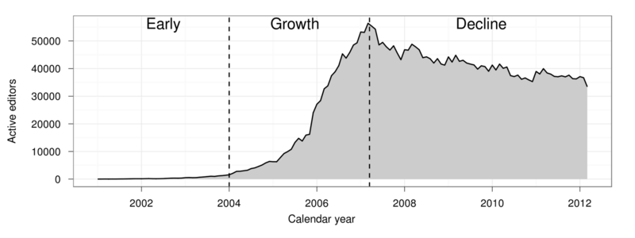
:m:Research:The_Rise_and_Decline
Halfaker, A., Geiger, R. S., Morgan, J. T., & Riedl, J. (2012). The rise and decline of an open collaboration system: How Wikipedia’s reaction to popularity is causing its decline. American Behavioral Scientist, 0002764212469365.

Slide 81
https://commons.wikimedia.org/wiki/File:Flickr_-_Official_U.S._Navy_Imagery_-_Sailor%27s_daughter_operates_a_fire_hose_with_crew_member_assistance..jpg

Slide 82
User:ClueBot NG

Slide 83
User:ClueBot NG

Slide 84
Standpoints & objectivity

Slide 85
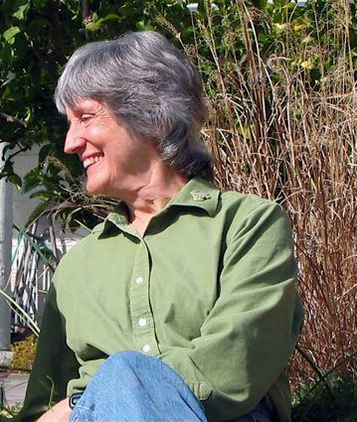
Standpoints & objectivity
Via commons CC-By_SA 3.0
Donna Haraway

Slide 86
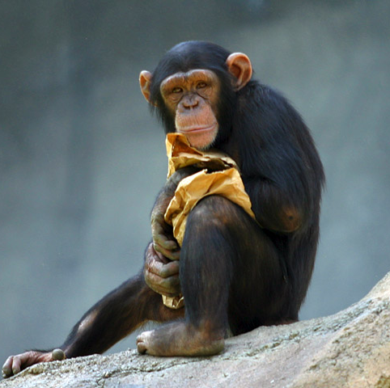
Standpoints & objectivity
Via commons CC-By_SA 3.0
Donna Haraway
Male scientists
Female* scientists

Slide 87
Standpoints & objectivity
Via commons CC-By_SA 3.0
Donna Haraway
Male scientists
Female* scientists

Slide 88
Standpoints & objectivity
Via commons CC-By_SA 3.0
Donna Haraway
Male scientists
Female* scientists

Slide 89
Standpoints & objectivity
Via commons CC-By_SA 3.0
Donna Haraway
Male scientists
Female* scientists

Slide 90
Standpoints & objectivity
Via commons CC-By_SA 3.0
Donna Haraway
reproductive competition
dominance
Male scientists
communication
social grooming
Female* scientists

Slide 91
Standpoints & objectivity
Your standpoint gives you a view of what’s
important & valuable. (comm vs. dominance)

Slide 92
Standpoints & objectivity
Your standpoint gives you a view of what’s
important & valuable. (comm vs. dominance)
An objectivity is what you construct to reify this value. (grooming patterns vs. sex partners)

Slide 93
Standpoints & objectivity
Your standpoint gives you a view of what’s
important & valuable. (comm vs. dominance)
An objectivity is what you construct to reify this value. (grooming patterns vs. sex partners)
Standpoints and objectivities can be merged and extended.

Slide 94
Standpoints & objectivity
Expanded standpoints
Expanded understanding
Via commons CC-By_SA 3.0
Donna Haraway
Multiple objectivities
reproductive competition
dominance
Male scientists
communication
social grooming
Female* scientists

Slide 95
Standpoint
Wikipedia is a firehose
Bad edits must be reverted
Minimize effort wasted on quality control work

Slide 96
Objectivity
Standpoint
Wikipedia is a firehose
Bad edits must be reverted
Minimize effort wasted on quality control work
User:ClueBot NG

Slide 97
Objectivity
Standpoint
Wikipedia is a firehose
Bad edits must be reverted
Minimize effort wasted on quality control work
MASSIVE SUCCESS!
User:ClueBot NG

Slide 98
THE INTERNET
90% reduction in workload
RecentChanges
User:ClueBot NG

Slide 99
Woah woah woah! All the newcomers are leaving!
Suh, B., et al. (2009). The singularity is not near: slowing growth of Wikipedia. WikiSym. ACM.

Slide 100
We forgot to design for socializing newcomers!
Halfaker, A. et al. (2012) The Rise and Decline of an Open Collaboration System. American Behavioral Scientist.
Woah woah woah! All the newcomers are leaving!
Suh, B., et al. (2009). The singularity is not near: slowing growth of Wikipedia. WikiSym. ACM.

Slide 101
Work allocation
Regulation of behavior
Quality control
Community management
Reflection (Adaptation)

Slide 102
Wikipedia is a firehose
Bad edits must be reverted
Minimize effort wasted on quality control work

Slide 103
Wikipedia is a firehose ✓
Bad edits must be reverted
Minimize effort wasted on quality control work

Slide 104
Wikipedia is a firehose ✓
Bad edits must be reverted ✓
Minimize effort wasted on quality control work

Slide 105
Wikipedia is a firehose ✓
Bad edits must be reverted ✓
Minimize effort wasted on quality control work ✓

Slide 106
Wikipedia is a firehose ✓
Bad edits must be reverted ✓
Minimize effort wasted on quality control work ✓
Socialize & train the newcomers!

Slide 107
2012 - 2015 : The conversation incorporates new standpoint
More newcomers -- major Wikimedia Foundation goal
New spaces developed for supporting newcomers
The Coop
The Teahouse

Slide 108
Win?

Slide 110
First, the sugar

Slide 111
Huggle is an amazing piece of software. I have no doubt it represents the state of the art in distributed quality control. This software and its users are responsible for critical work. It’s developers and users are wonderful people. We owe them a lot for their thankless work, so let me take this opportunity to say:
Thank You

Slide 112
Now for the medicine

Slide 113
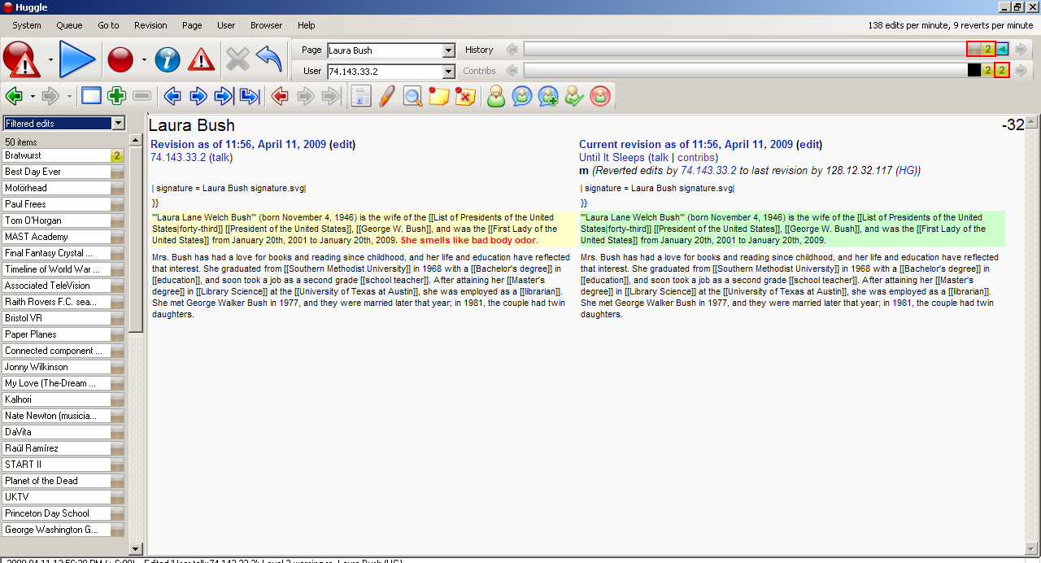
Huggle circa 2009

Slide 114
Huggle circa 2009
Good
Bad

Slide 115
Huggle circa 2009
Good
Bad
Probably bad
Probably less bad

Slide 116
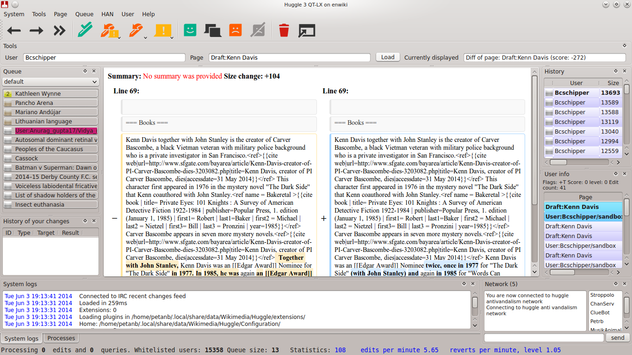
Huggle in 2015

Slide 117
Bad
Huggle 3.0
Good

Slide 118
Bad
Huggle in 2015
Good
Probably bad
Probably less bad

Slide 119
Good
Bad
Welcome!
Probably bad
Probably less bad

Slide 120
Quality control in Wikipedia still not designed with newcomer socialization in mind

Slide 121
Quality control in Wikipedia still not designed with newcomer socialization in mind
Newcomers (especially those who don’t conform) remain marginalized

Slide 122
Quality control in Wikipedia still not designed with newcomer socialization in mind
Newcomers (especially those who don’t conform) remain marginalized
Still not seeing gains in the retention of good-faith newcomers

Slide 123
Why?

Slide 124
Part 3: Infrastructure for socio-technical change

Slide 125
The machine classifier
https://commons.wikimedia.org/wiki/File:Artificial.intelligence.jpg
Public Domain

Slide 126
The machine classifier
is_anon
chrs_added
chrs_removed
cust_comment
repeated_chrs
longest_token
badwords_added

Slide 127
The machine classifier
is_anon
chrs_added
chrs_removed
cust_comment
repeated_chrs
longest_token
badwords_added
?

Slide 128
The machine classifier
Good.
is_anon
chrs_added
chrs_removed
cust_comment
repeated_chrs
longest_token
badwords_added
?
BAD!

Slide 129
The machine classifier
Good.
is_anon
chrs_added
chrs_removed
cust_comment
repeated_chrs
longest_token
badwords_added
?
BAD!
revert!
User:ClueBot NG

Slide 130
The machine classifier
Probably bad
Good.
is_anon
chrs_added
chrs_removed
cust_comment
repeated_chrs
longest_token
badwords_added
?
Probably less bad
BAD!
revert!
User:ClueBot NG

Slide 131
?
?
?
User:ClueBot NG

Slide 132
?
?
?
User:ClueBot NG
Wikipedia is a firehose ✓
Bad edits must be reverted ✓
Minimize effort wasted on quality control work ✓
Socialize & train the newcomers! ✓

Slide 133
?
?
?
User:ClueBot NG
Wikipedia is a firehose ✓
Bad edits must be reverted ✓
Minimize effort wasted on quality control work ✓
Socialize & train the newcomers! ✓
?

Slide 134
?
?
?
User:ClueBot NG
Wikipedia is a firehose ✓
Bad edits must be reverted ✓
Minimize effort wasted on quality control work ✓
Socialize & train the newcomers! ✓
20+ research papers on Wikipedia damage detection
Machine classification not part of standard CS degree
Many wiki-tool devs don’t have a CS degree anyway.
Labor intensive, performance considerations, etc.
?

Slide 135
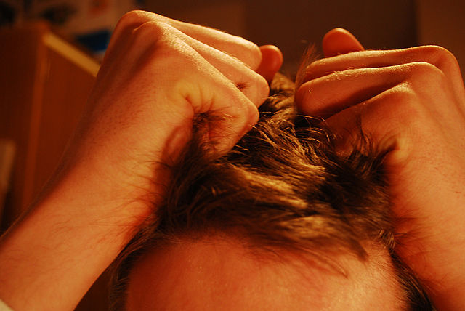
?
?
?
User:ClueBot NG
Wikipedia is a firehose ✓
Bad edits must be reverted ✓
Minimize effort wasted on quality control work ✓
Socialize & train the newcomers! ✓
20+ research papers on Wikipedia damage detection
Machine classification not part of standard CS degree
Many wiki-tool devs don’t have a CS degree anyway.
Labor intensive, performance considerations, etc.
?

Slide 136
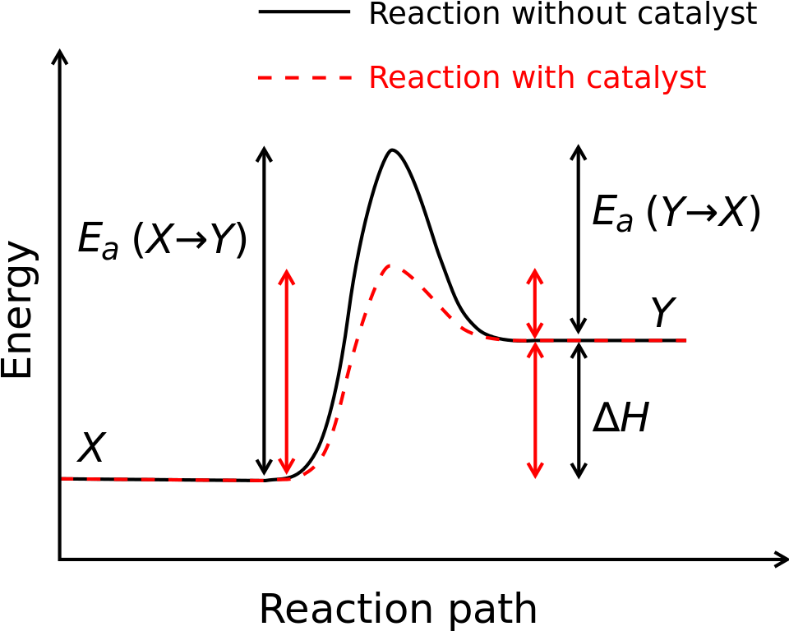

Slide 137
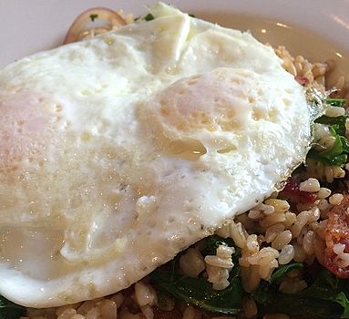
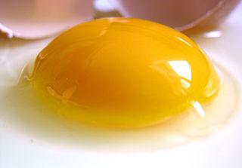
149F

Slide 138
72F

Slide 139
Building
a machine
learning
models
User:ClueBot NG
Better quality control & socialization
Energy
Progress ----->

Slide 140
Progress catalyst
User:ClueBot NG
Better quality control & socialization
Energy
Progress ----->

Slide 141
Revision scoring as a service!
?
?
?
User:ClueBot NG

Slide 142
Revision scoring as a service!
User:ClueBot NG
?

Slide 143
Revision scoring as a service!
Host Bot
User:ClueBot NG
?

Slide 144
Revision scoring as a service!
Host Bot
User:ClueBot NG
?

Slide 145
http://ores.wmflabs.org/scores/enwiki/damaging/638307884

Slide 146
http://ores.wmflabs.org/scores/enwiki/damaging/638307884
“English Wikipedia”

Slide 147
http://ores.wmflabs.org/scores/enwiki/damaging/638307884
Is this edit damaging?

Slide 148
http://ores.wmflabs.org/scores/enwiki/damaging/638307884

Slide 149
http://ores.wmflabs.org/scores/enwiki/damaging/638307884

Slide 150
http://ores.wmflabs.org/scores/enwiki/damaging/638307884
"638307884": { "prediction": false, "probability": { "false": 0.942, "true": 0.058
} }

Slide 151
http://ores.wmflabs.org/scores/enwiki/damaging/638307884
"638307884": { "prediction": false, "probability": { "false": 0.942, "true": 0.058
} }
http://ores.wmflabs.org/scores/enwiki/damaging/642215410

Slide 152
http://ores.wmflabs.org/scores/enwiki/damaging/638307884
"638307884": { "prediction": false, "probability": { "false": 0.942, "true": 0.058
} }
http://ores.wmflabs.org/scores/enwiki/damaging/642215410
"642215410": { "prediction": true, "probability": { "false": 0.080, "true": 0.920 } }

Slide 153
Fast (median delay 0.1 seconds)
Scale-able & redundant
Comparable to the state-of-the-art
Good for research too! Talk to me about that!

Slide 154
~20,000 lines of code +
1 advanced degree in Computer Science
User:ClueBot NG
Better quality control
Energy
Connect to ORES via HTTP
Progress ----->

Slide 155
~20,000 lines of code +
1 advanced degree in Computer Science
User:ClueBot NG
Energy
Connect to ORES via HTTP
Progress ----->

Slide 156
~20,000 lines of code +
1 advanced degree in Computer Science
User:ClueBot NG
Energy
Connect to ORES via HTTP
Progress ----->

Slide 157
Part 3.5: Feminist inspiration
Critique → Design

Slide 158
“Subjective Algorithms”

Slide 159
"algorithms, often aided by big data, now make decisions in subjective realms where there is no right decision, and no anchor with which to judge outcomes."
Tufekci, Z. (2015). Algorithms in our Midst: Information, Power and Choice when Software is Everywhere. CSCW (pp. 1918-1918). ACM.

Slide 160
"algorithms, often aided by big data, now make decisions in subjective realms where there is no right decision, and no anchor with which to judge outcomes."
Tufekci, Z. (2015). Algorithms in our Midst: Information, Power and Choice when Software is Everywhere. CSCW (pp. 1918-1918). ACM.
What is good? relevant? important? desirable? valuable?

Slide 161
Good.
is_anon
chrs_added
chrs_removed
cust_comment
repeated_chrs
longest_token
badwords_added
?
BAD!

Slide 162
Good.
and some important bad stuff
is_anon
chrs_added
chrs_removed
cust_comment
repeated_chrs
longest_token
badwords_added
?
BAD!
and some important good stuff

Slide 163
Please exercise extreme caution to avoid encoding racism or other biases into an AI scheme. For example, there are some editors who have a major bias against having articles on every village in Pakistan, even though we have articles on every village in the U.S. Any trace of the local writing style, like saying "beautiful village", or naming prominent local families, becomes the object of ridicule for these people. Others can object to that, however. But AI (especially neural networks, but any little-studied code really) offers the last bastion of privacy. It's a place for making decisions and never mind anybody how that decision was decided. My feeling is that editors should keep a healthy skepticism - this was a project meant to be written, and reviewed, by people. Wnt (talk) 12:58, 20 February 2015 (UTC)
From Wikipedia:Wikipedia_Signpost/2015-02-18/Special_report

Slide 164
Please exercise extreme caution to avoid encoding racism or other biases into an AI scheme. For example, there are some editors who have a major bias against having articles on every village in Pakistan, even though we have articles on every village in the U.S. Any trace of the local writing style, like saying "beautiful village", or naming prominent local families, becomes the object of ridicule for these people. Others can object to that, however. But AI (especially neural networks, but any little-studied code really) offers the last bastion of privacy. It's a place for making decisions and never mind anybody how that decision was decided. My feeling is that editors should keep a healthy skepticism - this was a project meant to be written, and reviewed, by people. Wnt (talk) 12:58, 20 February 2015 (UTC)
From Wikipedia:Wikipedia_Signpost/2015-02-18/Special_report
Reverted/Not reverted

Slide 165
Please exercise extreme caution to avoid encoding racism or other biases into an AI scheme. For example, there are some editors who have a major bias against having articles on every village in Pakistan, even though we have articles on every village in the U.S. Any trace of the local writing style, like saying "beautiful village", or naming prominent local families, becomes the object of ridicule for these people. Others can object to that, however. But AI (especially neural networks, but any little-studied code really) offers the last bastion of privacy. It's a place for making decisions and never mind anybody how that decision was decided. My feeling is that editors should keep a healthy skepticism - this was a project meant to be written, and reviewed, by people. Wnt (talk) 12:58, 20 February 2015 (UTC)
From Wikipedia:Wikipedia_Signpost/2015-02-18/Special_report
Reverted/Not reverted
“beautiful village”

Slide 166
Please exercise extreme caution to avoid encoding racism or other biases into an AI scheme. For example, there are some editors who have a major bias against having articles on every village in Pakistan, even though we have articles on every village in the U.S. Any trace of the local writing style, like saying "beautiful village", or naming prominent local families, becomes the object of ridicule for these people. Others can object to that, however. But AI (especially neural networks, but any little-studied code really) offers the last bastion of privacy. It's a place for making decisions and never mind anybody how that decision was decided. My feeling is that editors should keep a healthy skepticism - this was a project meant to be written, and reviewed, by people. Wnt (talk) 12:58, 20 February 2015 (UTC)
From Wikipedia:Wikipedia_Signpost/2015-02-18/Special_report
Reverted/Not reverted
“beautiful village”
BAD!
and edits to Pakistan Villages

Slide 167
“Feedback”
Reverted/Not reverted
“beautiful village”
BAD!
and edits to Pakistan Villages

Slide 168
“Feedback”
Reverted/Not reverted
“beautiful village”
Pakistan Villages

Slide 169
Empowerment vs. Power over

Slide 170
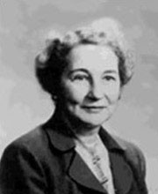
Empowerment vs. Power over
“hearing to speech”
vs.
“speaking to be heard”
Nelle Morton

Slide 171
“hearing to speech” -- I want to hear what you have to say, so I’ll make space for you to speak and listen.
“speaking to be heard” -- I want to set the tone of our conversation by talking first.

Slide 172
“Conversations” about advanced wiki-tools
Software engineer work (~4 years)
PhD in Computer Science
Background:
Psychology
Social science
Systems theory
HCI/Design practices
Wikimedia Foundation Staff

Slide 173
Opening up the “conversation” about quality control
Energy
Connect to ORES via HTTP
Progress ----->

Slide 174
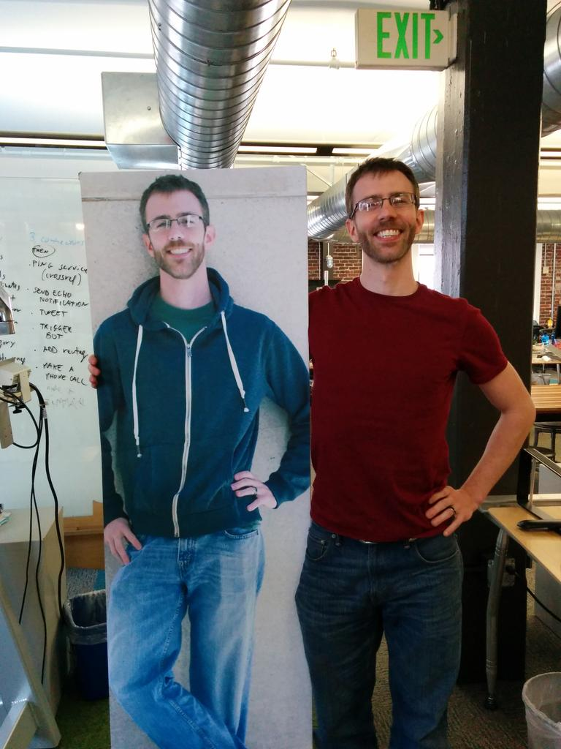
I think we should talk about quality control and socialization.

Slide 175
I think we should talk about quality control and socialization.
I think we should talk about <something else>.

Slide 176
<Something else>

Slide 177
<Something else>
<Something else>

Slide 179
Feedback
Manually re-labeling damage protects against feedback loops

Slide 180
Feedback
Manually re-labeling damage protects against feedback loops
Hearing to speech
Open, configurable
labeling system is useful for other projects.

Slide 181
HotCat
User:ClueBot NG

Slide 182
vandals
HostBot
good-faith
https://commons.wikimedia.org/wiki/File:Flickr_-_Official_U.S._Navy_Imagery_-_Sailor%27s_daughter_operates_a_fire_hose_with_crew_member_assistance..jpg
6,000 newcomers per day
User:ClueBot NG

Slide 183
vandals
Host Bot
HostBot
good-faith
https://commons.wikimedia.org/wiki/File:Flickr_-_Official_U.S._Navy_Imagery_-_Sailor%27s_daughter_operates_a_fire_hose_with_crew_member_assistance..jpg
6,000 newcomers per day
User:ClueBot NG

Slide 184
Wikipedia as a socio-technical system
Systems-thinking & Biological metaphors
~

Slide 185
Wikipedia as a socio-technical system
Systems-thinking & Biological metaphors
Critique of algorithmic quality control
Standpoint epistemology
Encoding of ideology in technology
~

Slide 186
Wikipedia as a socio-technical system
Systems-thinking & Biological metaphors
Critique of algorithmic quality control
Standpoint epistemology
Encoding of ideology in technology
Infrastructure for socio-technical change
“progress catalyst”
Hearing to speech vs. Speaking to be heard
The dangers of “subjective algorithms”
~

Slide 187
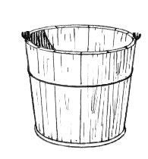
Thanks!
Props to my collaborators
User:Staeiou
User:He7d3r
User:とある白い猫
User:Awight
User:YuviPanda
User:Ladsgroup
User:Danilo.mac
User:Jtmorgan
User:Aetilley
User:Riedl
SCIENCE
SCIENCE
SCIENCE
SCIENCE
SCIENCE
SCIENCE
SCIENCE
Aaron Halfaker
ahalfaker@wikimedia.org
enwp.org/User:EpochFail
https://twitter.com/halfak

Slide 188
Communities as living, adaptive systems
Algorithms in social spaces
Empowerment as technological intervention
Machine learning support for collaborative work

