Slide 1




Transforming
Scholarly Communication
Lee Dirks
Director, Education
& Scholarly Communication
Microsoft External Research

Slide 2
Themes
Data tidal wave
Moving upstream
Integration into existing tools / workflows
Enabling semantic computing
Provision of services
  Data analysis
  Collaboration
  Preservation & Provenance
The potential for cloud services
The role of software

Slide 3
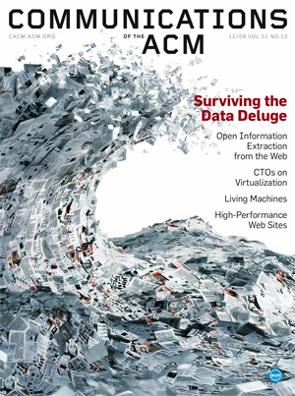
Data Tidal Wave

Slide 4

A Sea Change in Computing
Massive Data Sets
Federation, Integration &
Collaboration
There will be more scientific
data generated in the next
five years than in the history of
humankind
Evolution of
Many-core & Multicore
Parallelism everywhere
What will you do with
100 times more
computing power?
The power of the
Client + Cloud
Access Anywhere, Any Time
Distributed, loosely-coupled,
applications at scale across
all devices will be the norm
Notes:
THE DATA DELUGE. There will be more scientific data collected in the next five years than there has been in the history of human kind.
Data aggregation, filtering, analysis, visualization, etc. is empowering science. Multidisciplinary approaches to science, with computing as a core enabler, is imperative.
SOCIAL COMPUTING FOR SCIENTIFIC DISCOVERY. Collaboration and integration of data sets has never been more important.
All disciplines are amassing huge data sets. We need to move form data to knowledge. In order to do so, infrastructures and computing tools that allow researchers to collaborate and explore common data is crucial.
Advances in science and computing occurs through communities working as a team with massive aggregated data; not as individuals with a narrow view of their own data. It is as much about sociology as is it technological.
CONCRRENCY, COMPLEXITY, COMPOSIBILITY. There is a fundamental need to change the way we program computers. Many core / multi-core computing requires exploration of “Concurrency, Complexity, and Composibility”
Concurrency and complexity are the challenge; ‘composibility’ can be the solution.
Formal composition is required for components to plug together.
CLOUD + CLIENT. As computing chip power advances for both the servers and the client, applications need to take advantage of the integrated, balance of the capabilities. What will you do with 100 times more computing power? What are the new class of applications that will take advantage of the capabilities of Cloud + Client?
Developing for distributed, concurrent systems is the norm. The power is in Cloud + Client.
Highly distributed computing at any scale across all devices

Slide 5
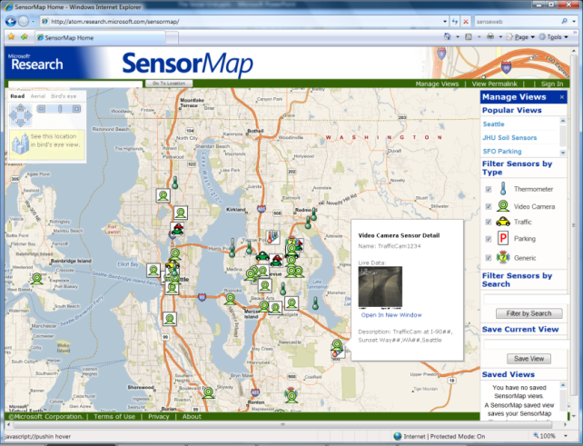
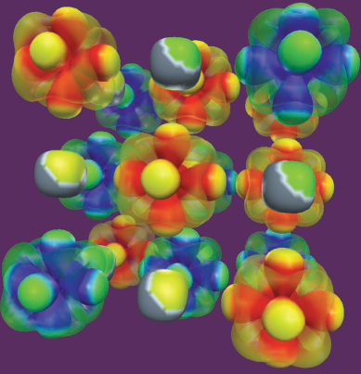
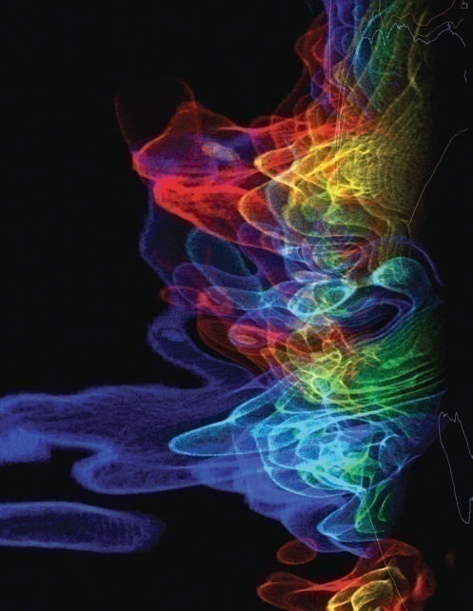
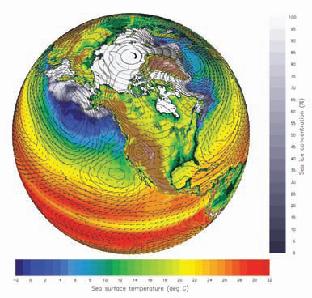
eResearch: data everywhere
Data collection
  Sensor networks, global databases, local databases, desktop computer, laboratory instruments, observation devices, etc.
Data processing, analysis, visualization
  Legacy codes, workflows, data mining, indexing, searching, graphics, screens, etc.
Archiving
  Digital repositories, libraries, preservation, etc.
SensorMap
  Functionality: Map navigation
  Data: sensor-generated temperature, video camera feed, traffic feeds, etc.
Scientific visualizations
  NSF Cyberinfrastructure report, March 2007

Slide 6
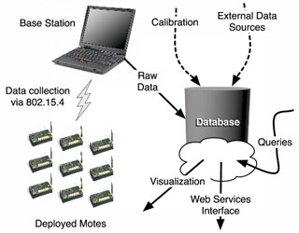
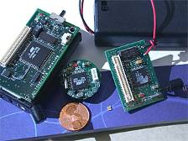
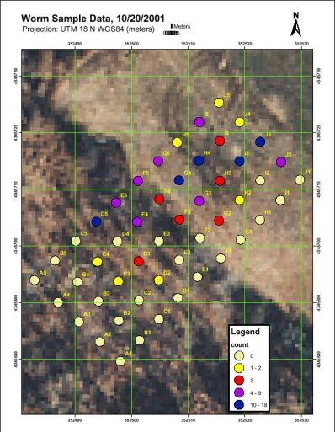
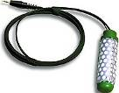
Wireless Sensor Networks
Uses 200 wireless (Intel) computers,
with 10 sensors each, monitoring
    Air temperature, moisture
    Soil temperature, moisture,
    at least in two depths (5cm, 20 cm)
    Light (intensity, composition)
    Soon gases (CO2, O2, CH4, …)
Long-term continuous data
Small (hidden) and affordable (many)
Less disturbance
>200 million measurements/year
Complex database of sensor data and samples
With K. Szlavecz and A. Terzis at Johns Hopkins
http://lifeunderyourfeet.org

Slide 7
Joe Hellerstein—UC Berkeley
Blog: “The Commoditization of Massive Data Analysis”
We’re not even to the Industrial Revolution of Data yet…
  “…since most of the digital information available today is still individually "handmade": prose on web pages, data entered into forms, videos and music edited and uploaded to servers. But we are starting to see the rise of automatic data generation "factories" such as software logs, UPC scanners, RFID, GPS transceivers, video and audio feeds. These automated processes can stamp out data at volumes that will quickly dwarf the collective productivity of content authors worldwide. Meanwhile, disk capacities are growing exponentially, so the cost of archiving this data remains modest. And there are plenty of reasons to believe that this data has value in a wide variety of settings. The last step of the revolution is the commoditization of data analysis software, to serve a broad class of users.”
How this will interact with the push toward data-centric web services and cloud computing?
  Will users stage massive datasets of proprietary information within the cloud?
  How will they get petabytes of data shipped and installed at a hosting facility?
  Given the number of computers required for massive-scale analytics, what kinds of access will service providers be able to economically offer?

Slide 8
The Problem for the eScientist / eResearcher
Experiments &
Instruments
facts
facts
?
questions
Other Archives
facts
answers
Literature
facts
Simulations
Data ingest
Managing petabytes+
Common schema(s)
How to organize?
How to re-organize?
How to coexist & cooperate with other scientists and researchers?
Data query and visualization tools
Support/training
Performance
  Execute queries in a minute
  Batch (big) query scheduling

Slide 9
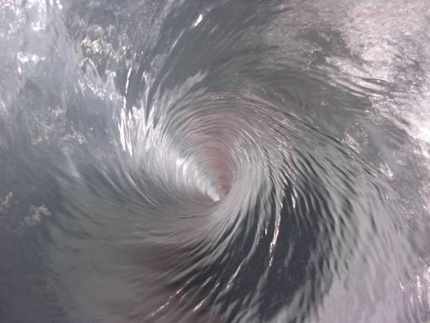

Slide 10
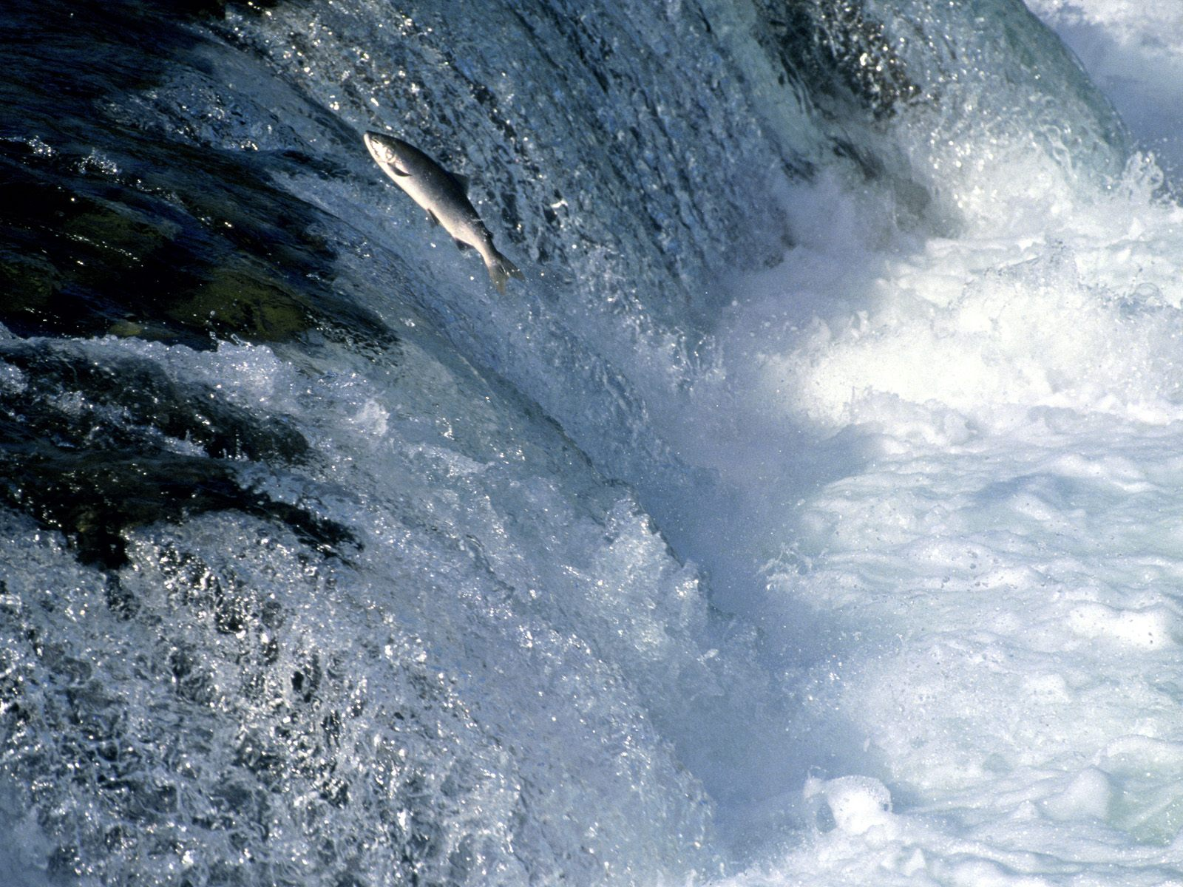
Moving Upstream

Slide 11
The Scholarly Communication Lifecycle
Collaboration
Data Collection, Research & Analysis
Publication & Dissemination
Storage, Archiving & Preservation
Authoring
Discoverability

Slide 12

Integration

Slide 13
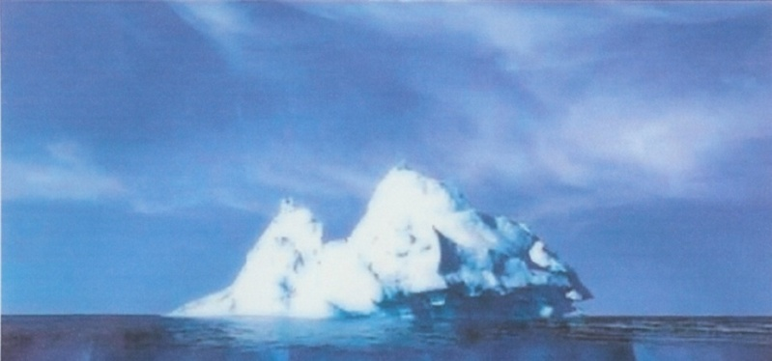
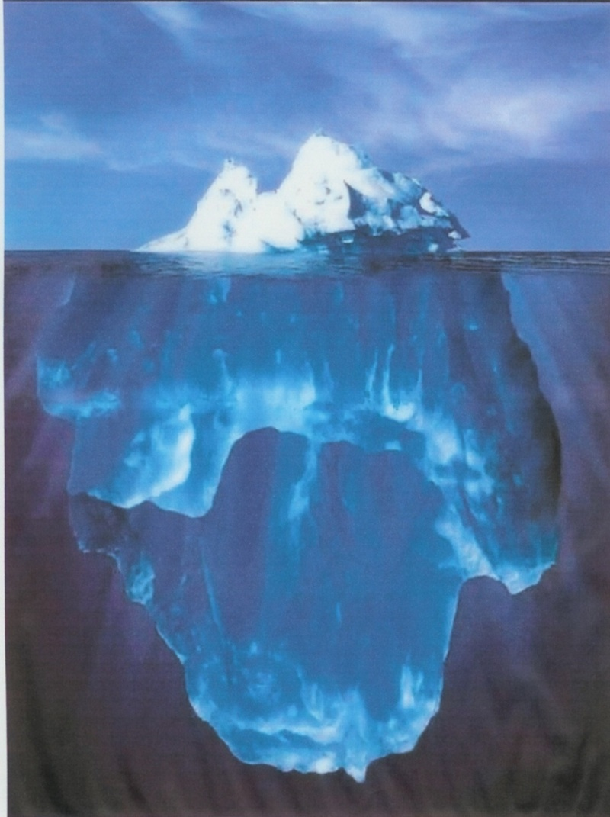
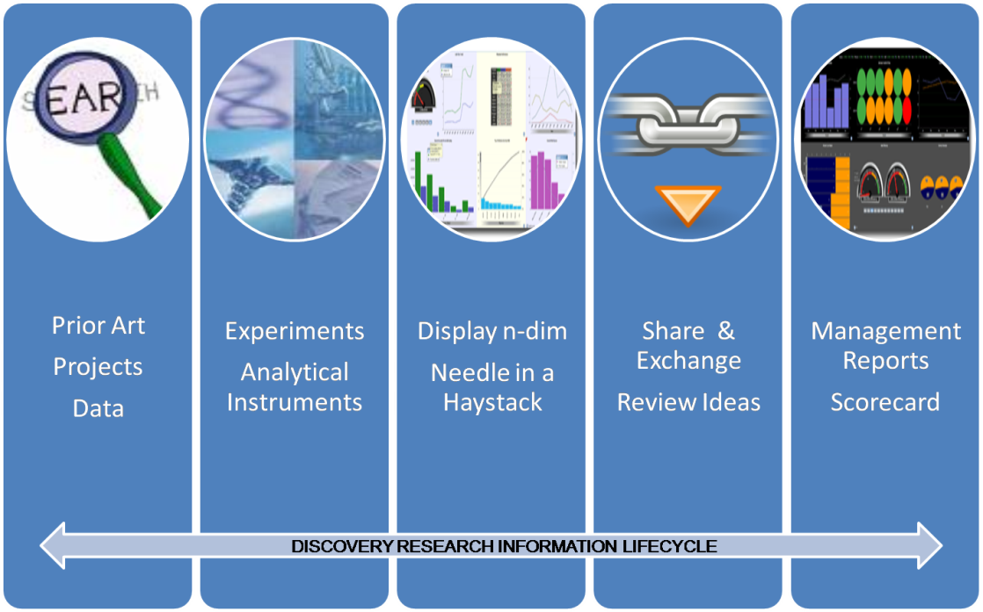
Facilitating the move from static summaries to rich information vehicles
Pace of science is picking up…rapidly
The status quo is being challenged and researchers are demanding more
Why can’t a research report offer more …

Slide 14

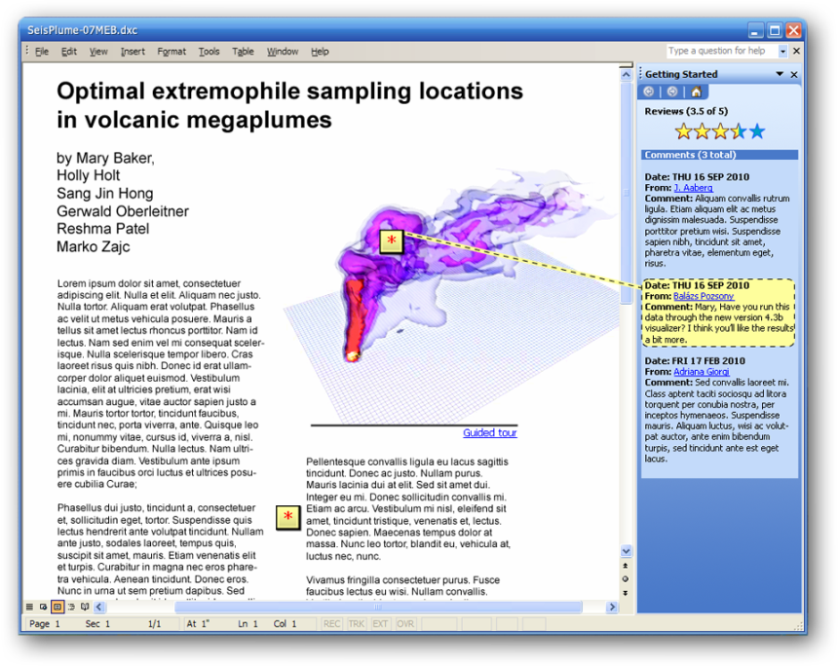


Envisioning a New Era of Research Reporting
Imagine…
Live research reports that had multiple end-user ‘views’ and which could dynamically tailor their presentation to each user
An authoring environment that absorbs and encapsulates research workflows and outputs from the lab experiments
A report that can be dropped into an electronic lab workbench in order to reconstitute an entire experiment
A researcher working with multiple reports on a Surface and having the ability to mash up data and workflows across experiments
The ability to apply new analyses and visualizations and to perform new in silico experiments
Reproducible
Research
Interactive
Data
Collaboration
Dynamic
Documents
Reputation
& Influence

Slide 15





Recent developments of interest
Elsevier's Article of the Future Competition
Grand Challenge & Article of the Future contest -- ongoing collaboration between Elsevier and the scientific community to redefine how a scientific article is presented online.
PLoS Currents: Influenza
In conjunction with NIH & Google Knol – a rapid research note service, enable this exchange by providing an open-access online resource for immediate, open communication and discussion of new scientific data, analyses, and ideas in the field of influenza. All content is moderated by an expert group of influenza researchers, but in the interest of timeliness, does not undergo in-depth peer review.
Nature Preceedings
Connects thousands of researchers and provides a platform for sharing new and preliminary findings with colleagues on a global scale – via pre-print manuscripts, posters and presentations. Claim priority and receive feedback on your findings prior to formal publication.
Google Wave
Concurrent rich-text editing; Real-time collaboration; Natural language tools; Extensions with APIs
Mendeley (and Papers)
Called “iTunes” for academic papers; around 60,000 people have already signed up and a staggering 4m scientific papers have been uploaded, doubling every 10 weeks

Slide 16
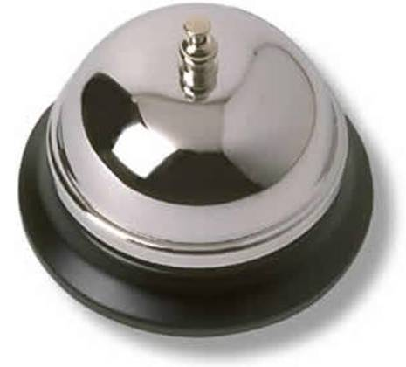
Services

Slide 17
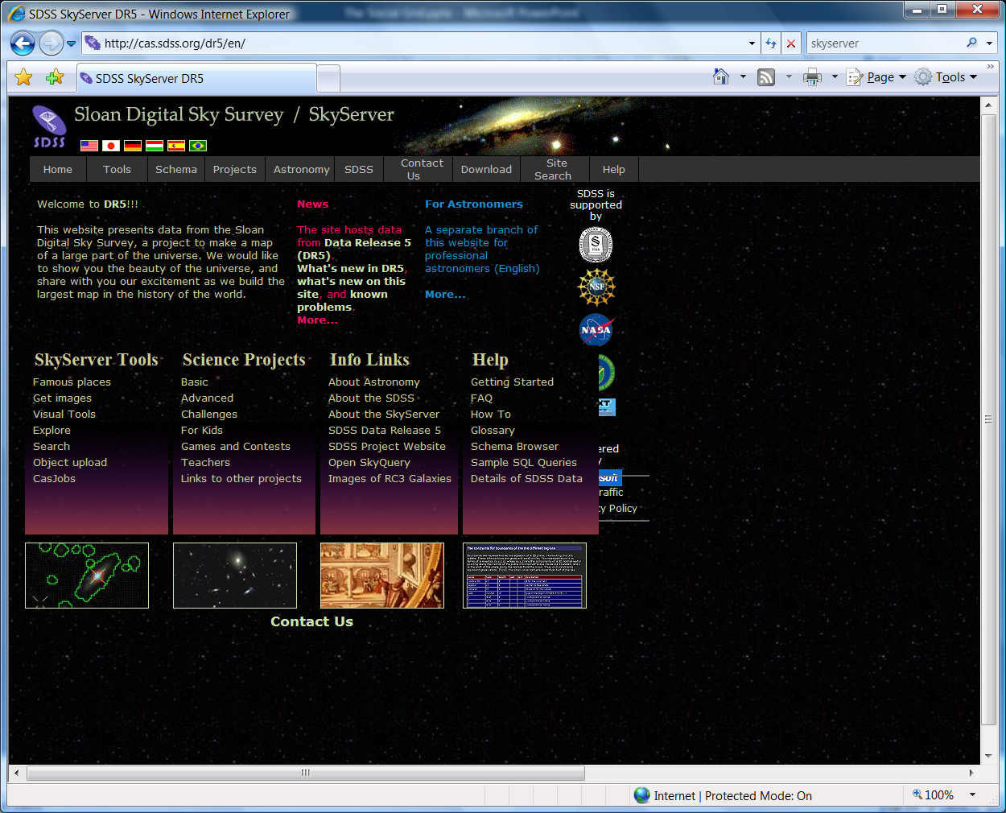
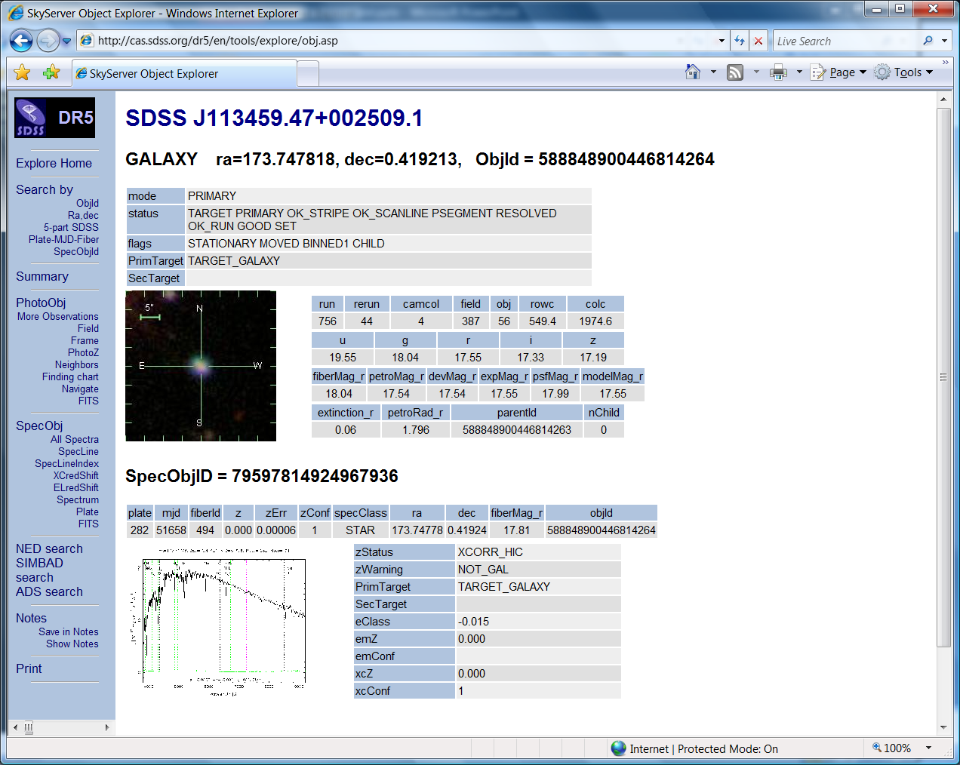
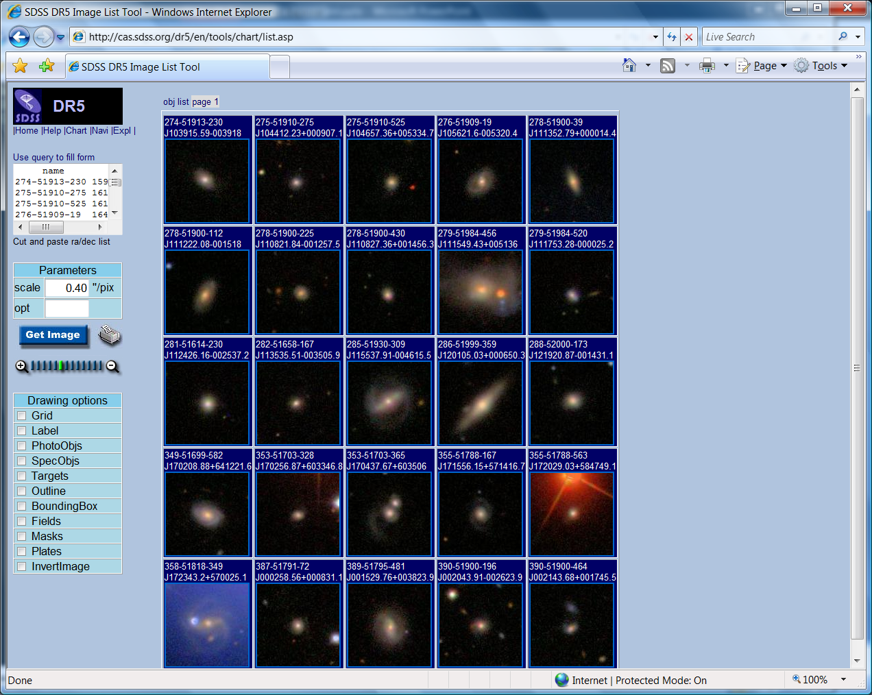
eResearch: data is easily shareable
Sloan Digital Sky Server/SkyServer
http://cas.sdss.org/dr5/en/

Slide 18
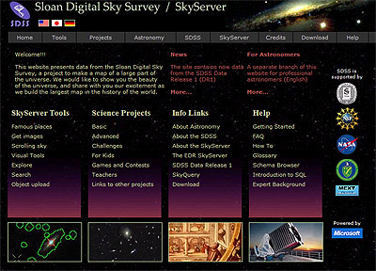
SkyServer
Sloan Digital Sky Survey: Pixels + Objects
About 500 attributes per “object”, 300M objects
Spectra for 1M objects
Currently 3TB+ fully public
From 13 institutions (nodes)
Prototype eScience lab
  Moving analysis to the data
  Fast searches: color, spatial
Visual tools
  Join pixels with objects
  http://skyserver.sdss.org/
  http://www.skyquery.net/

Slide 19
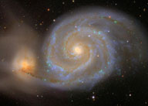
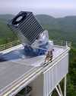
Public use of the SkyServer
Prototype in data publishing
  350 million web hits in 6 years
  930,000 distinct users
  vs. 10,000 astronomers
  Delivered 50,000 hours
  of lectures to high schools
  Delivered 100B rows of data
GalaxyZoo.org
  27 million visual galaxy classifications by the public
  Enormous publicity (CNN, Times, Washington Post, BBC)
  100,000 people participating, blogs, etc…

Slide 20
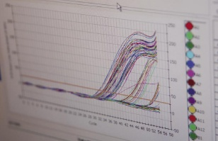
Concerns with Data Sharing
Data integration / interoperability
  Linking together data from various sources
Annotation
  Adding comments/observations to existing data
Provenance (and quality)
  ‘Where did this data come from?’
Exporting/publishing in agreed formats
  To other programs, as well as people
Security
  Specifying or enforcing read/write access to your data (or parts of your data)

Slide 21




Existing Sharing + Analysis Services
Swivel
IBM’s “Many Eyes”
Google’s “Gapminder”
Metaweb’s “Freebase”
And others…
  CSA’s “Illustrata”

Slide 22
Shifting Models
Publishing ecosystem shifts
  Adding value with services
  Model? IBM and Redhat for open source
  Enables rapid prototyping of new products/services
Repositories will contain
  Full text versions of research papers
  ‘Grey’ literature such as technical reports and theses
  Real-time streaming data, images and software
Assuming various flavors of repository software, enhanced interoperability protocols are necessary

Slide 23

http://www.data.gov/
The purpose of Data.gov is to increase public access to high value, machine readable datasets generated by the Executive Branch of the Federal Government. Although the initial launch of Data.gov provides a limited portion of the rich variety of Federal datasets presently available, we invite you to actively participate in shaping the future of Data.gov by suggesting additional datasets and site enhancements to provide seamless access and use of your Federal data.
Data.gov includes a searchable data catalog that includes access to data in two ways: through the "raw" data catalog and using tools.

Slide 24

WorldWideScience.org is a global science gateway connecting you to national and international scientific databases and portals. WorldWideScience.org accelerates scientific discovery and progress by providing one-stop searching of global science sources. The WorldWideScience Alliance, a multilateral partnership, consists of participating member countries and provides the governance structure for WorldWideScience.org.
WorldWideScience.org was developed and is maintained by the Office of Scientific and Technical Information (OSTI), an element of the Office of Science within the U.S. Department of Energy. Please contact webmaster@worldwidescience.org if you represent a national or international science database or portal and would like your source searched by WorldWideScience.org.

Slide 25
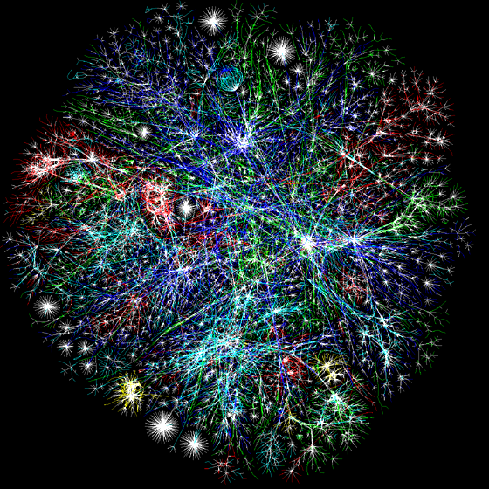
Enabling
Semantic Computing

Slide 26
From Cameron Neylon’s “Science in the Open” Blog:
The integrated lab record - or the web native lab notebook
What we are left with is the links themselves, arranged along a timeline. The laboratory record is reduced to a feed which describes the relationships between samples, procedures, and data. This could be a simple feed containing links or a sophisticated and rich XML feed which points out in turn to one or more formal vocabularies to describe the semantic relationship between items. It can all be wired together, some parts less tightly coupled than others, but in principle it can at least be connected. And that takes us one significant step towards wiring up the data web that many of us dream of the beauty of this approach is that it doesn’t require users to shift from the applications and services that they are already using, like, and understand. What it does require is intelligent and specific repositories for the objects they generate that know enough about the object type to provide useful information and context. What it also requires is good plug-ins, applications, and services to help people generate the lab record feed. It also requires a minimal and arbitrarily extensible way of describing the relationships. This could be as simple html links with tagging of the objects (once you know an object is a sample and it is linked to a procedure you know a lot about what is going on) but there is a logic in having a minimal vocabulary that describes relationships (what you don’t know explicitly in the tagging version is whether the sample is an input or an output). But it can also be fully semantic if that is what people want. And while the loosely tagged material won’t be easily and tightly coupled to the fully semantic material the connections will at least be there. A combination of both is not perfect, but it’s a step on the way towards the global data graph.

Slide 27
“Semantics-based computing” vs. “Semantic web”
There is a distinction between the general approach of computing based on semantic technologies (e.g. machine learning, neural networks, ontologies, inference, etc.) and the semantic web – used to refer to a specific ecosystem of technologies, like RDF and OWL
The semantic web is just one of the many tools at our disposal when building semantics-based solutions

Slide 28
Towards a smart cyberinfrastructure?
Leveraging Collective Intelligence
  If last.fm can recommend what song to broadcast to me based on what my friends are listening to, the cyberinfrastructure of the future should recommend articles of potential interest based on what the experts in the field that I respect are reading?
  Examples are emerging but the process is presently more manual – e.g. Connotea, BioMedCentral’s Faculty of 1000, etc.
Semantic Computing
  Automatic correlation of scientific data
  Smart composition of services and functionality
Leverage cloud computing to aggregate, process, analyze and visualize data

Slide 29
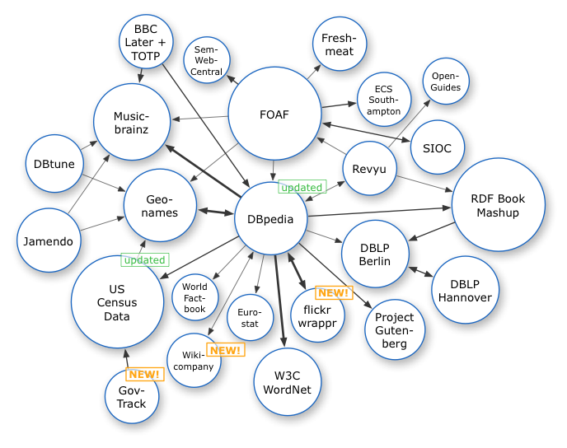
A world where all data is linked…
Data/information is inter-connected through machine-interpretable information (e.g. paper X is about star Y)
Social networks are a special case of ‘data networks’
Important/key considerations
  Formats or “well-known” representations of data/information
  Pervasive access protocols are key (e.g. HTTP)
  Data/information is uniquely identified (e.g. URIs)
  Links/associations between data/information
Attribution: Richard Cyganiak; http://linkeddata.org/

Slide 30




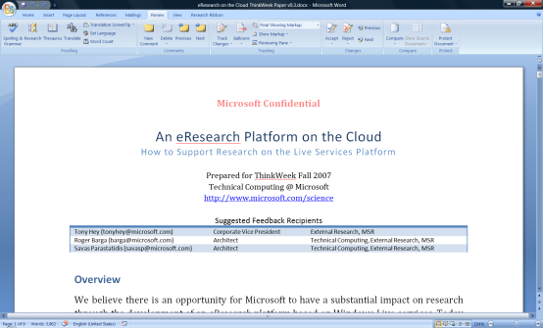

…and stored/processed/analyzed in the cloud
visualization and analysis services
Vision of Future Research
Environment with both
Software + Services
scholarly communications
domain-specific services
search
books
citations
blogs &
social networking
Reference management
instant messaging
Project management
identity
mail
notification
document store
storage/data services
The Microsoft Technical Computing mission to reduce time to scientific insights is exemplified by the June 13, 2007 release of a set of four free software tools designed to advance AIDS vaccine research. The code for the tools is available now via CodePlex, an online portal created by Microsoft in 2006 to foster collaborative software development projects and host shared source code. Microsoft researchers hope that the tools will help the worldwide scientific community take new strides toward an AIDS vaccine. See more.
knowledge management
compute
services
virtualization
knowledge discovery

Slide 31
Types of Cloud Computing
Utility computing [infrastructure]
  Amazon's success in providing virtual machine instances, storage, and computation at pay-as-you-go utility pricing was the breakthrough in this category, and now everyone wants to play. Developers, not end-users, are the target of this kind of cloud computing. [No network effects]
Platform as a Service [platform]
  One step up from pure utility computing are platforms like Google AppEngine and Salesforce's force.com, which hide machine instances behind higher-level APIs. Porting an application from one of these platforms to another is more like porting from Mac to Windows than from one Linux distribution to another.
End-user applications [software]
  Any web application is a cloud application in the sense that it resides in the cloud. Google, Amazon, Facebook, twitter, flickr, and virtually every other Web 2.0 application is a cloud application in this sense.
From: Tim O'Reilly, O'Reilly Radar (10/26/08)—”Web 2.0 and Cloud Computing”

Slide 32
The Rationale for Cloud Computing in eResearch
We can expect research environments will follow similar trends to the commercial sector
  Leverage computing and data storage in the cloud
  Small organizations need access to large scale resources
  Scientists already experimenting with Amazon S3 and EC2 services
For many of the same reasons
  Small, silo’ed research teams
  Little/no resource-sharing across labs
  High storage costs
  Physical space limitations
  Low resource utilization
  Excess capacity
  High costs of acquiring, operating and reliably maintaining machines is prohibitive
  Little support for developers, system operators

Slide 33
Cloud Landscape Still Developing
Tools are available
  Flickr, SmugMug, and many others for photos
  YouTube, SciVee, Viddler, Bioscreencast for video
  Slideshare for presentations
  Google Docs for word processing and spreadsheets
Data Hosting Services & Compute Services
  Amazon’s S3 and EC2 offerings
Archiving / Preservation
  “DuraCloud” Project (in planning by DuraSpace organization)
Developing business models
  Service-provision (sustainability)
  NSF’s “DataNet” – developing a culture, new organizations

Slide 34

Preservation
& Provenance

Slide 35
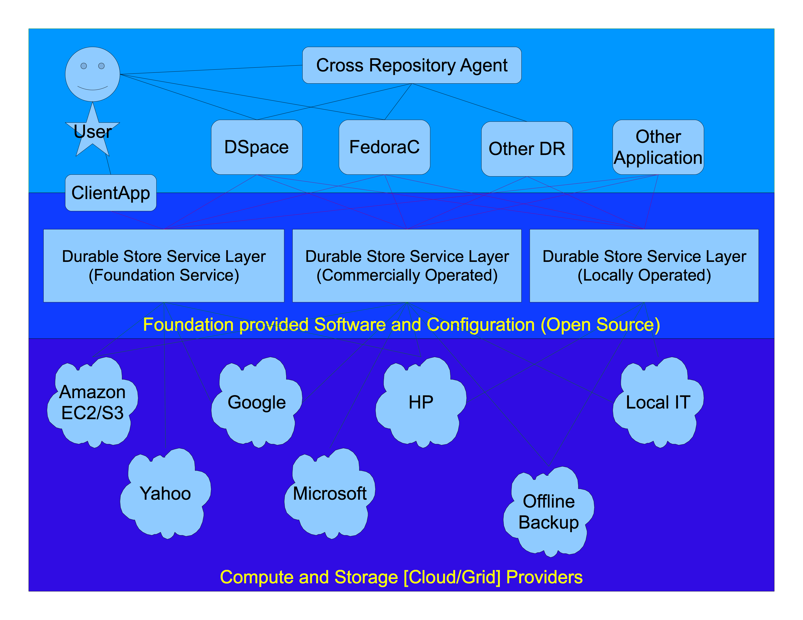
Courtesy: DuraCloud

Slide 36
John Wilbanks on “Cyberinfrastructure”
From the Science Commons blog…
There is a network that we can use for sharing scientific data: the Internet. What’s missing here is infrastructure — but not in the purely technical sense. We need more than computers, software, routers and fiber to share scientific information more efficiently; we need a legal and policy infrastructure that supports (and better yet, rewards) sharing. We use the term “cyberinfrastructure” — and more often, “collaborative infrastructure” — in this broader sense. Elements of an infrastructure can include everything from software and web protocols to licensing regimes and development policies.
Science Commons is working to facilitate the emergence of an open, decentralized infrastructure designed to foster knowledge re-use and discovery — one that can be implemented in a way that respects the autonomy of each collaborator. We believe that this approach holds the most promise as we continue the transition from a world where scientific research is carried out by large teams with supercomputers to a world where small teams — perhaps even individuals — can effectively use the network to find, analyze and build on one another’s data. ...

Slide 37

Software (alone) is not the answer.

Slide 38
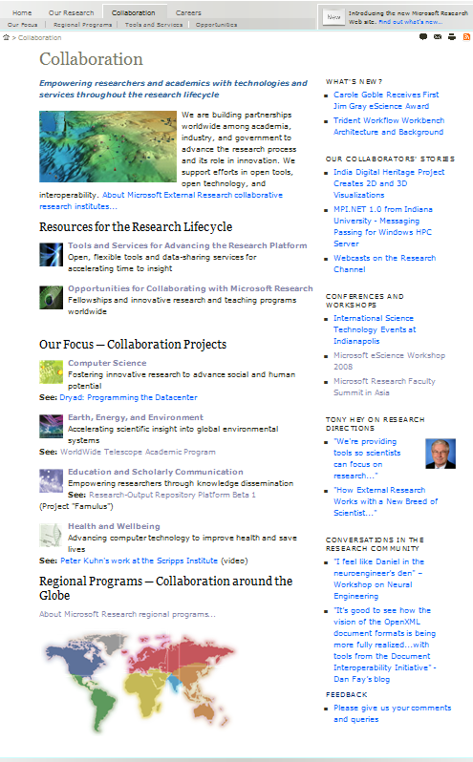
Information and Resources
http://research.microsoft.com/
This site contains information about and access to downloads of relevant tools and resources for the worldwide academic research community.

Slide 39

Questions?
Lee Dirks
Director—Education & Scholarly Communication
Microsoft External Research
ldirks@microsoft.com
URL – http://www.microsoft.com/scholarlycomm/

