Slide 1
Beyond Participation
Civic Engagement Through an Online Game
Eric Gordon, egordon@cyber.law.harvard.edu

Slide 2
Establishing the Problem
Few clear pathways to interface with government
Platforms for interaction and feedback tend to be poorly designed
Public feedback is conflated with civic engagement
Notes:
Few clear pathways to interface with government – the town hall meeting has played an important role in American democracy, but has become something of a hindrance as public participation is imagined in new social and media contexts.
Platforms for interaction have received little design attention because of the burden of the status quo. There is a need to understand social dynamics within local political contexts and design for and around them.
Public feedback is conflated with civic engagement– many government agencies focus on getting feedback from communities as an activity distinct from cultivating engaged communities. Whereas it is important to understand the correlation between quality of feedback and less quantifiable indicators such as collective efficacy and social trust.

Slide 3
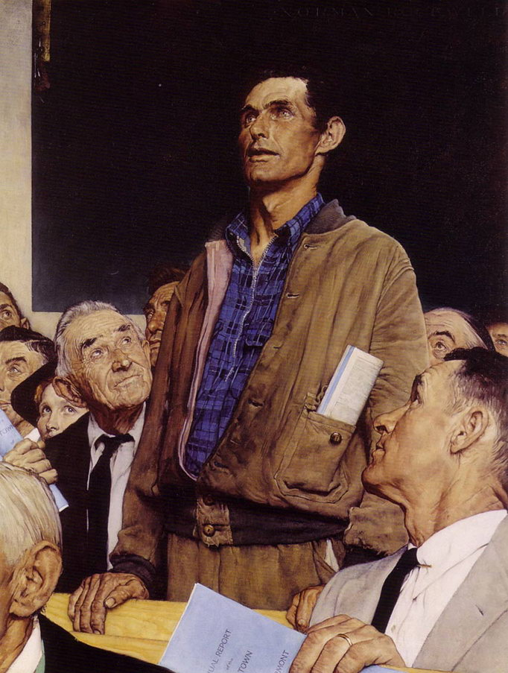
Focus on participation
Participation is a numbers game. To satisfy a mandate, city or state agencies attempt to “touch” a certain amount of people.
The focus is on “efficiency of reach” within an established context of public participation
Getting feedback from the public
Local capacity building, often part of state mandates, does not include efficacious communities, building social capital, neighborhood belongingness, etc.
i.e. meaningful inefficiencies.
Notes:
- But while government struggles with touching people, they tend to ignore the varied ways in which people engage in public life.
-

Slide 4
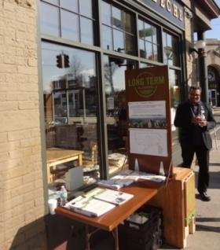
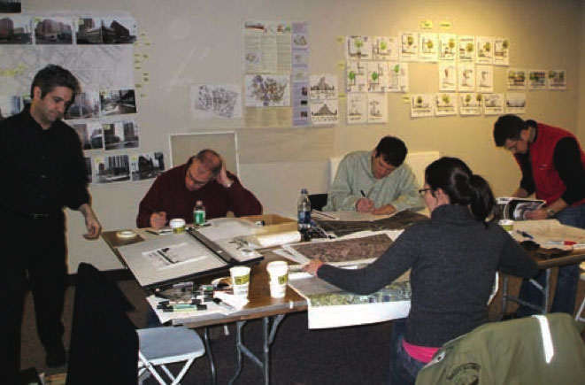
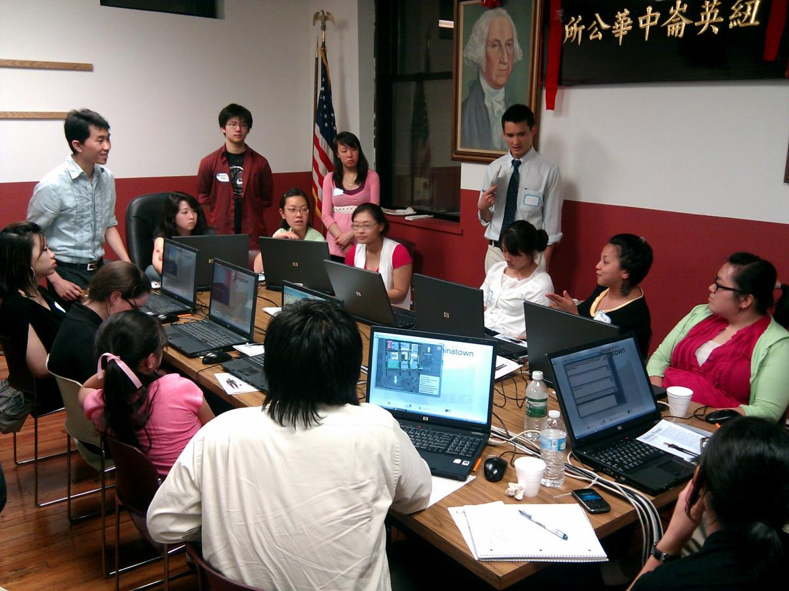
Meaningful Inefficiencies
Design Charrette, Rochester, NY
Roaming table, Detroit, MI
Participatory Chinatown, Boston, MA
Notes:
This is not to say there is a complete lack of creating engagement strategies. The last ten years, in particular, has seen a boom in placed-based engagement efforts that have sought to engage the public in planning or policy decisions. From a roaming table to talk to people in Detroit, MI, to a design charrette for a rochester transportation network, to game-based design processes like participatory chinatown, these efforts are time intensive efforts that build capacity, but have limited ability to scale.

Slide 5
New Tech, New Civics
How have the social conditions born of social media changed standard conceptions of civic life?
How have the social conditions born of digital games changed standard conceptions of civic life?
Normative question: How should these new conditions change public processes?
Networked
Archivable
Mobile / local
playful
Notes:
How have social conditions of social media changed standard conceptions of civic life?
How do citizens think about the public sphere and their desire and ability to connect?
Have have social conditions born of digital games changed standard conceptions of civic life?
Games are a significant part of many people’s cultural experience. How has this structured play changed how we think about interacting with systems?
How should the public sector respond to these changes?

Slide 6
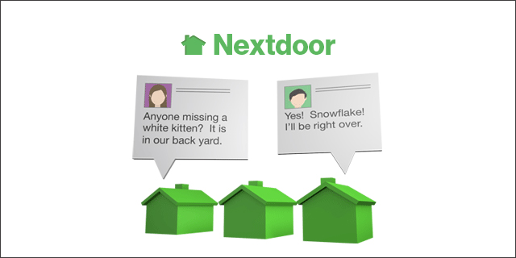
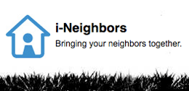
Landscape of Tools
Feedback
Local Communication
Reporting
Notes:
FEEDBACK
Textizen
Mind Mixer
Local Communication
Nextdoor
iNeighbor
Reporting
SeeClickFix
CitizensConnect

Slide 7
Civic Learning
participation
Interest
Desire
Need
Engagement
Civic Learning
Notes:
According to John Dewey, learning requires a structure of interaction that facilitates the learner’s actions and directs them to a greater purpose. “A purpose is an end-view,” he says. “It involves foresight of the consequences which will result from acting upon impulse.” Civic learning has this structure – it is more than just participation or opportunity to provide feedback.

Slide 8
Why Games?
Games can frame a process
Simplify complex systems with clear rule set
Create clear objectives
Provide regular feedback towards achieving those objectives
Provide opportunity for reflection
Add element of fun
Discovery
Exploration
Challenge
Notes:
In reference to early planning games, an article in Architectural Forum in 1968 says the following in reference to early games such as Metropolis and Neighborhood: “A game, which reduces the world to a comprehensible whole, and gives each player the same frame of reference, can go a long way toward giving him an understanding of his own concerns in relation to the total picture.”
I think it’s worth while to ask these questions again within a networked context.

Slide 9
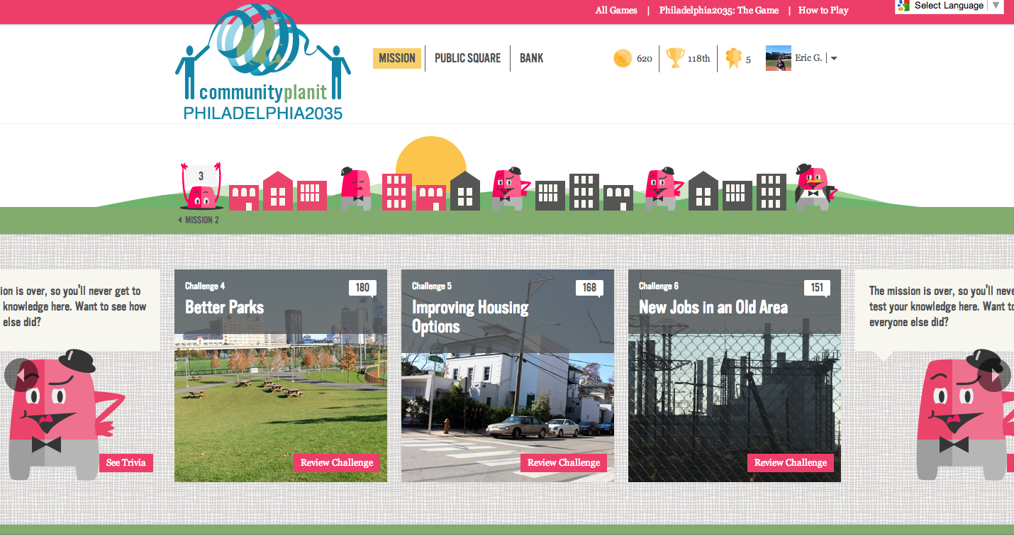
Case Study – Community PlanIt
Notes:
Play intro video

Slide 10
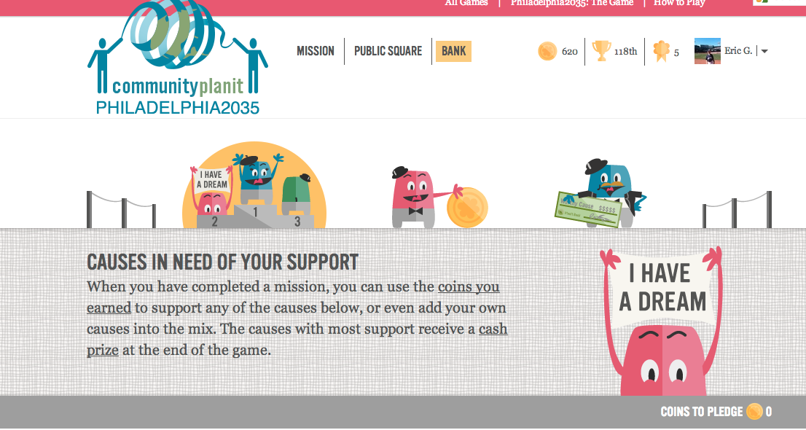
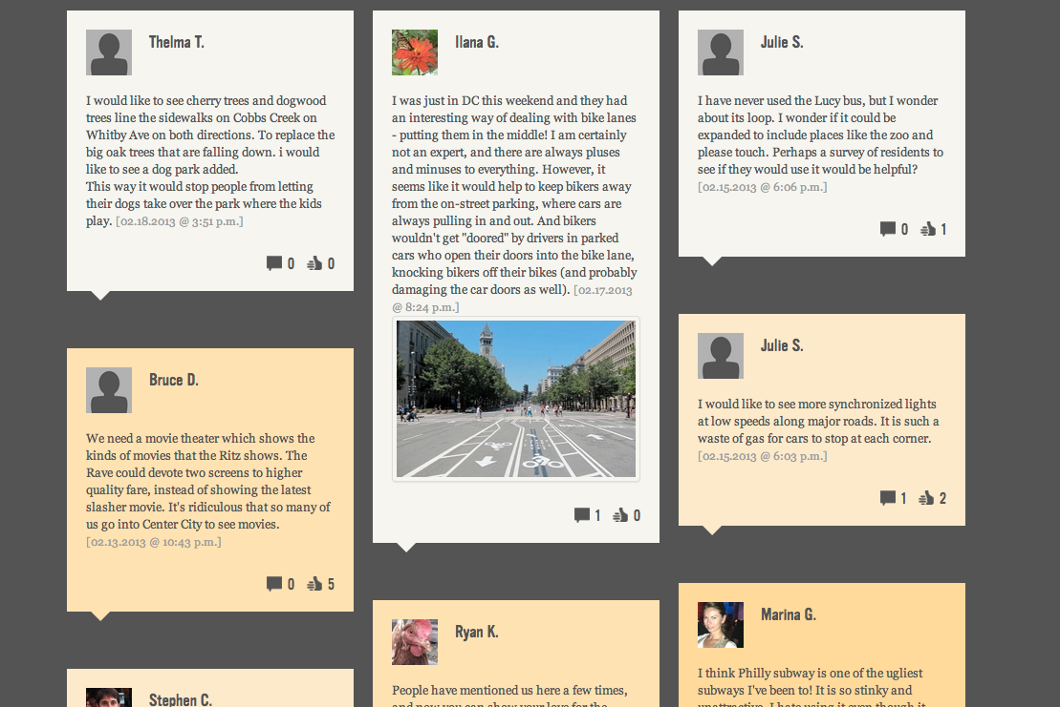
Game Structure
Goal: Earn coins and pledge them to causes
At game’s end, top 3 causes win cash prize
3 time-based missions
Each mission has ~12 challenges
Open-ended
Multiple choice
Map
Empathy
Each mission has ~4 trivia barriers
Each game ends with face-to-face game finale meeting

Slide 11
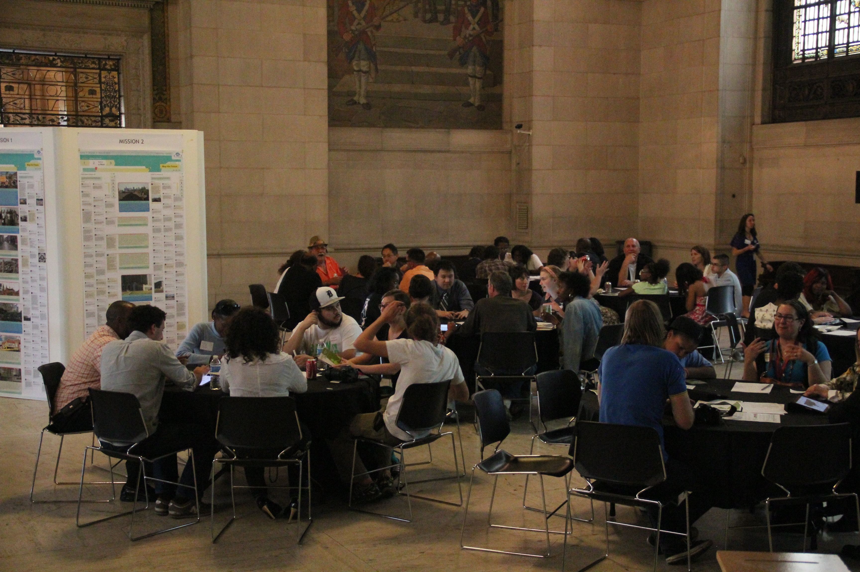
Goals of Game
Create a context for civic learning
Provide opportunities for communities to learn from each other and visualize social connections
Understand community priorities
Understand trade-offs, complexity of process
Bring more people into planning
Increase quality of data produced

Slide 12
Case Studies
Two completed case studies
Boston Public Schools – Education Planning (Sept-Oct 2011)
35 days
~500 players
~4600 comments
City of Detroit – Master Planning (May 2012)
21 days
~1000 players
~8600 comments

Slide 13
Case Studies (in progress)
Two case studies just completed
Salem, MA “The Point” neighborhood – Visioning (Feb 2013)
21 days
~600 players
~5000 comments
Philadelphia, PA “University City/Southwest area” – Master Planning (Feb 2013)
21 days
~900 players
~9100 comments

Slide 14
Research Design
Interviews with players and planners
Focus groups with youth
Observations of play sessions and meetings
Online survey

Slide 15
Research Questions
Can an online game:
enable lateral trust to motivate participation and build confidence in process?
create flexible publics to legitimize participation?
enable social learning opportunities to increase collective efficacy?

Slide 16
Lateral Trust
Players tended not to trust in the institutions sponsoring the game (BPS, City of Detroit)
“There’s a deep history that goes back decades in the city of Detroit particularly with community planning issues of people being told this is what it’s going to be or having a community planning input session as just a formality because the law says we have to take community input. So we’ll write people’s input down on a piece of paper and then put it on a shelf somewhere.” – Detroit player
Players came to the game through social connections or trusted community organizations
Through game play, players developed lateral trust relationships that would affect their social framing of issues and willingness to engage.

Slide 17
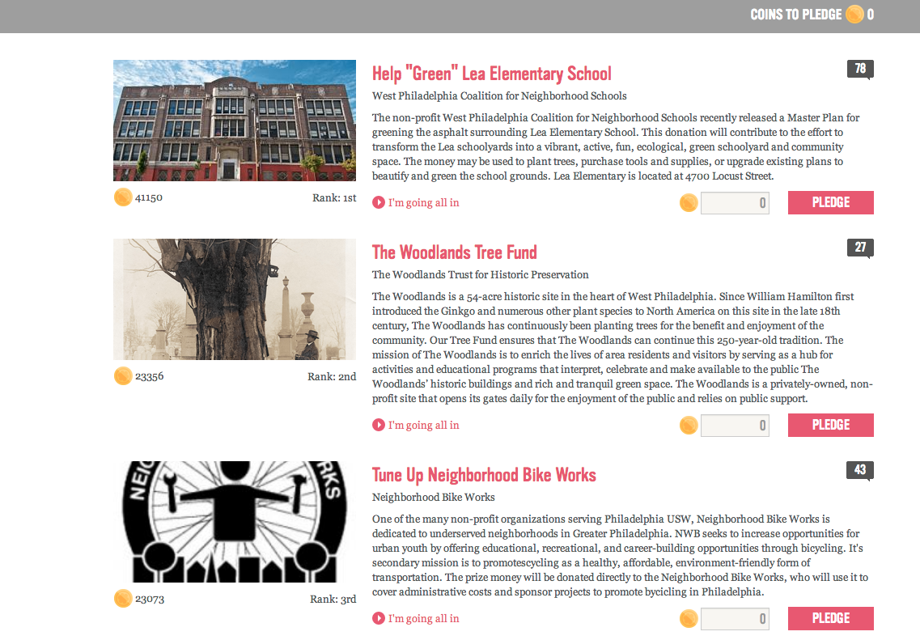
Lateral Trust
Players trusted in the game and its ability to archive
“This is something that you’re able to take as hard proof of the opinions of the people who are in the city and share it with people in positions of power. […] That kind of thing can come out of this data gathering“ – Detroit player
Notes:
- Making data available and making data community property
- Most people

Slide 18
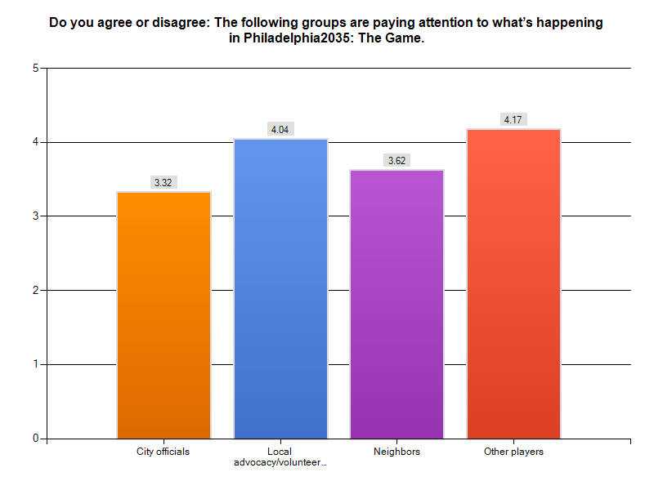
Lateral Trust
Re-imagine “who’s listening?”
Listening audiences extended to peers, community members, even outside audiences.

Slide 19
Flexible Publics
The online space creates the ability to reimagine traditional publics and audiences to legitimize participation
Generational publics
“I think there were kids in 8th grade doing this. I think like, oh my god, even kids can be involved. I do think kids have to be involved because they’re the next generation […] We’re just ignoring them all the time. Some [of their ideas] are probably better than a grownup person could have” – Detroit player
“They sound so fresh, so honest, so unbiased” – Detroit player
Likewise, youth spoke about the adult public as legitimate, or making the process real for them.

Slide 20
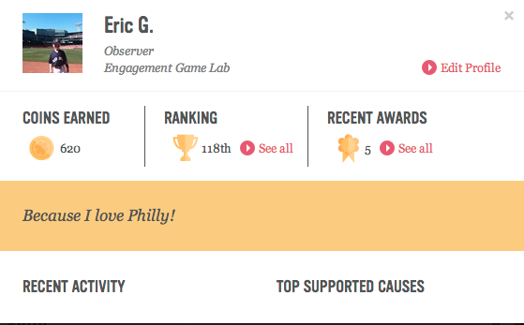
Negotiating public and private

Slide 21
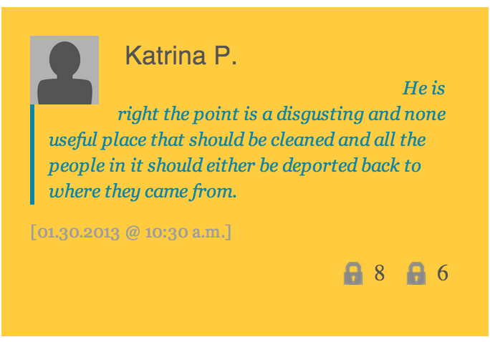
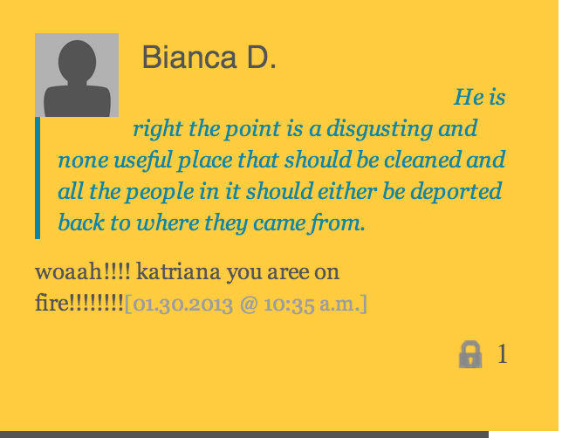
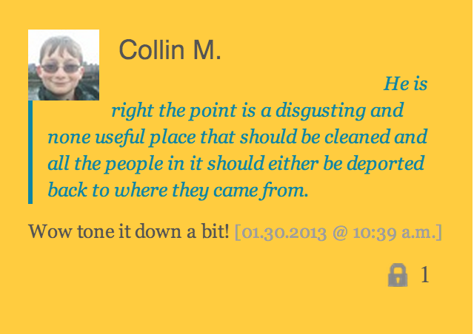
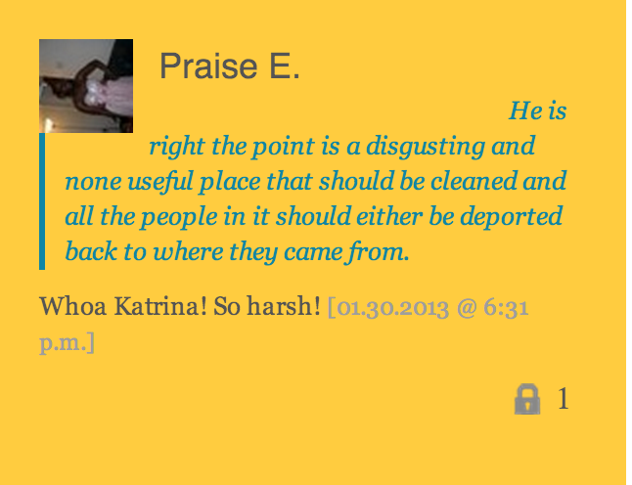
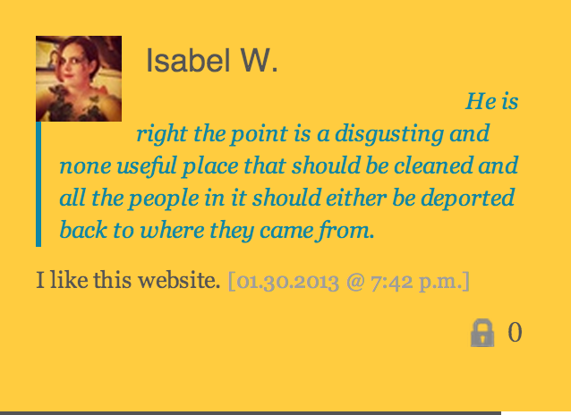
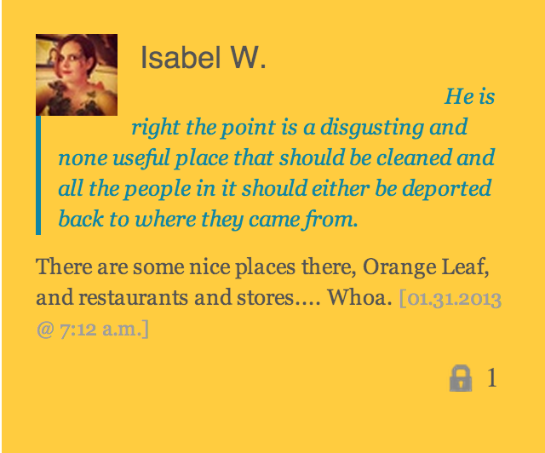
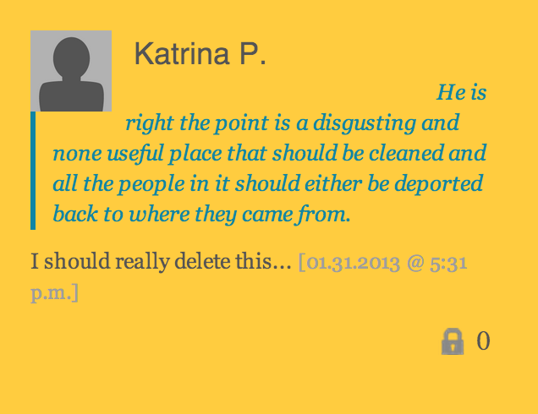
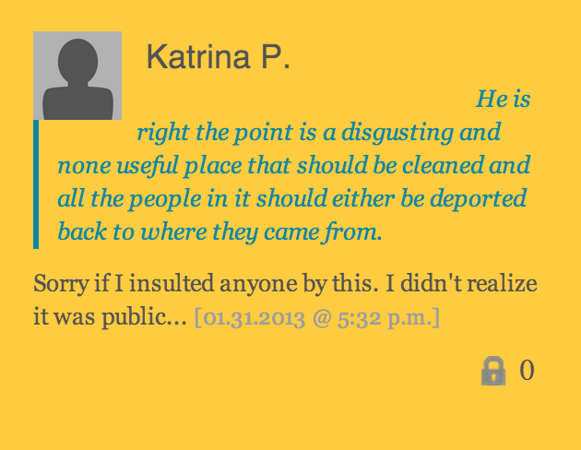
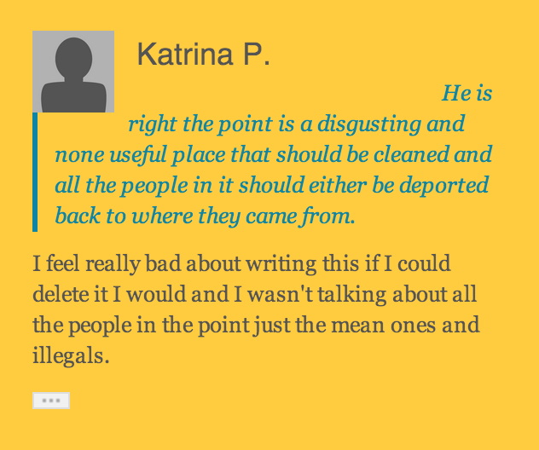
Notes:
In this case, this young player was not aware of the public and she felt comfortable making rather inflammatory statements. Her statements were immediately policed by other players and she came to the realization that her conception of public was wrong. She thought she was simply answering questions for “public officials.” But when the publicness of her statements became clear to her, she backed off from her position and became quite deferential.

Slide 22
Social Learning
The game frames learning goals without being too prescriptive.
Players reported that they learned more from their peers than from the “official planning” content.
“I put my comment and someone disagreed with it. It made me really think, ‘Wait. Maybe they are right.’ Even now I don't really know who's right, but I feel like it made me really think about what I thought prior” - BPS players
Survey given to Philadelphia players (n=117)
91% of players stated that they are more knowledgeable about other perspectives on local issues
91% of players stated that they are more interested in hearing others’ opinions about local issues.
75% stated that they feel more connected to their community
Only 44% said they were more trusting of city government
Community visualization

Slide 23
Lessons
Parallel game rules provide channel for social trust
Allowing for more flexible conceptions of audiences can create more legitimacy and force reflection on positions
Civic learning is motivated by social connections, and not merely clear channels between citizens and government.
Notes:
Magic circle establishes a self place that is outside of ordinary life for civic activity to take place

Slide 24
Thank you
Special thanks to the entire Engagement Game Lab staff, especially Steve Walter, Jesse Baldwin-Philippi, and Russell Goldenberg.
Eric gordon, egordon@cyber.law.harvard.edu

