Slide 1
Cyber War Is Not the Answer, But What Is? Addressing Cyber Conflict While Protecting Privacy and Internet Freedom
Berkman Center for Internet and Society
at Harvard University
Timothy H. Edgar
Visiting Fellow
Watson Institute for International Studies
Brown University
Notes:
Personal introduction and thanks to Urs Gasser/Caroline Nolin for invite (not here), others in audience
Problem is balancing our concerns about protecting our computer networks, especially as they support critical infrastructure, with personal privacy and liberty, and with business needs
Cyber conflict poses unique challenges for all of us – governments, citizens, companies – and for the future of the Internet.
Threats – not just malware and annoyance, but crime, espionage, even attacks – requiring major new security thinking
At the same time, a growing list of countries have adopted a variety of more or less restrictive Internet filtering practices
Not just the usual suspects – China, Russia, Iran
Also has been debated in Australia (the “great rabbit fence”) to filter illegal content, and voluntary filter for adult content
US proposals to extend cybersecurity filtering into critical infrastructure, including a test of this technology in defense companies
Major concerns persist about effects on Internet freedom, personal privacy – will we destroy the Internet to save it?

Slide 2
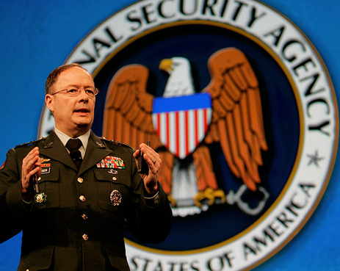
“freedom to connect”
“full-spectrum military cyberspace operations”
Notes:
Obama Administration: could be forgiven if it leaves us a little confused
US has announced “freedom to connect” is an aspect of fundamental human rights (Hillary Clinton)
Hillary Clinton gave an address at the Newseum in Washington – Jan 21, 2010 – defending Internet freedom as an aspect of fundamental human rights. Compared social networks to Soviet-era samisdat and announced a “freedom to connect” including State Department support for tools to circumvent Internet filtering.
Four months later, US created a new military command for cyberconflict, “Cyber Command,” collocated at the HQ of the NSA and headed by General Alexander, who is “dual hatted” as DIRNSA.
General Alexander, the director of the NSA, was confirmed by the Senate to lead the new Cyber Command, headquartered in Ft. Meade. He will have “two hats,” one under Title 10 and one under Title 50. May 21, 2010 – ceremony to inaugurate the new command.
Command will “direct the operations and defense of specified Department of Defense information networks and prepare to, when directed, conduct full-spectrum military cyberspace operations in order to enable actions in all domains, ensure U.S./allied freedom of action in cyberspace and deny the same to our adversaries” – Pentagon fact sheet.
Despite all this, computers, networks and data remain fundamentally insecure.

Slide 3
My administration will not dictate security standards to private companies.
Our pursuit of cybersecurity will not – I repeat, will not include – monitoring private sector networks or Internet traffic.
Notes:
In 2009, President Obama gave an address on cybersecurity – a first for a US president – announcing the results of a cyberspace policy review and laying out a plan of action for the government to address this problem.
The review looked back at previous efforts in the Bush administration to address this problem, primarily through taking steps to secure government netowrks, but it was broader.
Addressed major areas of cybersecurity – military/defense, intelligence, regulatory, privacy, government networks, education, research and development
Result was a White House cybersecurity coordinator and privacy official (me)
Two basic caveats – protect innovation and commerce/ protect privacy and civil liberties
Comprehensive cyber legislation – most important opponents – US Chamber and ACLU. President Obama recently released a more limited executive order, establishing a voluntary program to protect critical infrastructure.

Slide 4
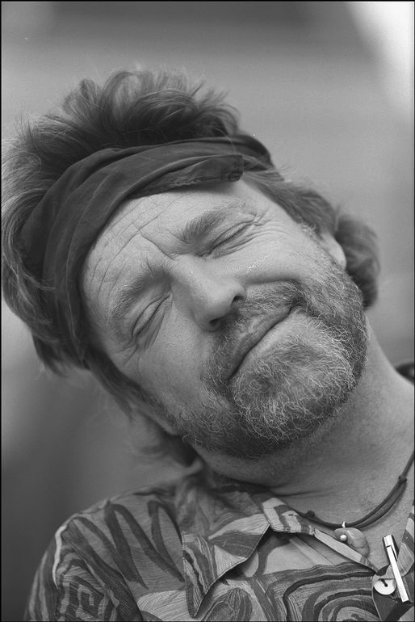
Governments of the Industrial World, you weary giants of flesh and steel. I come from Cyberspace. . . . You are not welcome. . . You have no sovereignty where we gather. John Perry Barlow, “Declaration of Cyberspace Independence.”
The Electronic Frontier
Notes:
Where did this idea that cyberspace should be immune from normal government regulation/free of (lawful) government monitoring? -Techno-libertarianism
Idea of “cyberspace” as a place liberated from government, social, traditional control, where you are free to be yourself
Idea of cyberspace/Internet freedom as liberating autocratic governments
Lessig: danger of “is-ism” – “West Coast Code” versus “East Coast Code” – the reason “cyberspace” is the way it is is only because it has been architected that way.
Change the architecture – the Code, and different values prevails.
However – before we assume things could have been different if the “internet was designed for security,” let’s pause and ask ourselves whether that was really possible. David Post, Jefferson’s Moose – open network – based on solving a couple very simple problems of moving packets – won out over other, closed models, which may have been more amenable to security. Anyone who’s tried to use the military’s closed networks knows they are not exactly a model of user-friendliness.
This suggests it may be much harder to change than just “changing the code.”

Slide 5
A product of fashion ....
... and fear.
“You don’t want your phone to be like a PC.”
Notes:
One way to try solve computer insecurity – corporate lockdown, perhaps for proprietary, intellectual-property reasons. Concern among more libertarian legal scholars this would destroy Internet’s “generativity.”
Zittrain: “The iPhone is a product of both fashion and fear.” Future of the Internet, p. 17
At iPhone launch: “We define everything that is on the phone. . . . You don’t want your phone to be like a PC. The last thing you want is to have loaded three apps on your phone and then you go to make a call and it doesn’t work anymore.”
A recognition of the problems of resilience and reliability that have come with a lack of security.

Slide 6
How did that work out?
Notes:
Not really a problem. Maybe we will have appliancized devices, but they’re not going to be more secure.
Symantec threat report from 2011
Mobile malware threat is among the fastest growing, according to security companies.
Creates new security threats – because mobile devices also have additional capabilities – tracking of location, cameras, microphones.
Unclassified demonstration at National Security Council – possible to load malware onto an iPhone, turn it on, stream audio, without the phone appearing to be on or do anything else.
Advice? Don’t take your device with you on certain international travel. Is this useful advice?

Slide 7
Cyber Espionage
China: “The world’s most active and persistent perpetrators of economic espionage.”
Russia: “Extensive, sophisticated operations.”
Pace of cyber espionage is accelerating.
A growing and persistent threat to US economic security.
Notes:
Issues of cyber espionage – has been going on for many years, on a massive scale.
Unclassified report from the National Counterintelligence Executive, part of the ODNI, from October 2011.
Assesses that foreign economic espionage, using cyber tools, is a growing and persistent threat to US economic security.
“US private sector firms and cybersecurity specialists have reported an onslaught of computer network intrusions that have originated in China, but the Intelligence Community cannot confirm who was responsible.”
US security firm Mandiant has alleged that a particular Advanced Persistent Threat group they have been tracking for years is a unit of the PLA; no public confirmation of this from the US government. The APT group uses spear phishing and other techniques to penetrate its targets, in multiple industry sectors, stealing intellectual property (including product design), negotiating positions, e-mails of high ranking executives. Active since at least 2004, with average penetration lasting one year – longest, four years.
Going back to economic collection report: “We judge that the governments of China and Russia will remain aggressive and capable collectors of sensitive US economic information and technologies, particularly in cyberspace.

Slide 8
Cyber War?
. . . seeking the ability to sabotage our power grid, our financial institutions, our air traffic control systems . . .
. . . cannot look back years from now and wonder why we did nothing . . .
Notes:
This year’s SOTU: Now, we know hackers steal people’s identities and infiltrate private emails. We know foreign countries and companies swipe our corporate secrets. Now our enemies are also seeking the ability to sabotage our power grid, our financial institutions, our air traffic control systems. We cannot look back years from now and wonder why we did nothing in the face of real threats to our security and our economy.

Slide 9
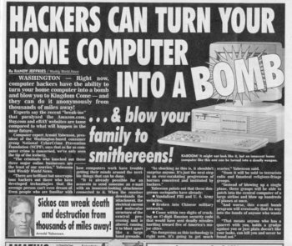
Notes:
Reliable open-source reporting from Weekly World News. ☺
What really gets people worried is real-world effects.
Hugo Teso, security consultant, made a real splash at a conference in Amsterdam hacking conference with his demonstration of insecurity in aviation control systems, showing how to remotely hijack an aircraft using an app he created for the Android phone. (Maybe the Apple app store would have rejected?)

Slide 10
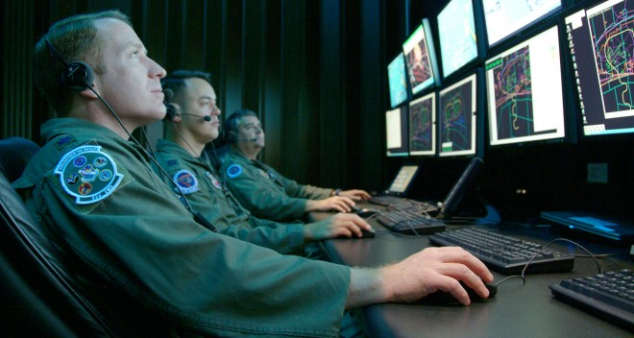
Inter Arma Silent Leges
Jus ad Bello
Jus in Bellum
Notes:
How do we address such a serious threat? One way – declare we are in a cyber war. (Similar to the approach some advocated prior to 9/11, and that was adopted by successive administrations after 9/11).
Cicero: In war, the laws are silent
Resort to force – UN charter 2(4) and article 51 (self defense)
many precedents from Cold War – US defines force narrowly, but quantum of force very little; USSR the opposite
problem of proxies – US v Nicaragua
Idea of “effects” not enough – cf. economic sanctions, covert ops (flood country with counterfeit currency)
one test – Schmidt factors –
Why does it matter: strong presumption again military responses to nonmilitary harms
International humanitarian law of armed conflict
what targets are allowed?
privileged belligerent status
Recent NATO funded study group produced a manual – headlines were “NATO says it can bomb hackers”

Slide 11
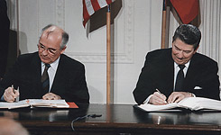
Cyber Arms Control?
Notes:
Sounds scary – what about limiting cyber arms through international agreement?
Russian proposal brought to UN since 1990s – ban information warfare, defined broadly, including the development of “doctrines” of cyber attack, use of Internet to spread information that it believes is destabilizing
-- not verifiable (“doviriyai no proviriyai”); overly broad definitions cover free speech; giving up capabilities in exchange for a simple promise (issue of Soviet failure to abide by bioweapons treaty during cold war)
UN General Assembly – passed general resolutions affirming importance of cybersecurity; appointed “group of government experts” to propose solutions.
US proposals – just follow law of armed conflict – some outside the government have advocated additional limits on deployment/use of cyber weapons, for example against banking infrastructure – very influential as author of this proposal (Bob Knake) is now working in the White House NSC cyber directorate
Internet governance internationally – follows the multistakeholder approach. Role for governments and traditional international organizations not as central. Proposals to change (cf. recent World Conference on Information Technology – ITU) very controversial.
Only real international instrument is the Council of Europe Convention on Cybercrime.

Slide 12
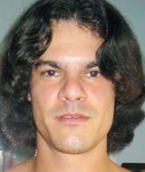
Cyber Crime
To make a point --
Or sometimes just for the lulz
For profit . . .
Notes:
What if we use law enforcement tools, treat the problem as a criminal one?
Albert Gonzalez – mastermind of “shadowcrew”
more than 4000 registered members of the shadowcrew website
170 million credit cards and ATM cards stolen
charged with traditional fraud crimes, but also with computer crimes under Computer Fraud and Abuse Act
20 years in prison, more than any other hacker
Anonymous
crowdsourcing loosely affiliated group
some do if for “hactivism” some of the lulz
international in scope
vaguely libertarian or anarchic, but no real ideology

Slide 13
Computer Fraud and Abuse Act
Access without or in excess of authorization
Access to defraud or obtain anything of value
Damage to a computer or data
Trafficking in devices or passwords
Felony if commercial advantage, financial gain, in furtherance of crime or tort, value exceeds $5000
Penalties of 5, 10, even 20 years in prison for felony offenses
Notes:
How did we address computer crime?
Criminalization of computer crimes, including hacking broadly defined (unauthorized access to computers, including violation of confidentiality, integrity and availability) – OK to trust prosecutorial discretion, or do we need narrower crimes? (terrible tragedy of Aaron Swartz and JSTOR; indictment charged crimes with very large penalties – 35 years – but AG says plea deal would have permitted very light sentences – 3-4 months, possibly no jail time)
Many other issues: white-hat hacking, “self-defense” – security companies like CrowdStrike arguing for such a rule to allow “hacking back” on behalf of corporate clients

Slide 14
Of Gigantic Coaches and Tiny Constables
Notes:
How do we obtain evidence to use in cybercrime cases? Need to get information quickly, across multiple jurisdictions, so important to know – 1) when warrant is required and when it isn’t, 2) what constitutes probable cause.
But – while technology develops rapidly, law develops incrementally, and by analogy to previous cases. In constitutional cases (including 4th Amendment), many judges favor an “originalist” approach, which makes privacy rights – and what law enforcement must do to respect them – dependent on having a correct understanding of what the framers meant by terms like “search” and “seizure” – or, on being able to predict what judges will think they meant.
Case in point – United States versus Jones (2012)
-GPS tracking device installed on suspected drug trafficker’s wife’s car, using a defective warrant, monitoring all movements for about a month
-lower court allowed information from public streets based on prevailing “reasonable expectation of privacy” test
-Supreme Court reversed, finding that the installation of the device was a “trespass” under 18th Century property law, and hence a per se search not requiring reasonableness inquiry
*unusual line-up – Scalia writes opinion, is joined by Roberts, Kennedy, Thomas, Sotomayor
*Alito writes opinion “concurring the judgment” – joined by Ginsburg, Breyer and Kagan – protesting use of trespass theory, would have relied on ‘reasonable expectation of privacy’ based on how extensive and pervasive the tracking was, not on the trespass (manner) in which information was obtained – highly artificial
Alito: late 18th century analog approach silly - “Imagine a case in which a constable secreted himself somewhere in a coach and remained there for a period of time in order to monitor the movements of the coach’s owner”)
Scalia: says the constable hiding in the coach is “not far afield” from what happened and there is “no doubt that the information gained by the [constable’s] tresspassory activity would be the product of an unlawful search”
Alito: retorts that “this would have required either a gigantic coach, a very tiny constable, or both – not to mention a constable with incredible fortitude and patience.”

Slide 15
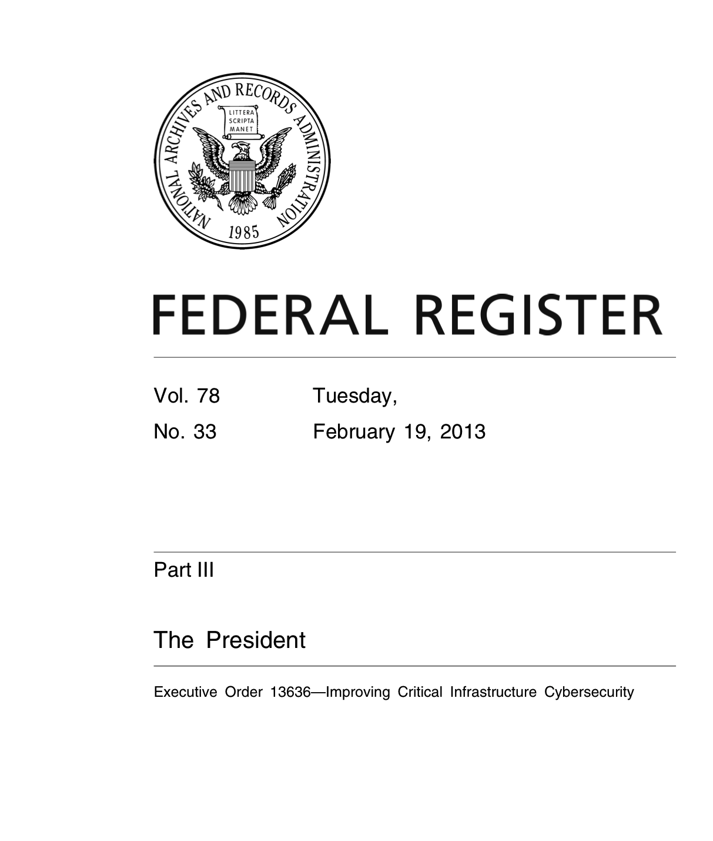
Voluntary Cybersecurity Standards
Information sharing for critical infrastructure
National Institute of Standards and Technology “Baseline Framework”
DHS to promote voluntary adoption of framework, in coordination with existing regulators
Privacy based on Fair Information Practice Principles
Notes:
Regulation? Senate could not agree on cybersecurity legislation last year – President Obama issued Executive Order 13636.
Critical infrastructure: “systems and assets, whether physical or virtual, so vital to the United States that the incapacity or destruction of such systems and assets would have a debilitating impact on security, national economic security, national public health or safety, or any combination of those matters.”
Information sharing program includes an expansion of the voluntary “enhanced cybersecurity services” information sharing program involving “classifeid cyber threat and technical information” to companies or cybersecurity service providers
Heart of Executive Order is the NIST-developed “Cybersecurity Framework.” NIST is developing now. Framework is to be based on existing standards and best practices as much as possible, and is to be “prioritized, flexiable, repeatable, performance based and cost effective” – emphasis on measuring security.
Security of DHS establishes voluntary cybersecurity program, in coordination with sector-specific agencies and existing regulators, to promote framework and identifies critical infrastructure at greatest risk – would pose “catastrophic regional or national effects on public health or safety, economic security, or national security” but cannot include “commercial information technology products or consumer information technology services” – labeled by the telecoms the “Google exception.”
Standards may end up being mandatory, through existing regulatory agencies – they will study requirements and report if they think they need more authority.
Privacy protections modeled on FIPPs – privacy assessment by DHS privacy and civil liberties officers, in consultation with agency privacy officers, coordinated by PCLOB – within one year, updated annually

Slide 16
Another view of regulation
Notes:
Supporters (Stewart Baker, lawyer and former NSA general counsel) and opponents (Chamber of Commerce) agree on one thing – standards may become “quasi-mandatory” both because of regulation and because they may set the bar for liability – government standards often are cited in deciding what is “reasonable care” in civil law suits
Whether you think this is a good idea depends on what you think of government standards.
House Homeland Security Chairman Michael McCaul – EO could “stifle innovation, burden businesses, and fail to keep pace with evolving cyber threats”

Slide 17
Emergency Powers
Notes:
Use unilateral presidential powers in a cyber-emergency, such as a cyber attack from a major power?
Section 706 of the Telecommunications Act of 1934 – gives the president power, in the case of “state or threat of war”
-suspend rules for “facilities or stations for wire communication”
-close “any facility or station for wire communication” and remove its apparatus and equipment
-”authorize the use or control of any such facility or station and its apparatus or equipment by any department of the government”

Slide 18
Internet Kill Switch
Notes:
Concern arose over an interpretation given to a proposal from Senator Lieberman involving power over Internet traffic in cyber emergencies. Not adopted, but . . .
Why important? Justice Jackson’s concurrence in Steel Seizures Case – Youngstown Sheet & Tube Co. v. Sawyer – Truman seizes steel mills. Was this constitutional?
--When the President acts pursuant to an express or implied authorization of Congress, his authority is at its maximum, for it includes all that he possesses in his own right plus all that Congress can delegate.
--When the President acts in absence of either a congressional grant or denial of authority, he can only rely upon his own independent powers, but there is a zone of twilight in which he and Congress may have concurrent authority, or in which its distribution is uncertain.
--When the President takes measures incompatible with the expressed or implied will of Congress, his power is at its lowest ebb, for then he can rely only upon his own constitutional powers minus any constitutional powers of Congress over the matter.
To get your attention – this analysis is relevant to such matters as whether the President can detain indefinitely an American citizen as an enemy combatant; whether the President can authorize warrantless surveillance of terrorists; whether the President can order the killing of an American citizen by drones.
In no case is there explicit statutory authorization for these policies; in some cases there is acquiesence, or unclear statutes that may point in different directions.
So the existence of this old statute may make a great deal of difference.

Slide 19
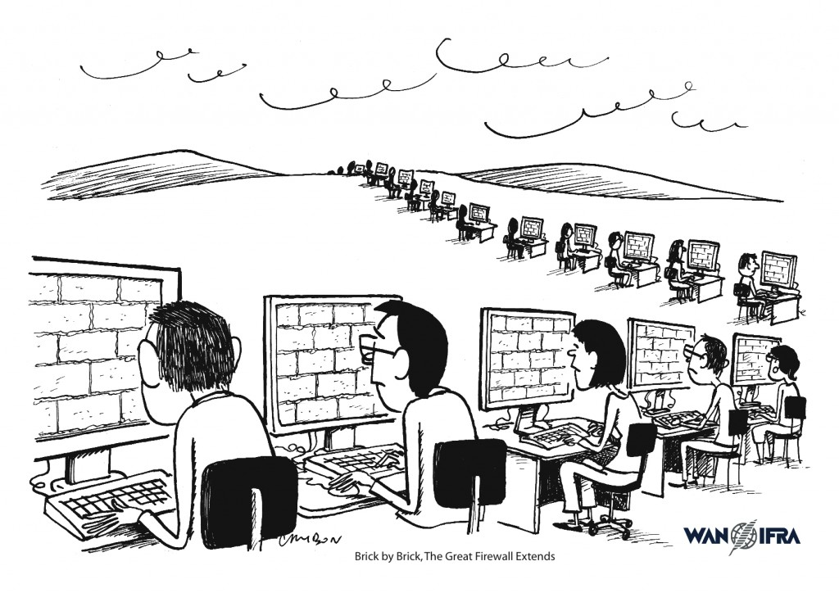
3
Notes:
What does this mean for Internet freedom?
China – largest and most sophisticated filtering systems in the world, according to the Open Network Initiative. Dubbed the “great firewall of China.” Built with technologies designed in US for purposes of workplace monitoring.
Shows authoritarian governments can have their cake and eat it too – don’t have to choose between Internet and censorship. No longer the case, as John Gilmore, one of the founders of the EFF famously said, that “the Net interprets censorship as damage, and routes around it.”
No longer true! China’s “great firewall” allows a highly sophisticated, functioning Internet, with a complex array of controls. Includes combination of technical filtering, keywords, and large-scale resources to monitor comments, etc.

Slide 20
Australia’s “Great Rabbit Fence”
Notes:
Opponents dubbed a mandatory Internet filtering proposal in Australia as its version of China’s “Great Firewall.”
Treats Internet content much more like TV is in the US, subject to much greater regulation. Would require: filtering and blocking of any illegal content (refused classification); voluntary filtering and blocking of any adult content.
Australian Communications and Media Authority has power to enforce content restrictions on Australian sites, and maintains black list of overseas sites to filter
Major controversy, particularly about the secrecy of the policy and the blacklist
Proposal to make mandatory still under consideration, but has been delayed by the controversy and by problems of accuracy involving several trials

Slide 21
Voluntary Arrangements with ISPs
Notes:
Critical role of intermediaries: ISPs
UK-based nonprofit – Internet Watch Foundation. Cooperates with ISPs in UK, Canada (“Operation Cleanfeed”) to identify child pornography and other illegal content (including racist material).
ISPs will block access to reported URLs and IP addresses.
Problems: lack of due process (sites blocked immediately, without court review); does it work? (would it be better to track and find out where it’s from)
Scope creep: pressure to use for copyright, sites like “Wikileaks.”
Very similar arrangements in US with US Department of Justice.

Slide 22
EINSTEIN
Notes:
Einstein intrusion detection system – now includes limited prevention
signatures derived in part from signals intelligence from NSA
alerts that do not include content provided to NSA
DHS privacy office oversight
Issues
-- Intelligence oversight and US persons
-- extension to defense industrial base, critical infrastructure – EO requires within 120 days procedures to expand to “all critical infrastructure sectors.”
--Not clear it can scale
--Question of oversight, especially if we move beyond signature-based detection

Slide 23
Privacy
Mark Zuckerberg: “That social norm is just something that has evolved over time.”
Scott McNealy: “You have zero privacy anyway. Get over it.”
Notes:
Not just worried about Internet freedom. Also worried about privacy.
Mark Zuckerberg, in 2011, being questioned about Facebook’s highly controversial changes to its privacy settings:
"People have really gotten comfortable not only sharing more information and different kinds, but more openly and with more people. That social norm is just something that has evolved over time."
Scott McNealy, CEO of Sun Microsystems, a decade earlier in 1999, was more blunt, as his company was under fire for privacy concerns around its new products.

Slide 24
Fair Information Practice Principles
Transparency
Individual Participation
Purpose Specification
Data Minimization
Use Limitation
Data Quality and Integrity
Security
Accountability and Auditing
Notes:
For privacy lawyers, “privacy” in information means compliance with the fair information practice principles.
Originates in 1973 Health, Education, Welfare report, “Records, Computers and the Rights of Citizens.”
Foundation for US privacy act (applies to government records)
Foundation for EU and OECD privacy law
Foundation for many other laws
Transparency: means privacy notices – concerning collection, use, dissemination, and maintenance of PII
Individual Participation: individuals should be involved, and, where practical, individuals should consent; also, access, correction, redress
Purpose specification: articulate authority for collection; purpose or purposes for use
Data minimization: only collect directly relevant and necessary PII, only retain as long as necessary
Use limitation: only use PII for purpose specified in the notice, sharing must be for a compatible purpose
Data quality and integrity: should assure, where practical, that data is accurate, relevant, timely, complete
Security: against unauthorized access, use, destruction, modification, disclosure
Accountability and auditing: compliance, training, auditing
In major tension with “Big Data” – and “data empowerment” (Obama’s views based on innovative data-driven campaign)
“Data.gov” – issues of privacy and security
EU approach: comprehensive (government and private sector), lead by national commissioners, considered an aspect of human rights
US approach: sector specific (Privacy Act for federal government, different rules for medical, financial, educational, etc. records, FTC backstop for industry self-regulation, Commerce green paper)

Slide 25
Crypto Answer: Information Sharing
Patriot Act access to records
Cannot reveal searches
Get entire database?
Alternative: Private Information Retrieval
Notes:
Problem: Information Sharing
Obama – signing Patriot Act renewal; many of his supporters would have preferred repeal (Leahy/Paul vote no)
--need to access small amounts of relevant information in large databases with privacy concerns
--government could ask for just data it is looking for, but this reveals intelligence interest in data
--government could ask for entire database on voluntary basis, or compel disclosure with new legal powers such as the Patriot Act
--would need to trust the government’s internal oversight mechanisms
Answer: Private Information Retrieval – funded by IARPA’s innovative privacy research program we supported, grew from a workshop in 2006, now detailed over many years in ODNI data mining reports

Slide 26
Crypto Answer: Online Authentication
Identity Solutions will be privacy-enhancing and voluntary
Solutions must enable a variety of transactions, including anonymous, anonymous with validated attributes, pseudonymous, and uniquely identified
Solution: Anonymous Credentials
Notes:
Problem: Online Authentication
WH effort to develop a policy for reliable online authentication
--need to reliably assert certain attributes (proof of age, possession of a subscription) without revealing identity, without tracking across online transactions
--government articulated this required in the National Strategy for Trusted Identities in Cyberspace (NSTIC), a requirement to avoid this system becoming a privacy disaster
--need to comply with privacy rules, including Fair Information Practice Principles, underlies both US and European privacy law (European more comprehensive)
Answer: Anonymous Credentials, based on crypto tools

Slide 27
Conclusions
Major cybersecurity threats abound and worsening, but careful of the hype
The Internet and “cyberspace”: promise and potential, not just peril
Robust legal frameworks to address: use them with care!
Don’t destroy Internet freedom while addressing cyber insecurity
Privacy: A fundamental value, but without easy answers
Crypto: Not a panacea, but very promising

