Slide 1
Innovation //: INTERMISSION

Slide 2
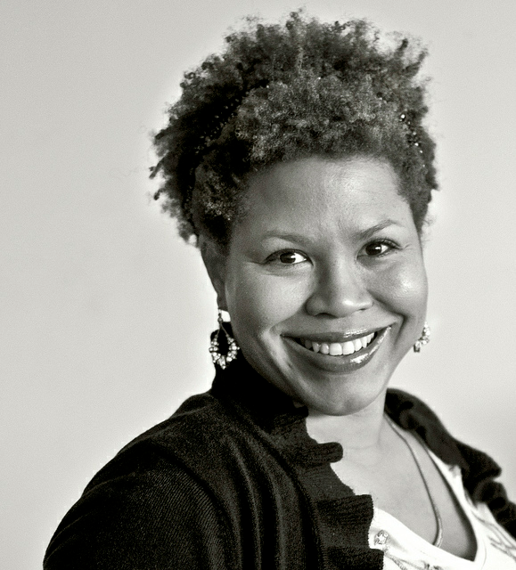
@ch3ryl

Slide 3
ABOUT ME// CHERYL CONTEE
The Root 100 List of
African-American Leaders 2009
Fast Company 2010
Most Influential Women in Tech
Huffington Post 2011
Top Female Founders to Follow on Twitter
2012 White House Digital Disruptors
2013 Harvard Berkman Center
for Internet & Society

Slide 5
FISSION // CLIENTS

Slide 6
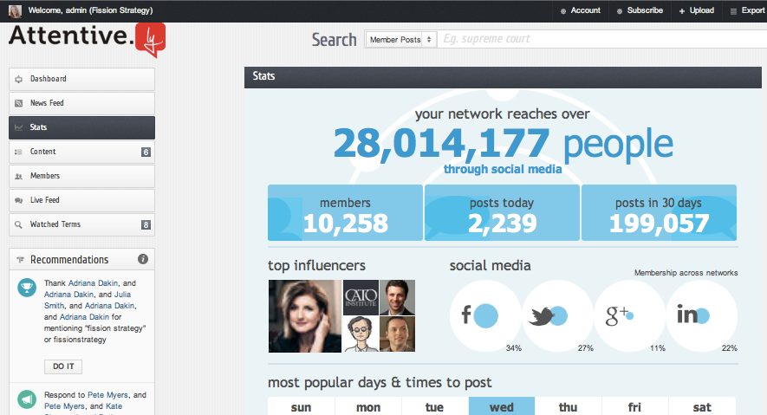

Slide 7
Innovation //: TREND GAP FUTURES SOLUTIONS

Slide 8
Innovation //: TREND

Slide 10
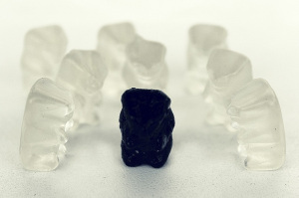

Slide 11
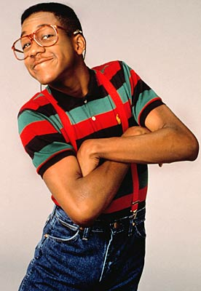

Slide 12
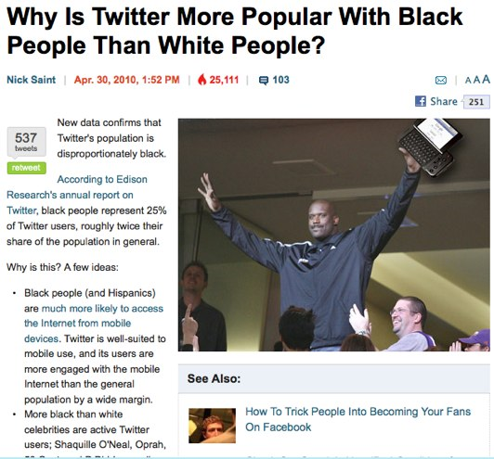
Notes:
Only 11% of teens use email
HispanicBusiness.com 2006 (plus Pew Hispanic Center 2007 report)
Acculturated – in U.S. for at least a few years – 82% of hispanics online
The findings also showed that the Internet continues to be the best source to make a final brand decision for most Hispanics online.
This year, 68 percent of online Hispanics said the Internet was their best source for making a final brand decision,
compared to 51 percent in a 2004 AOL study. The number of Hispanics doing price comparisons on the Web also continues to grow.
The survey found 72 percent of respondents use the Internet to compare prices of products versus 61 percent two years ago.
Hispanics are also are drawn to social networking sites. The survey found that 68 percent use instant messaging,
63 percent share photos online, 52 percent read or post blogs, 43 percent visit social networking sites, and 40 percent talk on a phone using the Internet.
Nearly half, 43 percent, of acculturated Hispanics are online and watching TV at the same time, the study found.
One third of unacculturated Hispanics are online and watching TV simultaneously

Slide 13
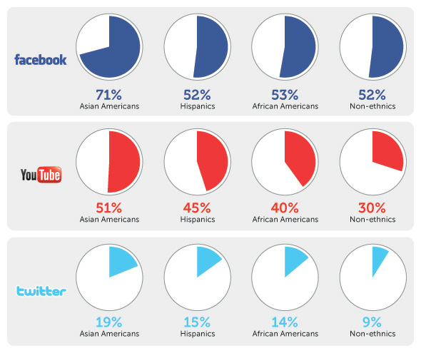
Source: Merkle, View from the Social Inbox: 2010
Notes:
Today, whites are the ones who lag behind all other groups in their use of advanced internet, smartphones and social media. Pew Internet has shown that 28% of black people use Twitter and 13% use it everyday. Hispanics are not far behind. Those numbers are 2x the rate of white use of Twitter.
The percentage of Americans of different ethnic backgrounds who visit popular social media sites at least weekly.
Hispanics adoption of smartphones increased from 43 percent in 2010 to 57 percent in 2012 (for those who own mobile phones).
Georgetown University has also conducted research on the topic of minority Americans and social networking use. According to their study Dynamics of Cause Engagement, “African Americans and Hispanics are significantly more likely to believe that they can help get the word out about a social issue or cause through online social networks (58% and 51% respectively, vs. 34% of Caucasians).” Furthermore, the study found 21% of White people looked to social media for additional sources of information, while Hispanics and African Americans turned to social media 27% and 31% of the time, respectively. Hispanics and African Americans are also “far more likely than Caucasians to join Facebook groups, contribute to blogs, and provide personal contributions spurred by online campaigns.”
http://socialtimes.com/touchy-territory-different-ethnicities-may-use-social-cause-social-media-differently_b64561
ibid.
Nielsen Company in 2011. Data from their September report entitled “The State of the African-American Consumer” indicates 44% of US African-American adults owned smart phones in Q1 2011, 22% higher than 36% among the overall population.
http://www.marketingcharts.com/direct/african-american-smartphone-penetration-higher-19414/
Google says 90% of people move between devices to accomplish a goal, whether that’s on smartphones, PCs, tablets or TV.
It’s important to note that class and education levels are also correlated to smart phone usage, with just 22% of people making less than $30K/yr saying they own one, compared to about 40% of people between $30K-$75K, and nearly 60 percent of people making more than $75K. The younger you are, though, the more likely you use a smart phone--even among people making less than $30K a year, 39% of those who are 18-29 years old say the have one. Older seniors, by contrast, are less likely, and poorer older seniors especially unlikely, to own a smart phone

Slide 14
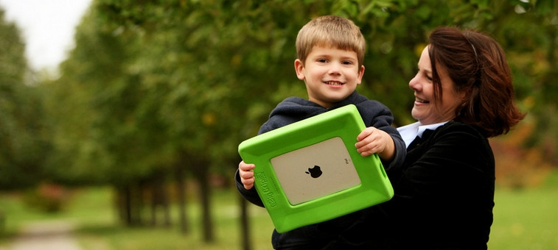
Notes:
Over 80 (some studies say over 90)% of moms are online
89% of household moms use the Internet at least twice a day.
Lots of reasons – keeping up with kids! Shopping, banking, info, education
93% prefer cause marketing & will switch brands
84% go online and over 60% rely on WOM online

Slide 15
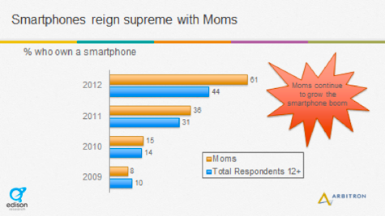
Notes:
Moms confirm what we assume from their heavy usage: that the Internet is essential to their lives. 58% of moms in this 2012 study said the Internet is “most essential,” which is a giant increase from where it was in 2002, a mere 17%.
Women have also taken big strides and now dominate social media. Comscore says women are the majority of social networking users and spend 30% more time on these sites than men; according to Nielsen, mobile social network usage is 55% female.
This shift in influence and power in favor of women has been tremendous. One example is a new social network called Pinterest whose user base is about 80% women and whose Facebook page fans are 97% female. Pinterest’s referral traffic is already approaching levels of Twitter and Facebook.

Slide 16
Innovation //: GAP

Slide 17
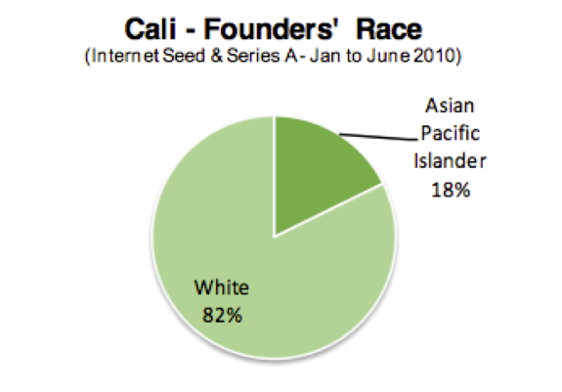

Slide 18
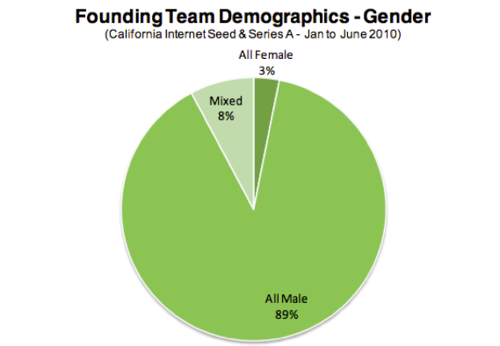

Slide 19
Only 4-9% of venture capital has gone to women entrepreneurs.

Slide 20
“They all seem to be white, male, nerds who've dropped out of Harvard or Stanford... So when I see that pattern coming in -- which was true of Google -- it was very easy to decide to invest.” - John Doerr

Slide 21
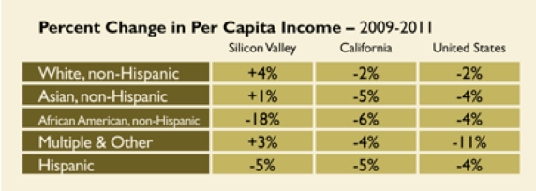
Notes:
According to Bracy, women make 49 cents for every dollar men make in Silicon Valley. You don't need a chart to feel the force of that statistic.
Much less than national avg of 77 cents to man’s dollar in 2012

Slide 22
“if a tech company is NOT headed by a white male nerd college dropout -- it’s probably undervalued.” - Dave McClure

Slide 23
Innovation //: FUTURES

Slide 24
Notes:
Two Futures - one where there’s digital equality - one with mirrors and one without a mirror to address the blind spot

Slide 25
Consumers or Creators?

Slide 27
Expression -> Entrepreneurs

Slide 29
Innovation //: SOLUTIONS

Slide 30
Solutions Yesterday
Re-tooling of High Schools
Word of Mouth/Cultural Campaign
Mass Migration Towards Jobs
Job Training By Employers
Affirmative Action in Schools & Jobs
Notes:
1) Role of business in education around World Wars to hasten the transition from agrarian based economy to manufacturing
High school to give Americans the basic skill employers needed to give jobs
But these philanthropies, perhaps the best known of which were the Carnegie Corporation, the Ford Foundation, and the Rockefeller Foundation, increasingly tried to raise the visibility of educational inequities and thus were widely perceived as liberal and altruistic for much of the twentieth century.¹
1890 to 1940 – business leaders actually sought control of local school boards – sure it was racist: Carnegie Foundation funded Tuskegee Institute led by Booker T Washington and focused on vocational ed
Today we spend $500-600 billion dollars on public edu. Where is that money going, exactly?
http://www.smithsonianmag.com/ideas-innovations/The-Business-of-American-Business-Is-Education-203028241.html
2) Word of mouth/cultural campaign: Triggered Mass Migration of African Americans toward cities
3) Affirmative action for both women and minorities - dedicating resources to active recruitment in education and jobs
That worked - worked for me and grandparents & parents - might not for my kids and grandkids unless we change things
Controversial today - yet transformed society and built a new multicultural middle class
[
We wouldn’t have a black president without these trends

Slide 31
Notes:
In 1999, Sugata Mitra was chief scientist at a company in New Delhi that trains software developers. His office was on the edge of a slum, and on a hunch one day, he decided to put a computer into a nook in a wall separating his building from the slum. He was curious to see what the kids would do, particularly if he said nothing. He simply powered the computer on and watched from a distance. To his surprise, the children quickly figured out how to use the machine.
Over the years, Mitra got more ambitious. For a study published in 2010, he loaded a computer with molecular biology materials and set it up in Kalikuppam, a village in southern India. He selected a small group of 10- to 14-year-olds and told them there was some interesting stuff on the computer, and might they take a look? Then he applied his new pedagogical method: He said no more and left.
$1 milliion from TED, Granny Cloud of retired UK teachers offering encouragement
Wired this month: “The Next Steve Jobs”
How poor is Paloma and her school: school is next to a giant dump. Electrical cord for projector ripped apart for the tiny amount of copper.
Despite this or maybe because of it:
Elementary school teacher Sergio Juárez Correa, 31, upended his teaching methods, revealing extraordinary abilities in his 12-year-old student Paloma Noyola Bueno.”
Paloma got highest score in math in Mexico. Genius level intellect

Slide 32
Notes:
Wired this month: “The Next Steve Jobs”
How poor is Paloma and her school: school is next to a giant dump. Electrical cord for projector ripped apart for the tiny amount of copper.
Despite this or maybe because of it:
Elementary school teacher Sergio Juárez Correa, 31, upended his teaching methods, revealing extraordinary abilities in his 12-year-old student Paloma Noyola Bueno.” Took a page from Mitra’s method and created a student-led innovative learning environment driven by his own self-education via the internet at home (not avail at school!)
Paloma got highest score in math in Mexico. Genius level intellect

Slide 33
Solutions Today
More Internet in Free, Public Spaces
Student-led learning with net-enabled tablets
Code that teaches young and old to code
Online tests that help design pathway to careers with self-teaching, scoring that goes to employers
Notes:
Increasing Competence & Channeling Prowess

Slide 34
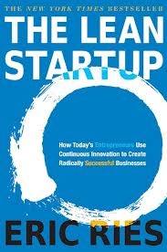
Solutions Today
Eric Ries’ Blind Resumes
Hackathons in the Hood //
Bits & Bytes in the Barrio
Reinvent Job Corps
Bones, CSI, NCIS & Grey’s Anatomy – Glamorize STEM careers
Notes:
Building Confidence, Lowering Barriers and Creating a Ready Workforce to re-energize the middle class

Slide 35
Notes:
> We must reinvent the notion that creating or using technology successfully is for some, not for all. We must abandon the notion that just because you live in a garbage dump, that doesn’t mean your mind is garbage. In fact, genius is all around us. An economy that goes from iindustrial to info – eliminating extreme poverty in its wake – just within our grasp. Isn’t that exciting? Don’t you want to be a part of that?
This won’t happen …. We can’t do it without you. Each person in this room is a person who has the power to help lead this revolution or stymie it in its crib. Which future will you create – because make no mistake, we are creating the future today that we will all live in tomorrow.

Slide 36
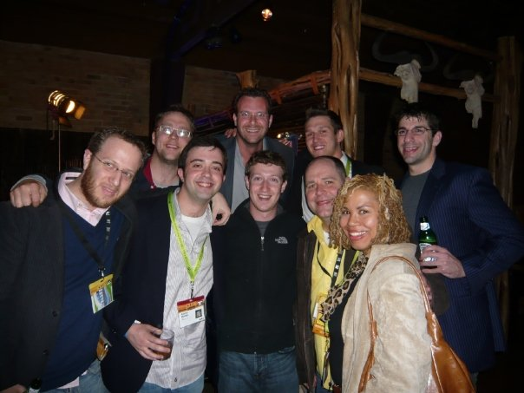

Slide 37
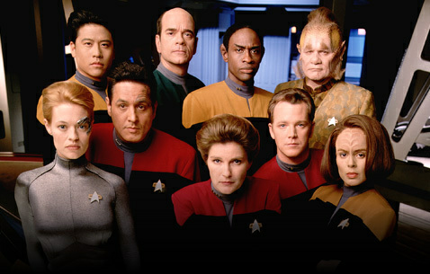

Slide 40
Innovation //: INTERMISSION

Slide 41
Notes:
This is Web 3.0 - how can trigger the next wave of innovation in new hardware & software?
This can create a renewed America where we enjoy more prosperity, more freedom, cooler apps for all.
More powerful, respected worldwide and maintain our leadership as a beacon of hope and opportunity. But first that means creating more opportunity here.

Slide 42
Who’s Leading
#YesWeCanCode
Digital Undivided
Girls Who Geek
Black Girls Code
#LATISM
Common Core
Notes:
Increasing Competence & Channeling Prowess
In 1999, Sugata Mitra was chief scientist at a company in New Delhi that trains software developers. His office was on the edge of a slum, and on a hunch one day, he decided to put a computer into a nook in a wall separating his building from the slum. He was curious to see what the kids would do, particularly if he said nothing. He simply powered the computer on and watched from a distance. To his surprise, the children quickly figured out how to use the machine.
Over the years, Mitra got more ambitious. For a study published in 2010, he loaded a computer with molecular biology materials and set it up in Kalikuppam, a village in southern India. He selected a small group of 10- to 14-year-olds and told them there was some interesting stuff on the computer, and might they take a look? Then he applied his new pedagogical method: He said no more and left.
$1 milliion from TED, Granny Cloud of retired UK teachers offering encouragement

Slide 43
@ch3ryl

